Slide 1
Collective Action Practices as the Basis for an Alternative Model for Energy Provision
Prof. Dr. Tine De Moor
Utrecht University

Slide 2
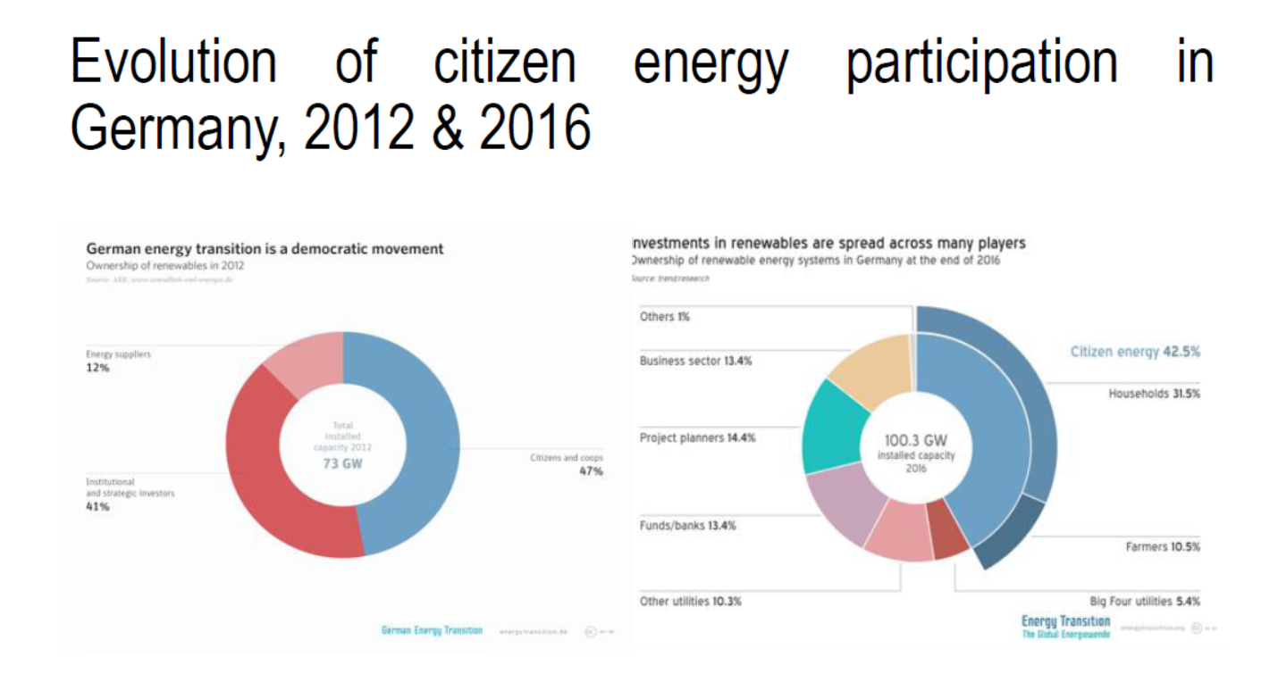

Slide 3
Approach & content
Longitudinal and primarily based on OTHER sectors than energy + focus on citizen based initiatives:
-understanding mechanisms of bottom-up formed institutions, currently driving change towards renewables
-understanding change over time, pathway to to resilient societies but also lock-in effects, path depedency
-understanding society-wide system transitions: ‘system changes only happen when enough people do enough things differently enough’ (Watson, 2012: 488).
-identify alternative social practices
Content:
SHORT-TERM CHANGE: last 30 years (approx.)
POLITICAL: Changes in relationship citizens-policy making
ECONOMIC: Formation of “new” collectivities:
New “alliances”: collaborative production/consumption
Increasing nr of “prosumers”, not just in energy
INSTITUTIONAL: Institutional features of citizen collectivities
LONG-TERM TRANSITION: last 1000 years
other waves of institutionalised collective action in the past: complexity is not new!
Motivations individual/meso level
Causes on macro-level
Comparison waves

Slide 4
Changes in involvement of citizens in policy making and implementation
 | Topic | CO-DECIDING | PARTICIPATION | CO-CREATION | PARTNERSHIP | INDEPENDENT CITIZENS’ COLLECTIVE
 | Examples | Referenda G1000 (platforms for democratic innovation) | Citizen budgets | Government facilitates initiative (e.g., via infrastructural means) Right to Challenge | Right to challenge, citizens’ collectivities with extensive government involvement | Citizens’ collectivities without any government involvement
 | Role of citizens’ participation | Advisory / Consulting | Policy participation | Social participation | Social initiatives | Social initiatives
 | Actions of citizens | Advising | Co-deciding | Co-implementation | Execution | Execution according to own planning and schedule
 | Ownership / decision-making power | Government | Government, possibly with mandate granted to citizen juries | Government Needs to be initiated by citizens, local government facilitates (by providing and monitoring framework) | Citizens Self-governance by citizens, limited involvement local government. Local government is one of many equal parties involved. | Citizens Full self-governance by citizens, no government support and/or involvement
 | Domain | Mainly limited to political participation |  | Mainly concerning provision of public and private services and goods |  | Mainly concerning provision of private goods and services

Slide 5
Since approx. 2005: rediscovery of the collectivity in economic exchange
PPPs
STATE
Liberalisation
MARKET
COLLABORATIVE CONSUMPTION
Peer-to-Peer
COLLABORATIVE PRODUCTION
COLLECTIVITIES PROVIDE IN PUBLIC SERVICES
COLLECTIVITIES

Slide 6
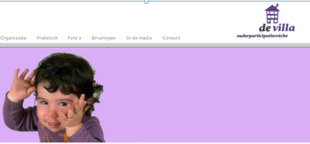
Collaborative PRODUCTION
CITIZENS’ COLLECTIVITY PROVIDES PUBLIC GOOD/SERVICE, often in co-operative format
PPPs
STATE
MARKET
COLLECTIVITIES PROVIDE PUBLIC SERVICES
COLLECTIVITIES

Slide 7
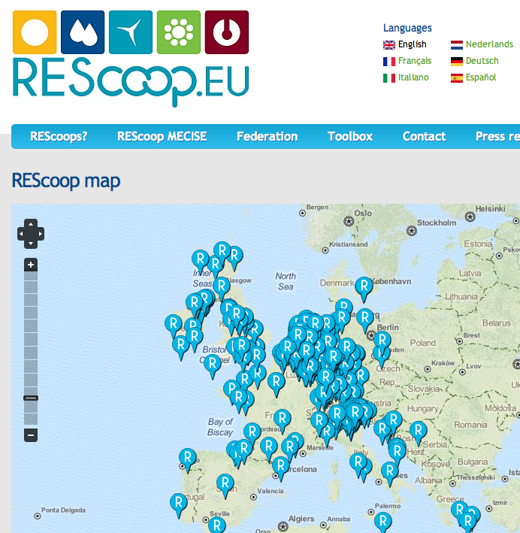

Slide 8
EvolutiOn of the number of new cooperatives per sector 1990-2012 (Netherlands)

Slide 9
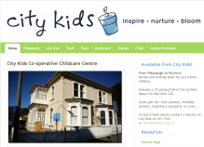
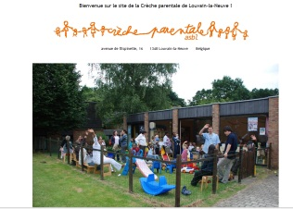
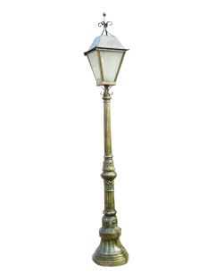
 |  | Products/services are offered to/can be used by
 |  | To members of the collective | To others for free | To the market (sale)
Products/services are offered by | by the collective
 | By the state (cond. of citizenship) | Public collective partnership | Pure public goods | Public private partnership
 | by the market (sale) |  |  | Market produce sold on the market
Institutions for collective action/commons

Slide 10
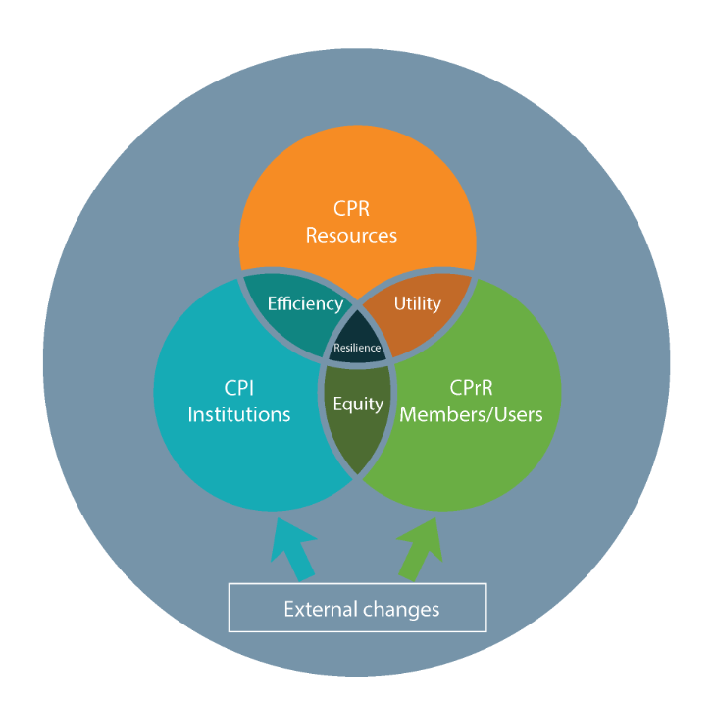
Institutions for collective action=Groups with rights + collective resources + self-devised rules

Slide 11
RESOURCES:
-use has effect on stock
-use can be phyiscally delimited
INSTITUTIONS:
based on
Self-regulation
Self-sanctioning
Self-governance
USERS: prosumers
Builds on reciprocity through participation of a well-defined group of people

Slide 12
RESOURCES:
-use has effect on stock
-use can be phyiscally delimited
INSTITUTIONS:
based on
Self-regulation
Self-sanctioning
Self-governance
USERS: prosumers
Builds on reciprocity through participation of a well-defined group of people
Groups of citizens creating and managing a collective good and/or service, whereby the individual use right of the group members is set and limited the by collective decisions of all groups.

Slide 13
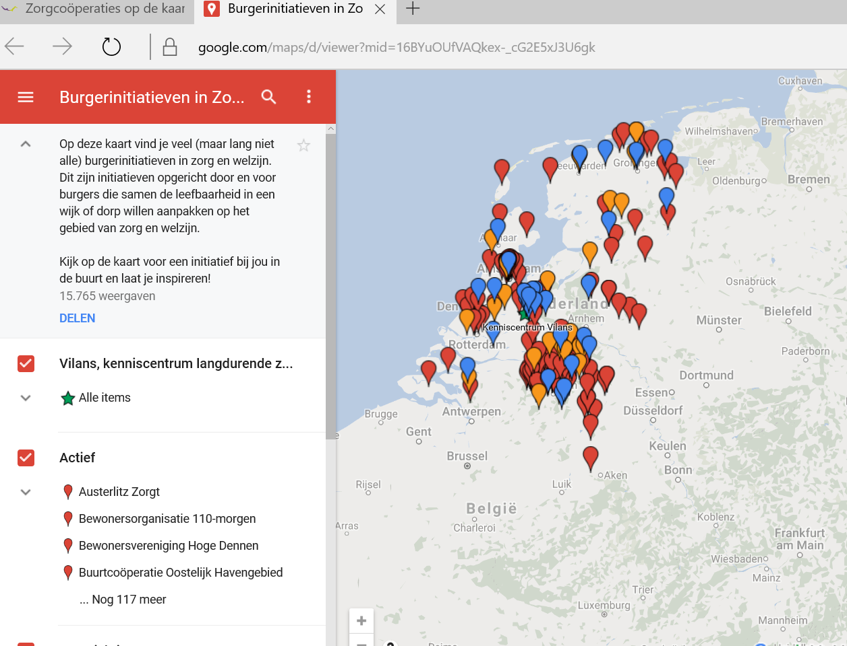
Care collectivities in the Netherlands

Slide 14
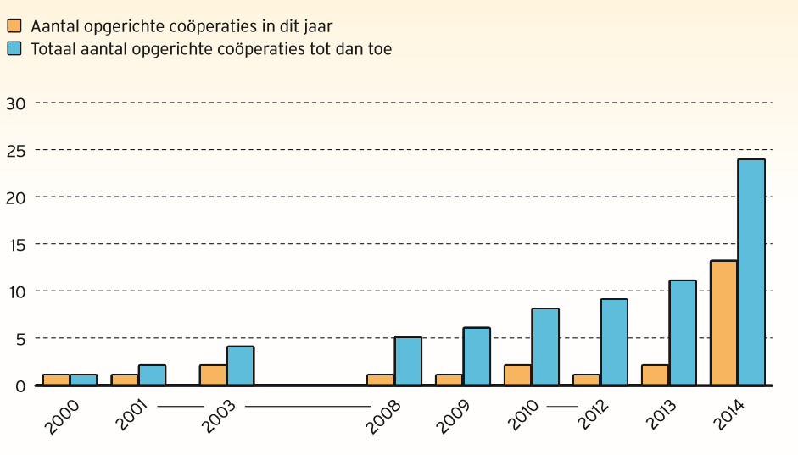
New forms of cooperatives, e.g. gebiedscooperaties (NL)
# cooperations newly founded
Total # of cooperations

Slide 15
Commons, guilds, waterboards...: 1000-1600
Liberalization
Formation of nation-states

Slide 16
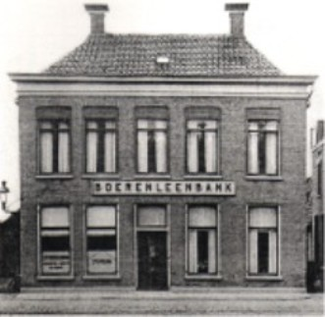
Cooperatives, associations, labour unions, 1880-1920

Slide 17
1000 years - 3 waves of citizens’ collectivities
A new “wave” always emerges after accelerated developments in the free market
Free market system & privatization do not always yield the desired effect
Effect on prices?
Effect on quality?
Accessability?
-> Citizen’s collectivities emerge in reaction to no or insufficient supply by commercial suppliers / the free market system
-> but offers also (re)new(ed) way of citizens dealing with social dilemma’s through collective action, dealing with sufficiency and resource efficiency

Slide 18
(some) Differences between the past and today
1st wave: splits; 2nd wave: fusions; 3rd wave: platforms? Supra-local networks (e.g. REScoop)
Life span of modern institutions is remarkably shorter than life span of institutions that emerged in the first wave
Goals have been “split-up”:
Historical:
Social and economic needs brought together into one collective
Consumption and production together
Now: participating in several different collectivities is essential to provide for all everyday needs
-> Disadvantage:
Reduces the opportunities for using reciprocal behaviour as a complementary incentive
To provide for all needs, one needs to be a member of several different collectivities

Slide 19
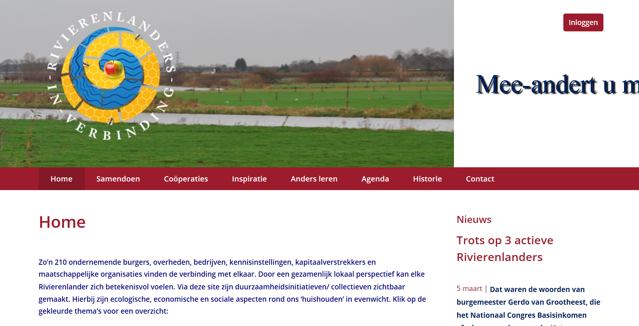
Multi-purpose-multi-stakeholder coops

Slide 20
Risks of market economy
Supply-driven rather then demand-driven
Extended supply chains due to subcontracting
Intermediate evaluations hard to accomplish, usually only evelaution at the end of the contract
In case of new contract partner, new conditions may apply
-> citizens prefer direct, hands-on approach

Slide 21
Risks of new collectivities
Insufficient intergenerational solidarity may endanger longevity
Citizen’s collectives take over / create public services, but tend to become independent very fast:
“We will manage it oursevelves, without government involvement”
-> governments should ensure accessability to services for all social classes and generations
-> governments should safeguard a fair distribution of pulic services and goods
-> governmental provisions will be needed to guide, stimulate and support processes (e.g. fiscal instruments)

Slide 22
Research challenges?
Mapping current wave of new collectivities, not only energy sector
Exploring advantages of institutional diversity in energy sector: collectivities as drivers of transition towards renewables?
Identifying incentive structures in different sectors for citizens to initiative collectivities
Exploring combinations of goals, including energy, to make citizens’ collectivities more durable
Developing policy instruments to stimulate development of institutions for collective action

Slide 24
Characteristics of emergence of institutions for collective action
Institutional design: self-enforced, exclusive and autonomous
Exclusiveness: access rules to differentiate insiders from outsiders
Bottom-up formation
Self-enforced , self-monitored and self-sanctioning
Heavy reliance on group norms
Self-Protection against free market
Autonomous and tolerated by authorities
Avoiding internal conflicts and enhancing cooperation via
mechanisms to offer resources at a uniform price on basis of autonomously defined quality standards (not via market)
Income assurance for all members

Slide 25
Citizens’ collectivities and the free market system: An ambiguous relationship
Citizens’ collectivities: Seek to limit the commercialization
of common goods and services
Heirnis, 16 May 1705: Every entitled member will be allowed to graze his cow, on the condition that he swears an oath to use the milk of that cow for his own use only and not to sell or let out his grazing rights
Bestmen, 15 May 1770: No one will be allowed to dig any peat within the mark with the purpose of selling this peat
BUT
There is also a stimulus by the free market system in regard to individual willingness to act reciprocally
-> Citizens’ collectivities: modus vivendi in a developing market system

Slide 26
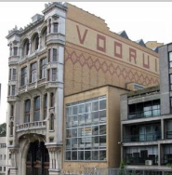
Citizens’ collectivities: not necessarily opposed to the free market
Use of free market mechanisms (e.g., price mechanisms) for its own functioning
Trendsetter for innovation of the free market:
Educational / training aspects
Brand as quality indicator
Buyers’ collectivities -> supermarkets
-> Institutions for collective action: often trendsetters for new developments within the free market system

Slide 27
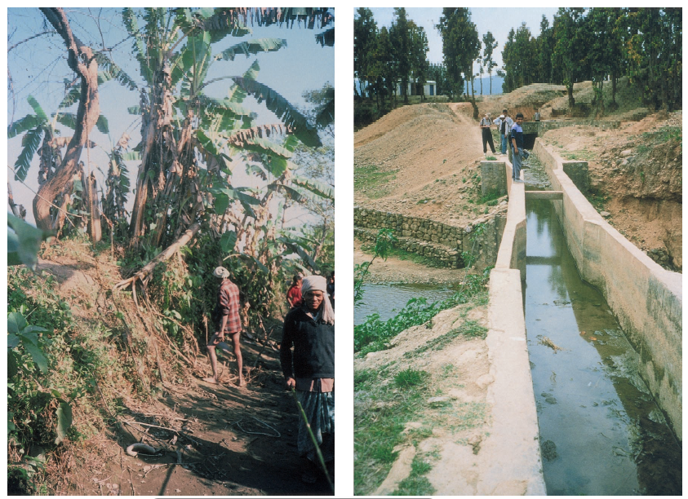
Technology: not necessarily an improvement.... Replacement(Nepal) farmer-owned irrigation system (LEFT) by government-owned irrigation system (right panel)
Physical capital markedly better than that possessed by the earlier
BUT:
never been able to provide water consistently to villages. Agricultural
productivity is lower now than it was under farmer management
Tech
Tech

Slide 28
Group size

