Slide 1
Combining Qualitative and Quantitative Foresight Methods for Energy Futures
Workshop on “Social practices and complex systems” (ISPRA, 20-21 March 2018)

Slide 2
Overview
What is a ‘good’ foresight exercise?
A constructivist outlook
Empirical findings (from the FORUM project)
Tentative conclusions

Slide 3
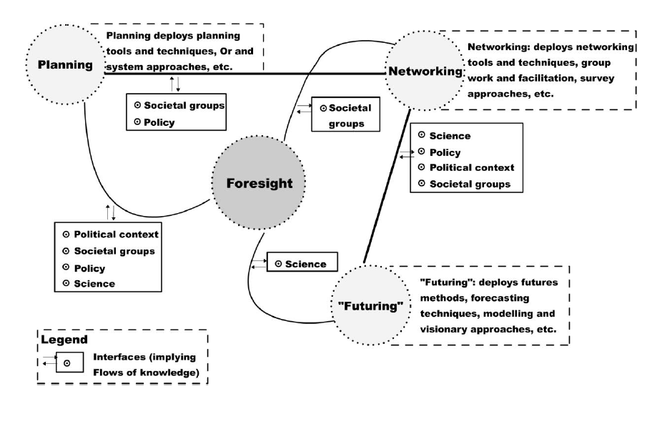
Foresight as a hybrid activity…

Slide 4
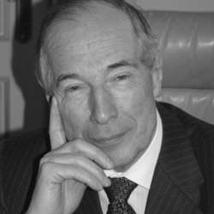
… depending on different justifications…
Foresight ‘sells’ well, when brought in a ‘spectacular’ way.
I can only have ‘contempt’ for this study.
Study is a ‘prediction’, but:
  Can we say anything meaningful about 2050?
  Will every roof be paved with solar panels?
  Will we redirect a large % of the public budget towards renewables (neglecting health care etc.)?
Predictions have been and will always be wrong (e.g. fusion energy, ...).
It would be better to do a prediction about the behaviour of the energy system on a cold day in the near future.
Example of a reaction to the VITO study “Towards a 100% RE system in Belgium by 2050”

Slide 5
… therefore needing a constructivist approach.
Objective criteria
reflect on the suitability of knowledge to represent the object of interest as an object (i.e. something that will not change its qualities from one context to another): one can think of criteria such as controllability, reproducibility and non-ambiguity of research (in other words, the standard criteria of empirical research).
Subjective criteria
  reflect on the suitability of knowledge to be assimilated or internalised by an individual: utility, simplicity, and coherence with existing knowledge can all be relevant knowledge selectors.
Intersubjective criteria
  point at the degree of acceptance of an idea within a group of subjects (e.g. peers): collective utility, expressiveness, degree of formalisation, conformity with existing beliefs and authority all belong to this category.

Slide 6
A constructivist view on foresight: translations
From ‘reality’ to a ‘modelled reality’
    more than one model of ‘reality’ is possible
From a ‘modelled reality’ to a ‘computable reality’
    social behaviour is sometimes difficult to compute
From ‘computable data’ to ‘significant data’
    depending on how data are selected, the future can be ‘shaped’
From ‘significant data’ to ‘policy evaluation’
    sometimes the policy problem or question is vague; value choices made by scientists

Slide 7
A constructivist view on foresight: boundary objects
legitimacy
    combination of ‘competence’ and ‘normative authority’
power
    agenda setting, creative solutions
speed
    timely provision of useful research
effectiveness
    in ‘real world’ circumstances
feasibility
    also in a political sense
social acceptance

Slide 8
The FORUM project
Comparing LEAP (accounting framework) and TIMES (optimisation)

Slide 9
Lessons from the FORUM project
Expectations of ‘intermediaries’
Temporal and spatial resolution of models
    Look beyond horizon 2050
    Integrate energy policy in a EU perspective
Security of supply & reliability of energy system
    Need for a high temporal disaggregation to address challenges of intermittent RES production
Information on costs and benefits of transition
    Be very precise in cost communications
    What to use as a point of comparison?
    Include social costs !
    Be careful with cost optimisation approach

Slide 10
Lessons from the FORUM project
Expectations of ‘intermediaries’
Aptness to include lifestyle changes
    Beyond assumption of price elasticity
    Beyond “what if” type of analysis
Internal consistency
    Impact of energy system on general economic conditions (and vice versa)
Transparency & openness to stakeholder inputs
    Consult stakeholders on inputs for key parameters
    Be transparent on values for key parameters and how ‘robust’ they are

Slide 11
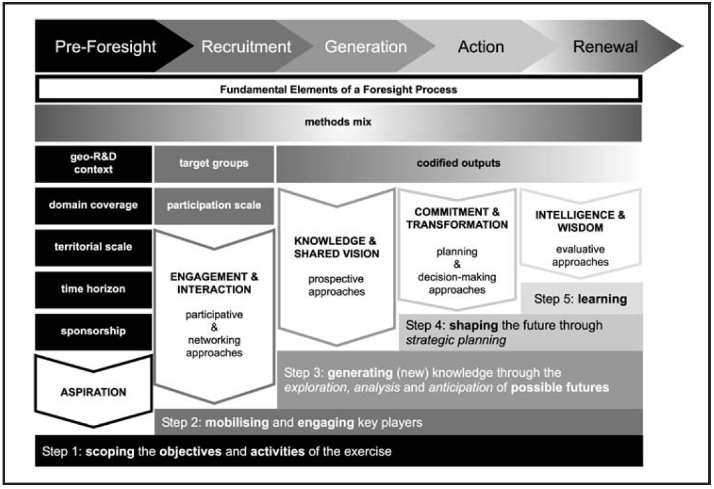
Conclusion - The need for an integrated approach

Slide 12
Conclusion - Pay specific attention to:
the diversity of the core group participating in the foresight exercises
the available resources
the strength of the evidence used
the explicit discussion of normative elements
the development of coherent and engaging storylines
the exploration of ‘surprise events’
avoiding narrow problem framings.

Slide 13
Dr. Erik Laes
Senior Expert
Smart Energy and Built environment (SEB)
VITO NV | EnergyVille
Thor Park 8310, 3600 GENK
tel. +32 14 33 59 09 | erik.laes@vito.be

