Slide 1
Opportunities and Challenges Associated with the Development of Local Energy Communities in Germany
Discussion Panel 5: Some main existing experiences in the EU
JRC Ispra Site
IT-21027 Ispra, Varese, Italy
Sarah Rieseberg
Arepo Consult
rieseberg@arepo-consult.com

Slide 2
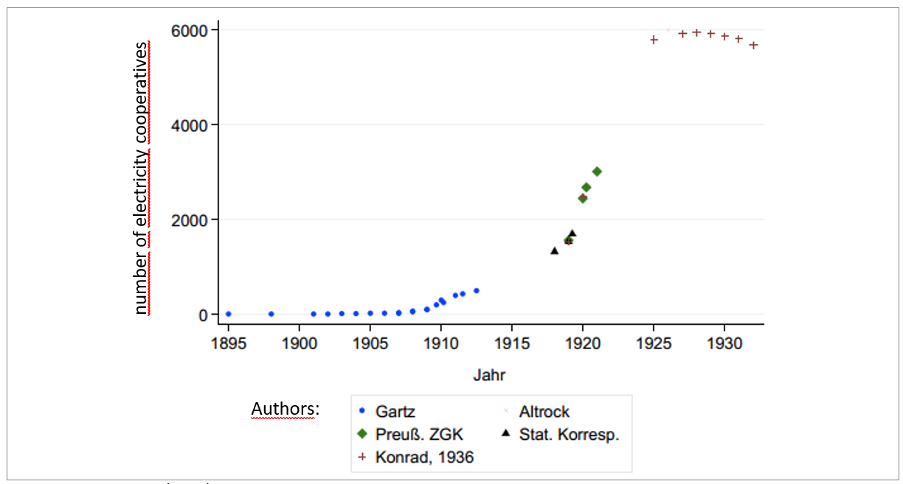
Historical perspective on community-based renewable energy in Germany
Electricity cooperatives in the German Empire and the Weimar Republic 1895-1932
Source: Holstenkamp (2012).
Notes:
Germany looks back at a two-part history of community energy. The roll out of electrical infrastructure in the late 19th century was also the beginning of modern community energy. Particularly in rural areas, which were largely neglected by commercially-run electricity providers, communities themselves stepped in and founded their own power companies. Researchers have shown that up to 6,000 energy cooperatives existed in Germany by the late 1920s. Most of these cooperatives did not survive the various regime changes that Germany experienced. After the Second World War, all electricity providers in East Germany were nationalized. In West Germany, the energy system came to be dominated by four major energy companies: E.ON, RWE, Vattenfall and EnBW. These four later took over the former GDR transmission (and many distribution) grids after reunification.
0s

Slide 3
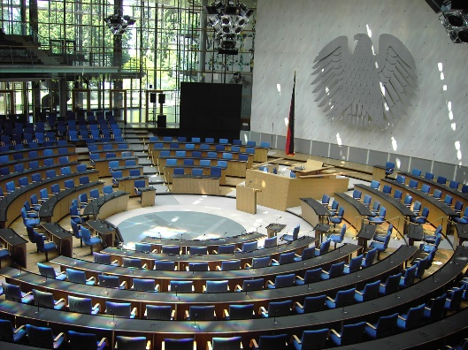
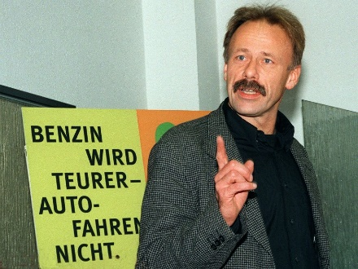
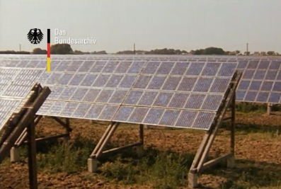
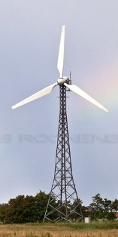

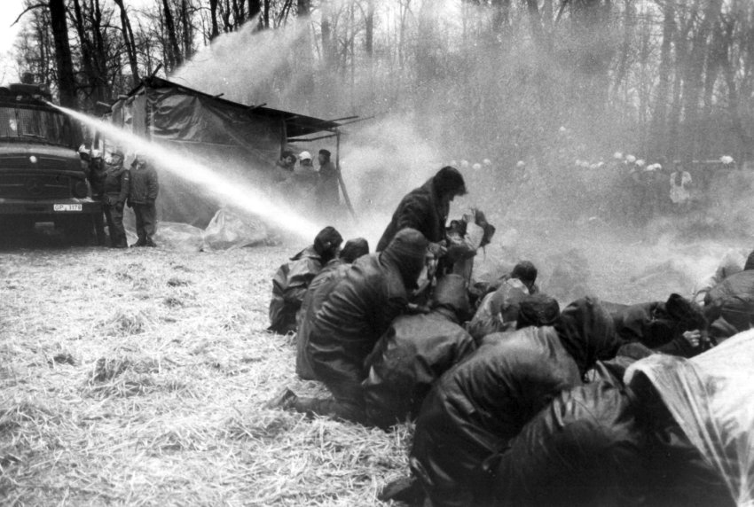
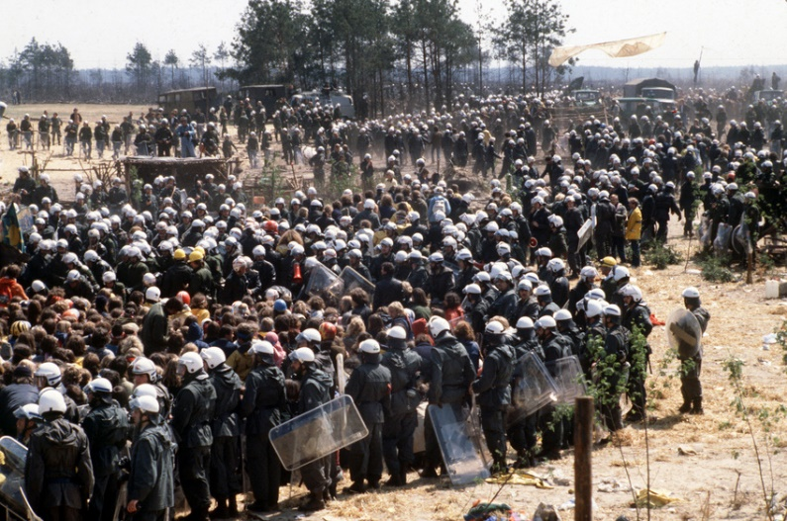
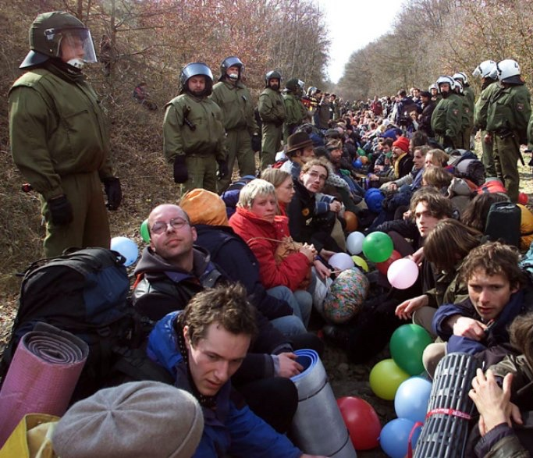
A short history of the new community energy
2000 EEG on Federal level
1983 Pellworm
1992 1. feed-in tariff
1975 Wyhl
1980 Gorleben
2001 Dannenberg
Source: Zeit (2010), Spiegel , energie-experten.org
Notes:
With the rise of the environmental and anti-nuclear movements in the late 1980s and early 1990s, many initiatives started experimenting with renewable energy to show that alternatives to fossil fuels, nuclear energy and centralized energy systems were possible. The first feed-in tariff for renewables, which later became known as the “Aachen Model,” was passed by the city of Hammelburg in 1993. 40 other German cities followed by the year 2000. Similar energy revolutions took place with the grid infrastructure: After a decade-long fight to take control of their electricity grid, the “Energy Rebels of Schönau” succeeded in buying their district grid in 1996.
In the year 2000, a national feed-in tariff was established, transforming a community rebellion into large-scale investment in energy infrastructure. By 2012, investment by private individuals in renewable energy installations reached 5.1 billion euros, about 30 % of total investment (ReNews, 2014).
With the feed-in tariff, community energy experienced a revival, though still far behind the first wave of community energy in the 20th century. At the end of 2016, 1,747 community energy companies and cooperatives existed in Germany (Holstenkamp et al., 2017). Of these, the vast majority (87 %) were active in energy production, 15 % were involved in energy distribution and 12 % in heat networks. The cooperatives and companies not only managed to collect large amounts of capital but have also shown to be at the forefront of innovative business models as well as developing technologies for the energy transition. The next section presents some examples with truly innovative models.
In the city of Aachen, civic groups (among them a solar and a wind energy association) proposed communal feed-in legislation to their council. But the city of Hammelburg became the first municipality to pass municipal feed-in legislation according to the “Aachen Model.“
Picture sources: https://www.zeit.de/politik/deutschland/2010-10/fs-castor-2
http://www.spiegel.de/fotostrecke/anti-akw-bewegung-no-atomstrom-in-my-wohnhome-fotostrecke-107148.html
https://www.energie-experten.org/erneuerbare-energien/windenergie.html

Slide 4
Ownership structure of installed RE capacity (2012)
72.9 GWel
Source: trend:research (04/2013)

Slide 5
Innovation and community-based renewable energy

Slide 6

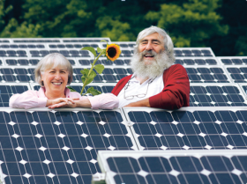

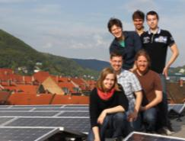

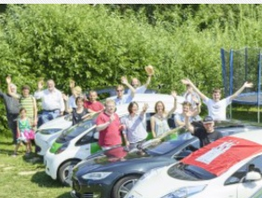
Community-based renewable energy:
An innovative force
EWS Schönau – the Energy Rebels:
  Prosumer test project: 29 users, producers and prosumers with PV, CHP, 2 fuel cells and 3 electric vehicles are connected via a peer-to-peer trading system based on block-chain, forming an independent consumer-producer unit.
Heidelberger eG
  Sector-coupling: Inhabitants of an urban neighbourhood are offered a full energy service package of tenant electricity, e-mobility, storage and load management.
Inselwerke:
  E-Mobility: The co-op maintains 20 e-mobility charging stations on the island Usedom, active in the construction of a nation-wide network of e-mobility charging stations run by energy cooperatives throughout Germany.
Notes:
EWS Schönau is the product of the “Energy Rebels’“ fight to purchase their local distribution grid. The initiative functioned as an informational and educational hub for many civil society organisations dedicated to energy democracy, and also for other community-based renewable energy companies. EWS Schönau produces electricity from Combined Heat and Power (CHP), hydro, solar and wind. With its “solar-cent program”, the company offers a subsidy for privately-owned renewable energy installations. The company’s most recent innovative project is a prosumer model based on block-chain technology. 29 users, producers and prosumers with photovoltaics, CHP, two fuel cells and three electric vehicles are connected via a peer-to-peer trading system forming an independent consumer-producer unit.
The Heidelberger e.G. was founded in 2010 by students of Heidelberg University. By 2018, the cooperative had 339 members. When feed-in tariffs were cut dramatically, the HEG reacted to the end of the PV business model by developing a so-called “tenant electricity” business model, exploiting a loophole in the electricity regulation. This model is exempted from certain electricity charges, allowing them to be competitive with the grid price. HEG has been a very innovative cooperative with several ground-breaking pilot projects. Their latest project is a sector-coupling energy project offering the inhabitants of an urban neighbourhood a full energy service package of tenant electricity, e-mobility, storage and load management.
Inselwerke e.G. is an energy cooperative that was founded in 2013 on the island Usedom in the Baltic Sea. It is special to some degree as the co-op not only addresses energy production, but also mobility and energy efficiency. For example, the co-op has engaged in an energy service business model by replacing the municipal street lamps with LEDs. The cooperative’s investment is paid back from the energy savings. The co-op currently maintains 20 e-mobility charging stations on the island, most of them equipped with solar carports. The cooperative is active in the construction of a nation-wide network of e-mobility charging stations run by energy cooperatives throughout Germany.

Slide 7
Benefits of community-based renewable energy

Slide 8
Investment motives of community-based RE companies
Investment motives of community energy companies (cooperatives versus GmbH & Co. KG)
Scale: 1 = unimportant, 5 = very important
Source: own translation of Leuphana & Nestle (2014).

Slide 9

Benefits of community energy
Environmental benefits
Global climate, environment, biodiversity
Public benefits
Acceptance of energy projects
Social Capital
Self-efficacy & transfer of social participation to other fields
Competences dealing with public administration
Acquiring of new skills
Community spirit
Financial Benefits:
Return on investment
Reduction of climate mitigation costs
income opportunity, e.g. land rental
Creation of jobs and markets
Lower prices for electricity, hot water or heat
Tax and tenure revenue for the municipality
Social benefits:
Social spending through increased public income
Contractually agreed contributions by investors, e.g. decontamination of landfills
Foundations that support local community activities

Slide 10
The growth of community energy has not gone uncontested.

Slide 11
Two blows to community energy in Germany

Slide 12
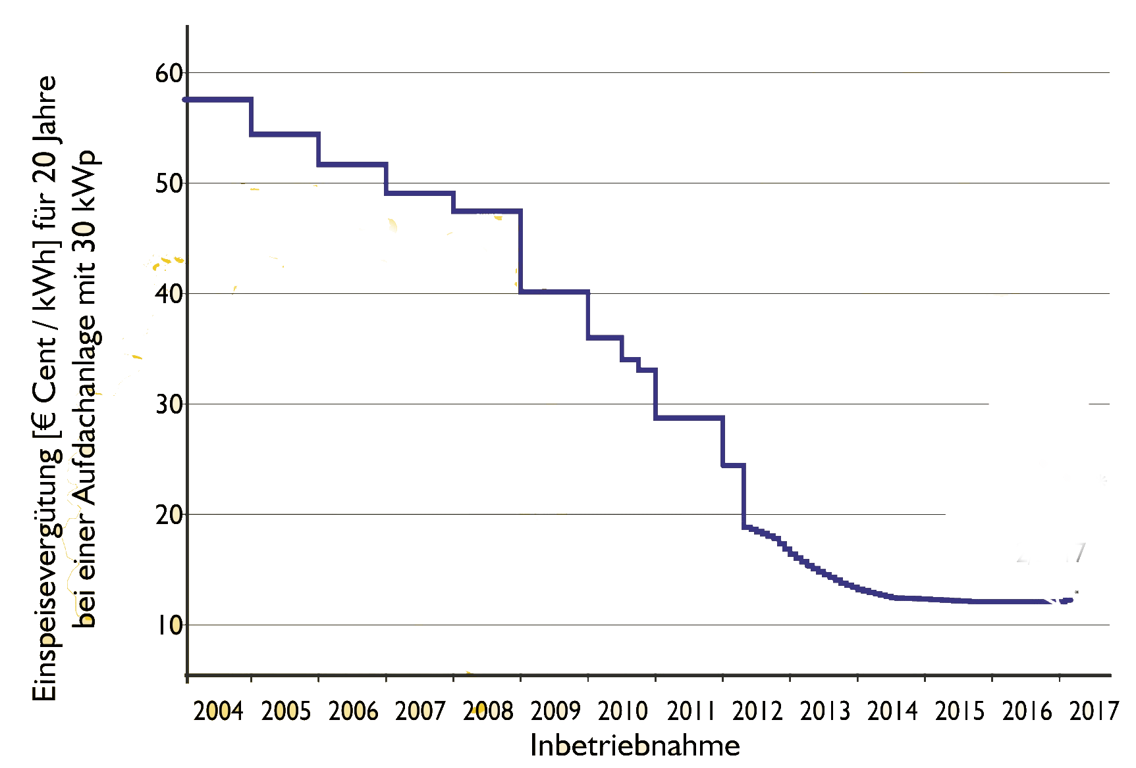
Blow # 1: Dramatic cut in roof-top solar feed-in tariffs
Rapid cuts in feed-in tariff for roof-top solar render roof-top solar -outside of individual self-consumption- unprofitable
Solar feed-in tariff cuts 2010
feed-in tariff (€Cent/KWh over 20 years for roof-top 30 KWp
Year of entry into service
Notes:
Source: sonnentiatiative eV

Slide 13
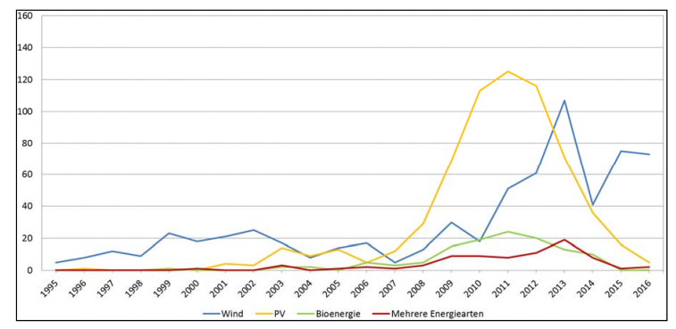
Trends on the funding of new community-based companies
Establishment of new community energy companies by energy type
Solar feed-in tariffs cuts 2010
Source: Holstenkamp (2017).

Slide 14
Blow # 1: Dramatic cut in roof-top solar feed-in tariffs
Solar feed-in tariffs cuts 2010
The dramatic cut in feed-in tariffs hit collective community-based renewable energy the hardest because it destroyed its core business model
The only remaining fields are:
  roof-top PV for self-consumption (owner = investor) for private individuals with very high energy demands or for medium-sized companies

Slide 15
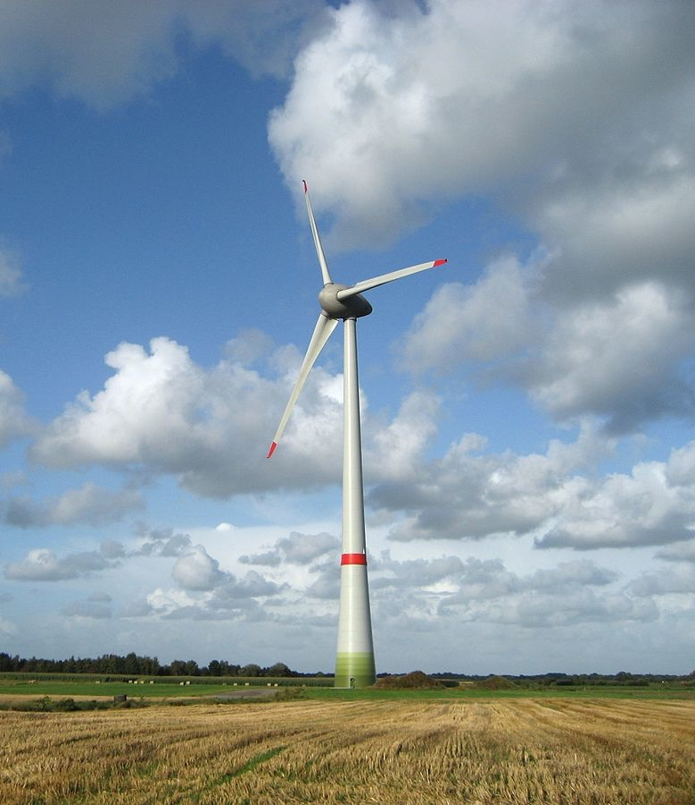
Blow # 2: EU-Guidelines and the implementation of tender models
Introduction of tender model 2017
2014: EU Guidelines on state aid for environmental protection and energy 2014-2020
2017 Interpretation and implementation of the guidelines by the German government: The German government introduces tender models for onshore & offshore wind and free-field PV
  At first legislation included preferential treatment for “community energy”
  conventional investors had formed puppet community energy companies as a vehicle to benefit from the exemptions and won >90% of auctions, thereafter the German government stripped the legislation of preferential treatment for community energy

Slide 16
Trends in the share of ownership in installed RE capacity
2012 2017
72.9 GWel
100.3 GWel
Source: trend:research (04/2013), trend:research (2017)

Slide 17
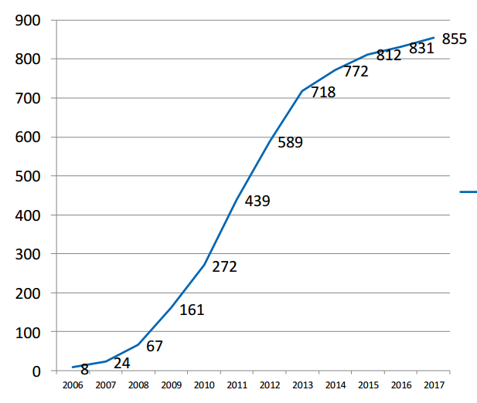
Cumulative number of energy cooperatives founded (within the DGRV)
number of electricity cooperatives
Source: DGRV (2017).

Slide 18
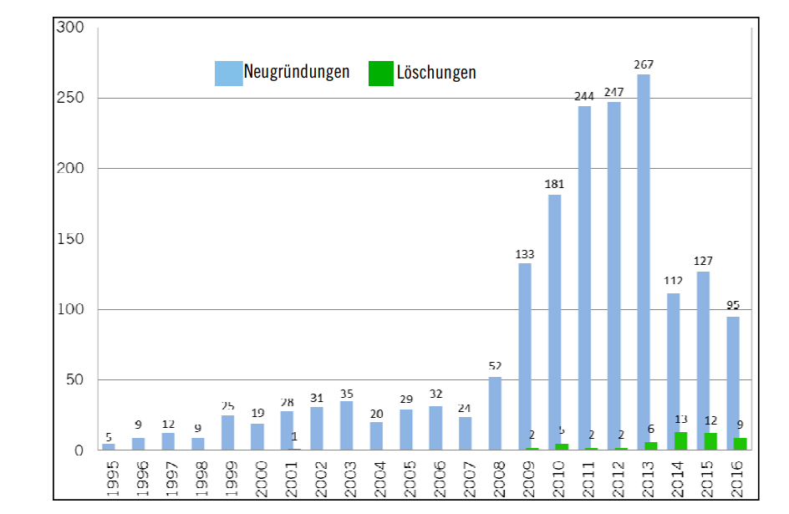
Trends in the founding of new community-based companies
New founding and liquidations of community-based renewable energy companies
Solar feed-in tariffs cuts starting in 2010
Introduction of tender model 2017
New founding
Liquidation
Source: Holstenkamp (2017).

Slide 19

Discussion and lessons learned
In the first wave of renewable energy expansion after the introduction of the EEG (∼2002-2012) community energy proved to be able to collect large amounts of capital and proved to employ innovative projects
The expansion of community-based renwable energy has slowed dramatically, due to changes in their market environment.
There are (at least) two interpretations of what happened
  „The renewable energy industry grew up and there was no place for community-based companies lacking the economies of scale of multinational corporations.“
  „Community-based renewable energy was side-lined by deliberately destroying its business model. The limitation to individual self-consumption & auction models was introduced to path the way to a RE system dominated by private ownership“
Notes:
Community energy in Germany can look back at two truly impressive decades of success. However, there are many signs that the 20th century could repeat itself, with community energy wiped out again. This would be the result of strategic policymaking. The German feed-in-legislation was altered, in a step-by-step process, in favor of large corporations and market concentration. After the end of solar and the introduction of auction systems, collective community investment is unlikely to defend its position and could soon be reduced to a niche phenomenon.

Slide 20

Opportunities and Challenges Associated with the Development of Local Energy Communities in Germany
Discussion Panel 5: Local energy communities, municipalities and social innovation: description of some main existing experiences in the EU and of the associated innovation potential.
Sarah Rieseberg
Arepo Consult
rieseberg@arepo-consult.com

Slide 21
Arepo Consult (2016). Subsector Analysis.
Community-based renewable energy models
an analysis of existing participation models and
best practices for community-based renewable
energy deployment in Germany and internationally. Describing 39 Examples
of international community-based
renewable energy projects
GIZ .
https://www.giz.de/fachexpertise/downloads/giz2016-en-pep-soa-th-subsector-analysis-community-based-renewable-energy.pdf

Slide 22
Literature
AEE trend:research (2018) Bürgerenergie bleibt Schlüssel für erfolgreiche Energiewende.
DGRV (2017) Energiegenossenschaften 2017. Ergebnisse der DGRV-Jahresumfrage (zum 31.12.2017).
Holstenkamp, L. (2012) The Rise and Fall of Electricity Distribution Cooperatives in Germany, Paper presented at the „Conference on Cooperative Systems“, Bolzano, 9 November 2012.
Holstenkamp, L., Kahla, F., Müller, J., Degenhart, H. (2017) Development and State of Community Energy Companies and Energy Cooperatives in Germany. Leuphana University.
IZES (2015) Nutzeneffekte von Bürgerenergie. Eine wissenschaftliche Qualifizierung und Quantifizierung der Nutzeneffekte der Bürgerenergie und ihrer möglichen Bedeutung für die Energiewende.
Leuphana Universität Lüneburg & Nestle, U. (2014) Marktrealität von Bürgerenergie und mögliche Auswirkungen von regulatorischen Eingriffen.
ReNews (2014) Großteil der Erneuerbaren Energien kommt aus Bürgerhand.
trend:research (2013) Ownership distribution of installed RE capacity for power production throughout Germany in 2012. Renewable Energies Agency.
trend:research (2017) Ownership distribution of installed RE capacity for power production throughout Germany in 2016. Infographic Dossier: Renewable Energy in the Hands of the People. Renewable Energies Agency. https://www.unendlich-viel-energie.de/media-library/charts-and-data/infographic-dossier-renewable-energy-in-the-hands-of-the-people.
Notes:
The first major hit for CbRe was the dramatic cut in PV feed-in tariffs. The community energy companies that were founded between 2009 and 2012 were heavily focused on photovoltaic energy (yellow line in Figure 5). But in 2012, the CDU-CSU-FDP government cut the PV feed-in tariff to such an extent that business models based on feeding photovoltaic electricity into the grid were no longer viable. Since many community energy initiatives were based on this model, the founding of new initiatives largely came to a halt. By 2016, the number of new community energy companies focused on solar had practically dropped to zero. From 2012 onwards, most new community energy companies focused on wind (blue line in Figure 5).

