Slide 1
Community energy in Italy: lessons from existing evidence
Chiara Candelise
IEFE Bocconi
Gianluca Ruggieri
Insubria Univeristy
JRC Seminar – Ispra, 23° November 2018

Slide 2
Outline presentation
Defining community energy
Evidence on community energy in Italy
Concluding remarks

Slide 3
Defining energy community
Civil society engagement can take several forms
  Grassroot associations, collective purchasing of energy service, community programmes for poverty alleviation, energy production and energy distribution cooperatives, or a mix of those
Quite heterogeneous sector
Different definitions in academic literature. Most commonly concentrate on energy communities:
  Which imply a form of citizens ownership or financing of the energy project.
  Where citizens directly benefit from the outcomes of the initiative.

Slide 4
Historical coops vs modern energy communities (EC)
Early 20th century energy coops:
  Cooperatives founded to produce and provide electricity to its members
‘New wave’ in 2000s, modern EC driven by energy transition:
  Liberalization – entrance of small players in the market
  EU support to RES (e.g. FiT)
  Civil energy movement
For example, Germany:
  Over 900 EC, since 2010 (modern EC)
  95% focus on electricity production, of which ¾ from PV Members are owners/investors, but not necessarily directly benefit from electricity (product/service) provision
Sources: Yildiz et al, 2015; Wierling, A., 2018

Slide 5
ITALY

Slide 6
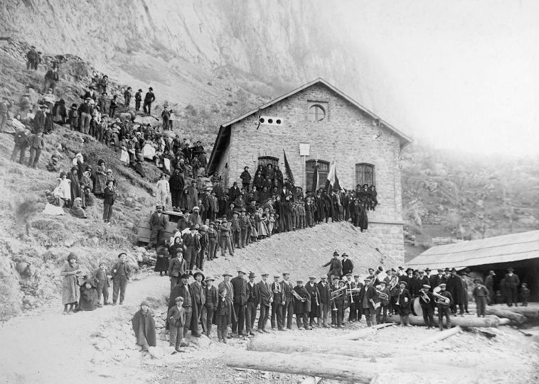
Fontanone hydroelectric plant
Paluzza, 1913

Slide 7
Historical background
In the alpine region several local cooperatives were able to build hydroelectric plants and the distribution grid (e. g. Società per l'Illuminazione Elettrica in Chiavenna, 1894)
During the nationalisation (ENEL was founded in 1962) most of the cooperatives were included in the national vertical integrated (almost) monopolistic utility
A number of them refused to join the national utility and continued their own activities even after the liberalisation process started in 1999 with the implementation of the EU Directive 96/92/CE concerning common rules for the internal market in electricity

Slide 8
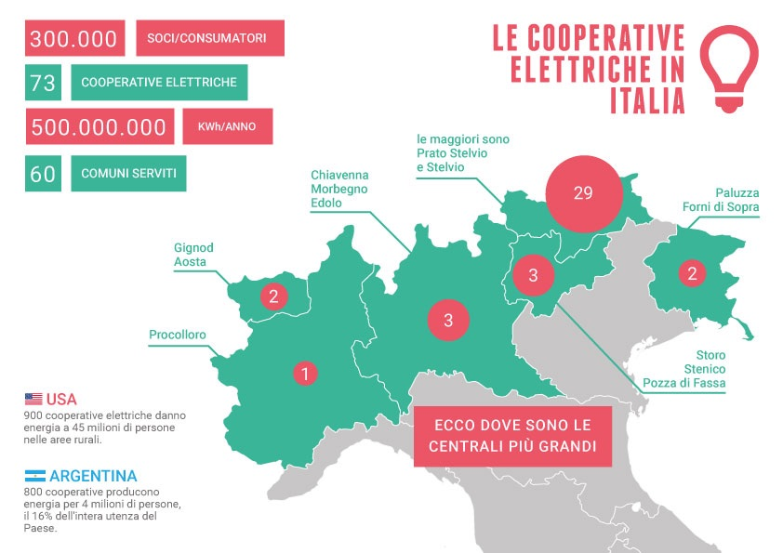
Alpine communities historical electrical cooperatives

Slide 9
Energy community in Italy: our focus
Focus on EC initiatives:
  Which imply a form of citizens ownership or financing of the energy project.
  Where citizens directly benefit from the outcomes of the initiative.
Focus on ‘new wave’ of EC initiatives:
  Since late 2000s
  Focus on renewables
  Operate in liberalized energy market
Not included:
  Other forms of civic engagement (green associations, collective purchasing of energy services and ethical consumerism) – despite present in the Italian energy ecosystem
  Historical cooperatives (enjoy a special legal status; can own and manage the local distribution network)

Slide 10
Systematic review of CE in Italy
1.
Systematic review of CE sector
2.
Qualitative and longitudinal data collection
3.
Data and qualitative content analysis
4.
Case study analysis
5.
Discussion of results
14 Italian CE initiatives identified through systematic web searches, grey literature and stakeholders engagement
Data collection - semi structured interviews
Analysis of evidence – emerging trends
Case studies (too small sample for quantitative analysis)

Slide 11
Data collection
Dynamics of creation
Type of activity, timing
Outcomes
Proponent (Municipality, Community, Company)
Approach (Top down, bottom up)
Legal form (Coop, Ltd company)
Ownership (% of members/citizens)
Type of activity (energy production, energy distribution, energy services or a mix)
Timing (start date, duration)
Technology (PV, wind, etc)
Geographical scope (local, national)
Returns offered (% interest on investment)
Other monetary benefits (saving on electricity bills, royalties)
Energy/social services offered (education activities, EE audits, collective purchasing of services/products)

Slide 12
EMERGING EVIDENCE

Slide 13
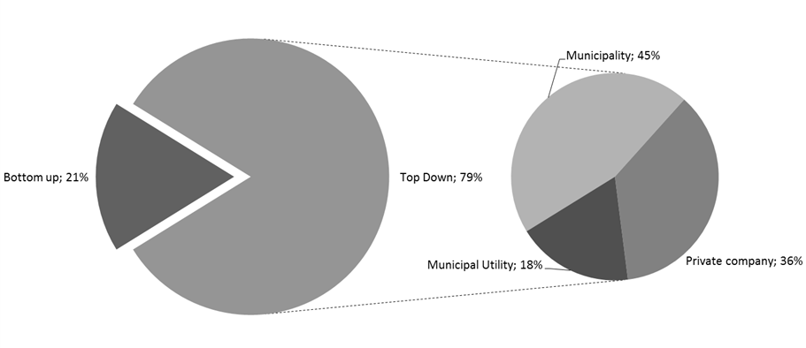
Dynamics of creation: proponent, approach
79% Top down initiatives, of which
  45% promoted by municipalities
  18% promoted by municipal utilities
  36% by private companies
Emerge role of municipalities

Slide 14
Dynamics of creation: legal form, ownership
Legal structures: ~ 60% coop; the rest company, association
Level of citizens ownership (and co-determination) not necessarily correlated to coop legal structure -> dynamics of creation more relevant
Strong top down approach or company proponent -> lower citizens ownership and lower co-determination in organizational structures

Slide 15
Type of activity
13 out of 14 Electricity Production as main activity
  13 developed PV plants
  mainly medium/small (~20-100kw)
  apart from 4 proposed by commercial actors (~1MW)

Slide 16
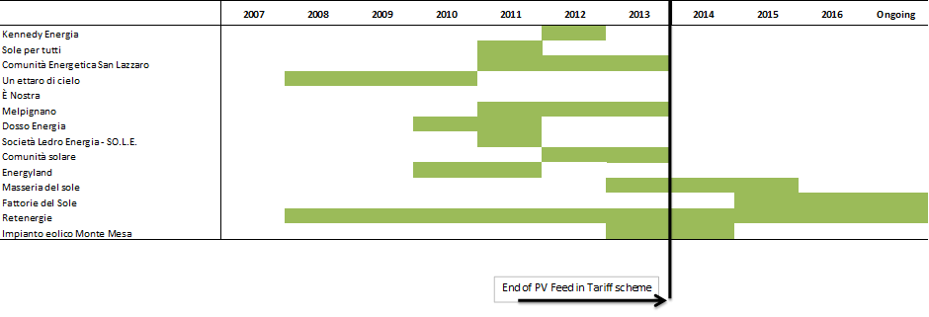
Timing
  Strongly dependent on FiT support to PV (up to 2013)
  After 2013 the only electricity production initiatives still ongoing are those promoted by commercial actors and/or larger/national scope still operating (For Green’s initiatives – Retenergie)
  E’ nostra (electricity distribution) ongoing

Slide 17
Outcomes
Wide range of returns offered!
Monetary outcomes:
  Returns on the investment
  Savings on the energy bill
  Royalties for municipalities
Non monetary outcomes:
  Other energy services (e.g. energy audits, collective purchasing schemes)
  community development schemes (e.g. educational programmes)

Slide 18
Typologies/business model
Two main typologies:
  Electricity production initiatives:
    primary activity development of a single renewable plant.
    Main objective: distribution of ownership and returns among citizens/members (the majority: ~10)
    Higher returns offered (~5-8%)
  Others:
    Develop multiple local projects
    Objective: provide wider environmental and social benefits to community (~4)
    Offer other energy services to citizens/members
    Lower returns offered (~1,5-3%)
Mostly ‘ad hoc’ initiatives (low replication)

Slide 19
Case studies – For Green
For Green: Italian multi-utility
First PV plan developed in 2010 (Energyland), then two others in 2011 and 2015 (Masseria del Sole, Fattorie del Sole)
Dynamics of creation: company, top down, coop, average 60 % ownership members/citizens
Returns: 6.5%-8% (including saving on electricity energy bill)
Other services: none
Energyland
Portion | 3 kW
Initial investment | 10,800€
Capital | 3,000€
Lending | 7,800€
Annual return on capital (variable) | 0€ to 120€ per year (0%-4%)
Annual restoration of the lending | 390 € per year (7,800€/20 years)
Annual electricity free of charge, kWh | 3,000 kWh
Value of electricity bill saving | 510€ to 600€ per year (0.17-0.20€/kWh)
Total return | 6.5% - 8.8%
Total number members | 187 (lower than 300 initially planned)

Slide 20
Case studies - Retenergie
Coop aim: “to contribute to a new economy based on principles of environmental sustainability, sobriety and solidarity”
Dynamics of creation: community, bottom up, coop, 100% citizens/members ownership members/citizens
Returns: 1.5%-3.5%
Other services: collective purchasing schemes (domestic PV, storage, domestic EE audits, EV), other services (insurance, internet, bank services)
 | 2009 | 2010 | 2011 | 2012 | 2013 | 2014 | 2015
Cumulative number of PV plants | 0 | 0 | 5 | 7 | 7 | 7 | 9
Cumulative capacity installed (kWp) | 0 | 0 | 171 | 446 | 446 | 446 | 630
Cumulative investment by citizens (k€) | 0 | 0 | 628 | 1 278 | 1 278 | 1 278 | 1 575
Cumulative number of members | 147 | 230 | 368 | 541 | 694 | 814 | 911
Return on capital | 0 | 0 | 0 | 0 | 0 | 0 | 0
Return on social lending | 3.5% | 2.5% | 2.5% | 3% | 3% | 2%-3% | 1.5%-3%

Slide 21
Case studies – Comparison
Different routes to citizens engagement
  Top down (lower citizens ownership), bottom up (100% ownership)
Different levels of co-determination
  Higher co-determination in Retenergie (board of directors respond to assembly, in change of strategic decisions)
Outcomes
  For Green offer higher returns; Retenergie offer other non-monetary/community services
Trigger different citizens’ investment behaviours
  Retenergie (community logics): majority ‘norm driven’ investments, low expectation of returns (by 2015 49% capital, 51% social lending)
  Overall, higher investment quota in return driven investments (Fleiss 2017, Holstenkamp & Khala 2016)

Slide 22
Concluding
Community energy sector in Italy very small (when focus on ‘new wave’ of EC initiatives)
EC initiatives driven by energy transition:
  mainly electricity production provision, strongly driven by RES policy support (PV FiT)
  Two main typologies emerging
  Low replication
  Only few larger ones still proposing new activities
Looking forward?
Role of policy?

Slide 23
THANKS.
Università Commerciale Luigi Bocconi
Via Röntgen 1 | 20136 Milano – Italia |
Tel +39 02 5836.5384 | www.dondena.unibocconi.it

