Slide 1
Come Together – the History of Swedish Energy Communities
Dick Magnusson
Department of Thematic Studies – Technology and Social Change

Slide 2
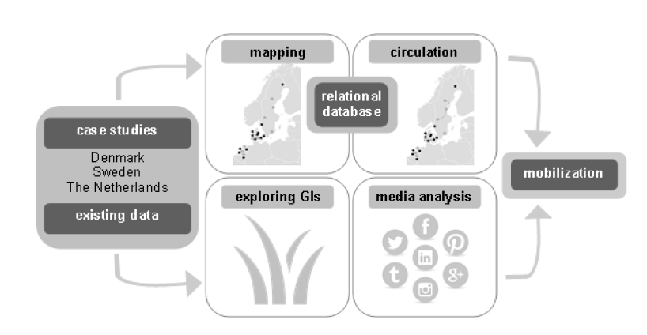
MobGIS - Mobilizing grassroots capacities for sustainable energy transitions: path improvement or path change?
JPI Climate-funded project on grassroots initiatives and innovations
Linköping University – Sweden
Radboud University Nijmegen – Netherlands
Aalborg University – Denmark

Slide 3
Aim and argument
The aim is to describe and analyze the existence and characteristics of Swedish community energy
Argument: community energy is contributing to the Swedish energy transition, but in modest terms. The main achievement is rather a democratization and decentralization of energy production
What are the history, scope, scale, characteristics and activities of Swedish CE?
How can this be understood in relation to existing energy regime and landscape?
Notes:
Work in progress

Slide 4
Methods and material
Mapping of existing community energy initiatives in Sweden
Databases (e.g. electricity certificate system database), research reports, reports from umbrella organizations, branch journals, web searches, web-based survey
E.g. Background information, location, goals, strategies, starting date, legal form, technology used.
Interviews with representatives of initiatives and umbrella organisations
43 interviews
36 different initiatives (two interviewed twice) and five umbrella organizations

Slide 5
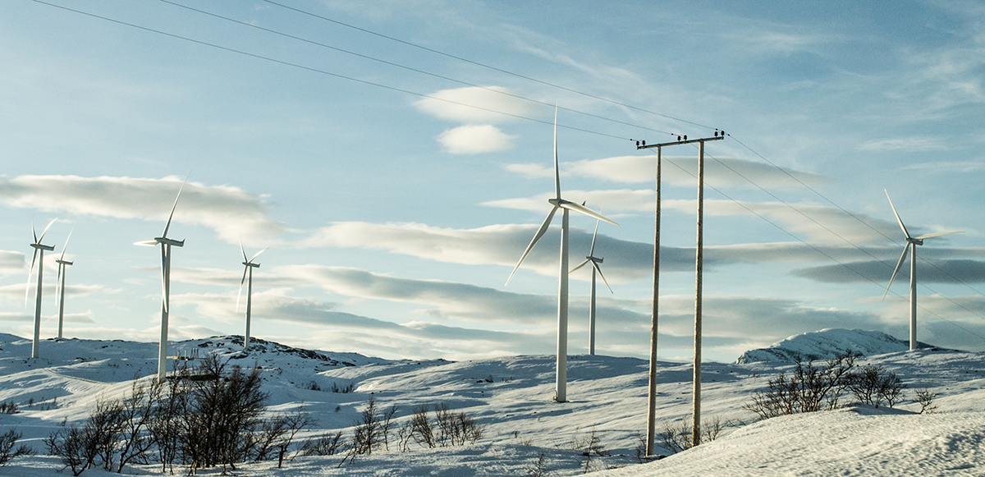
Definition of community energy
“initiatives run by civil society actors (such as charities, not-for-profit organizations, voluntary neighborhood networks and co-operatives) which develop either or both energy saving and renewable energy generation measures.” (Martiskainen, 2017, p. 80).
Initially broad definition
Mainly incorporated associations
No municipal actors

Slide 6
The Swedish energy landscape
Strong municipalities
Planning monopoly, taxation rights, self-governing
Municipal energy companies since mid 1800´s
Liberalization of electricity market in 1996
Electricity market - Hydro power (40%), Nuclear power (40%), Wind (10%) and CHPs (10%)
Heating market - District heating (60%), electricity (24%), biomass and combinations (14%) and 0il (2%)
Notes:
Weak regions
Solar PVs is basically less than 1%
There are more Gis in other countries, around 330 in Netherlands, even more in Denmark calculating the 100s of community owned DH-systems, around 500 in GB

Slide 7
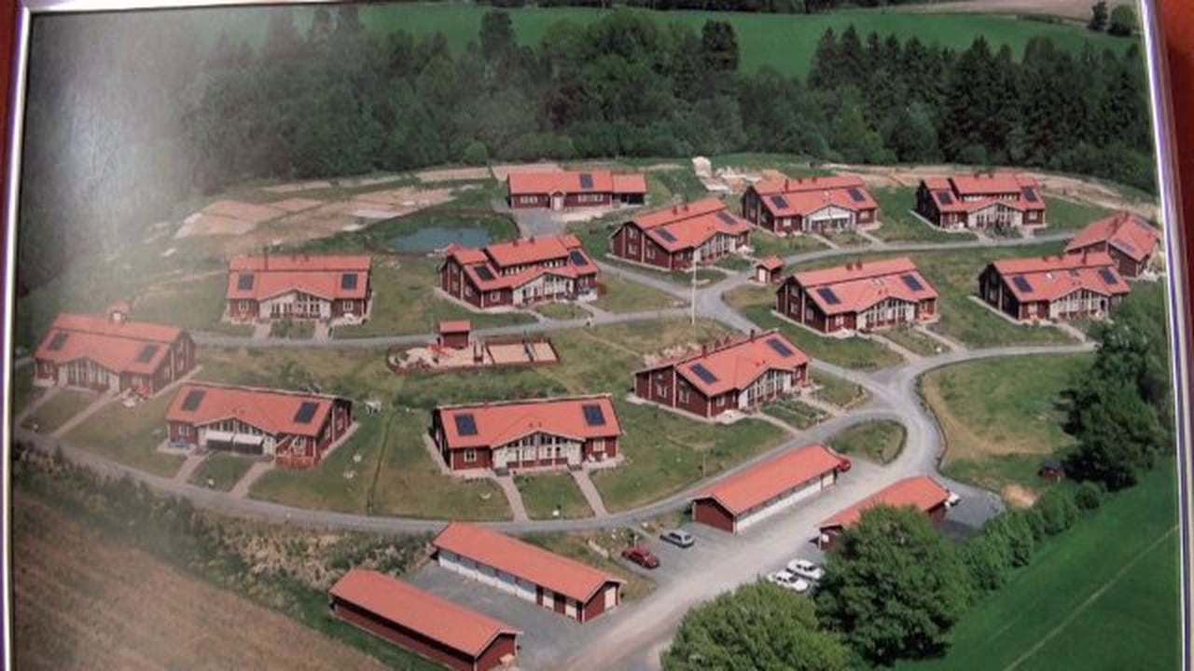
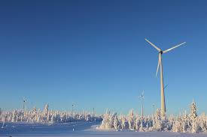
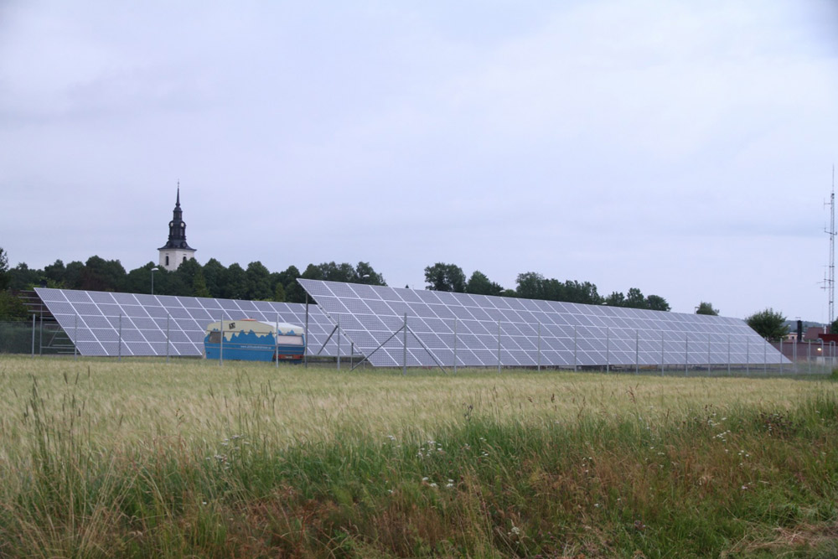
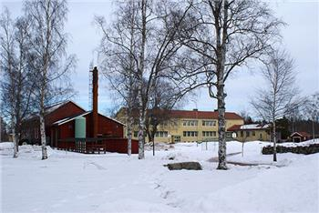
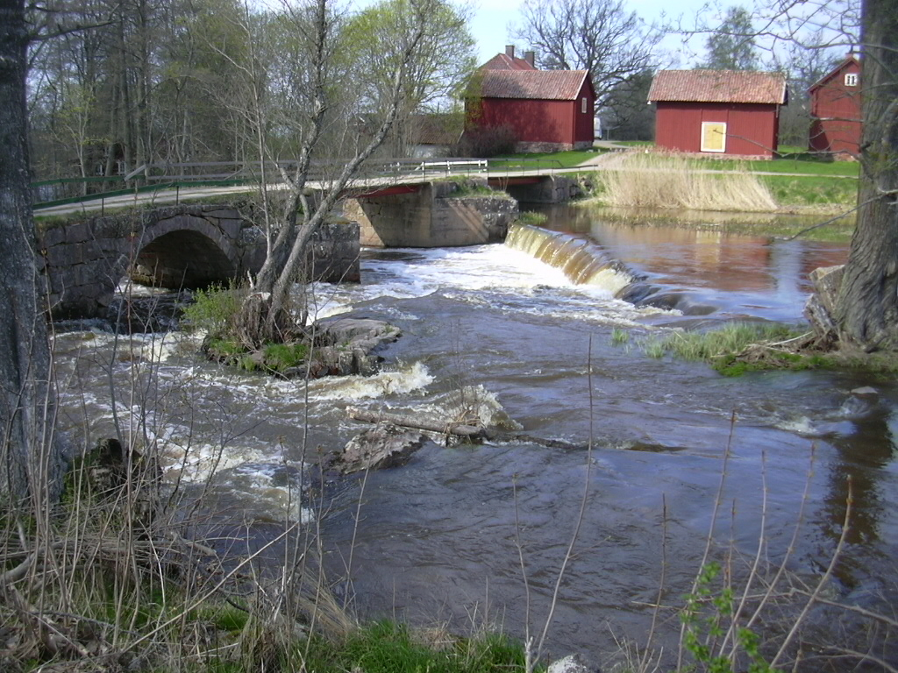
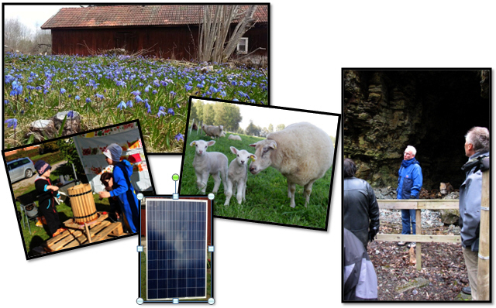
Notes:
These are the various forms of GIs in Sweden, predominanly based on technology – wind, solar PVs, hydro power, local heating, eco-villages and rural sustainable communities

Slide 8
Characteristics of community energy in Sweden
137 GIs – several owns several RE technologies
Total capacity of around 160 MW
78 active wind cooperatives – 20 recently discontinued
32 eco-villages
10 small scale heat systems
9 solar cooperatives
8 rural communities (hydro power, energy savings)
Notes:
Wider definition than Smith & Seyfang

Slide 9
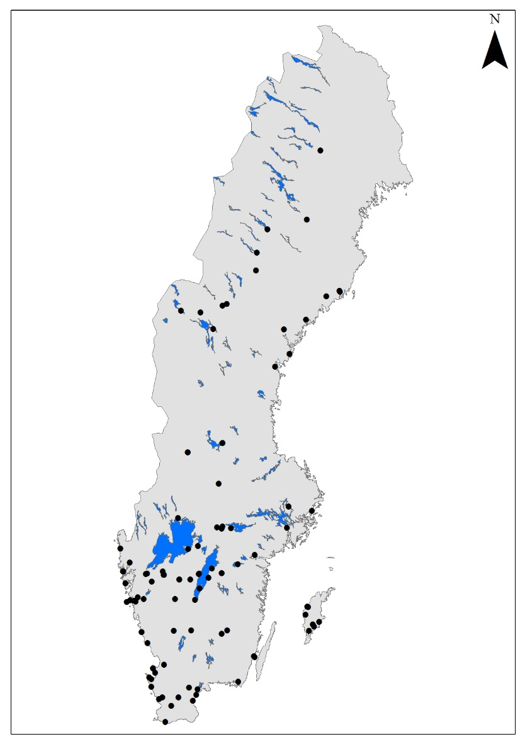
Notes:
The GIs are spread out across Sweden, although most are concetrated in the south. The different techologies are spread out in a similar pattern, but the geographical complexity is added in some cases, wind cooperatives, as the organisation might be located in the south but they own plats spread out in Sweden or especially in the north.
The starting years show some patterns also, and one have to bear in mind that the wind cooperatives are the larges number in quantity. Before 1990, very few, only eco-villages, while the 1990´s was a major boom, due to a few reasons: the electrictiy market was to, or was, deregulated, openingen up a window of opportunity for wind cooperatives. This, combined with national policyes supporting investment in RE, and wind especially, kickstarted that development. IN parallell, which I will talk about more in detail later, is that Eco-villages really boomed in the 1990s, with 30 or so projects running, not all of them sucesfull though. The development calmed down a bit between 2000 and 2005, still with some new projects starting, but it really took of again 2005-2010 – especially with wind power. The reasons seem to have to do with green electricity certificate system maturing and being more in Gis minds, a maturing niche and I would argue a generel increasing trend for climate change awareness. This stopped after 2009, with few new starting, a few discontinuing, especially due to a new tax regulation, restricitng the incentives for memebers to invest as their economic gain were limited. The ones starting are rather a few eco-villages and solar cooperatives.

Slide 10
Wind cooperatives
Started after 1990
Subsidies, tax reductions
Liberalization of electricity market 1996
Started as local initiatives – now many are open for members across Sweden
Innovation limited today
Taxation on wind cooperatives limits growth
20 discontinued last 10 years

Slide 11
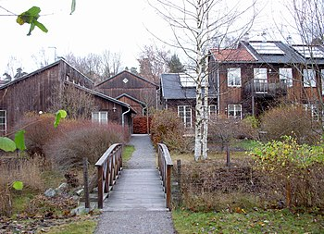
Eco-villages
Eco-villages
Started from 1980´s – first as citizen initiatives, later with more involvement from building companies
Boom in 1990´s
The initial tenants are moving, goals changing
Several initial innovative technical systems are abandoned for municipal ones

Slide 12
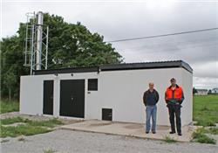
Small-scale heat systems
Small-scale district heating systems
Small companies, open for customers – local initiatives
Rural community, applied for grants, built the system themselves
Small plants – 100-2000 Kw

Slide 13
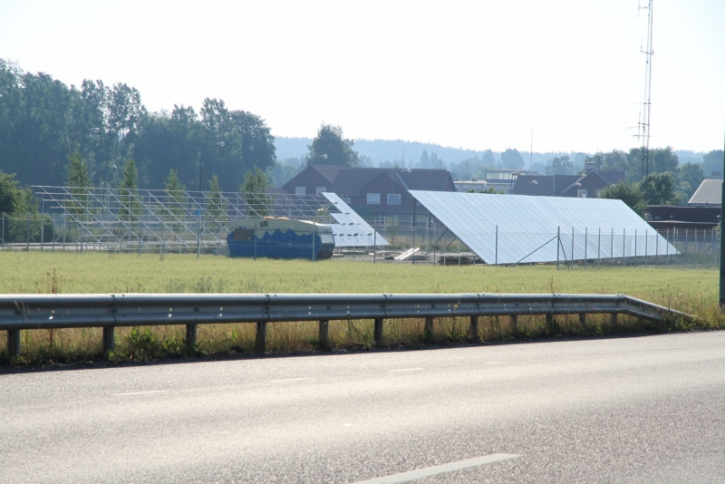
Solar PVs
Similar ownership structure and business model as wind cooperatives
Started since 2009 – inspiration from one particular initiative
Members buy electricity or get dividend
Innovative – organizational and business model

Slide 14
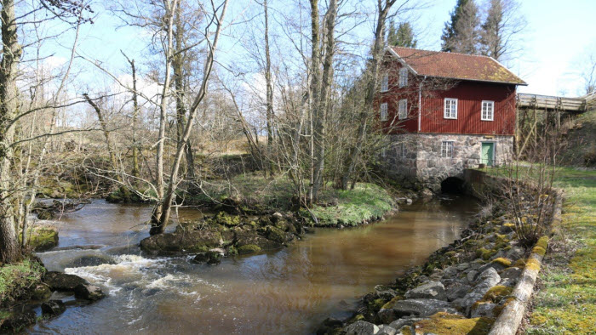
Rural communities
Rural communities
Villages with common goal of sustainability
Champions are central, applying for grants, arranging events
Transition movement
Hydro power – renovation of old plant
Plants built from 1970´s and forward
A new start more than innovative

Slide 15
How can we understand this movement?
Technical innovation rather limited
“Tinkering” and local adjustments
Social innovation most evident among eco-villages
Collective living, common-houses, working groups
The pioneers were technically innovative when starting
Policy influence limited
The cooperatives need to adjust to regime structures

Slide 16
How can we understand this movement?
Rather few initiatives in total
Institutional, systemic, legislative, historical factors
Centralized electricity system
Nuclear power, hydro power, historically low electricity prices
District heating in 283 of 290 municipalities
Strong municipalities
Low carbon energy system already
Community aspects mainly in rural areas – practical cooperation
Economic instruments not focusing on these kinds of organizations

Slide 17
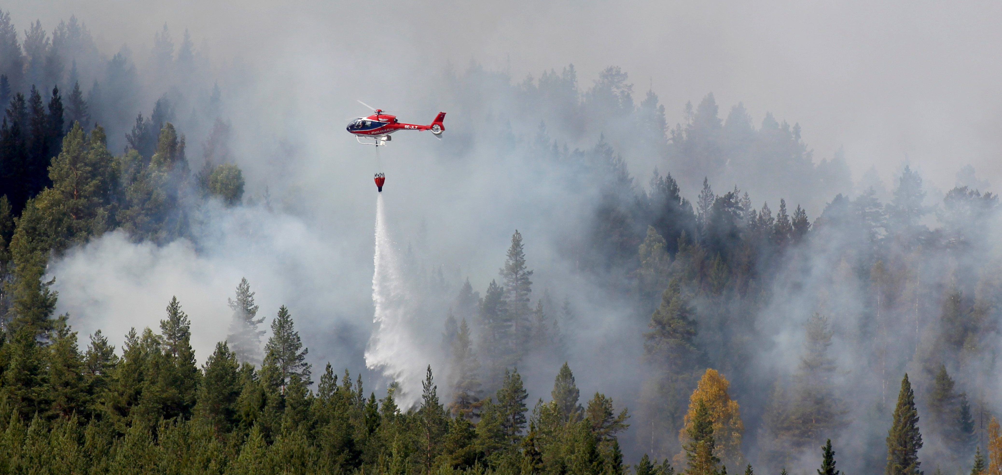
The future
Most innovations and activities among eco-villages
Internet, international networks
Several wind cooperatives have been discontinued
Low electricity prices, technical life span
Policy need to support the initatives
Will climate change continue to be on the agenda?

