Slide 1
The Co-City and Tech Justice
From Urban Commons to Urban Co-Governance, A Social Innovation for the Energy Transition
Christian Iaione
Professor of land use, regulatory innovation, urban law and policy at LUISS Guido Carli University (IT)
Faculty Co-Director of LabGov.City – LABoratory for the GOVernance of the City as a Commons
www.LabGov.City (research labs)
www.Commoning.City (empirical research project)

Slide 2
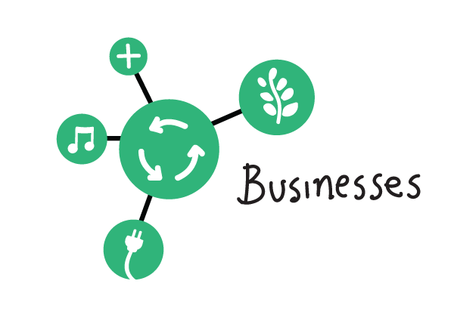
Co-City > Urban Co-Governance
The quintuple helix approach > five urban actors > just and democratic city (building on governance/diffusion of innovation literature)

Slide 3
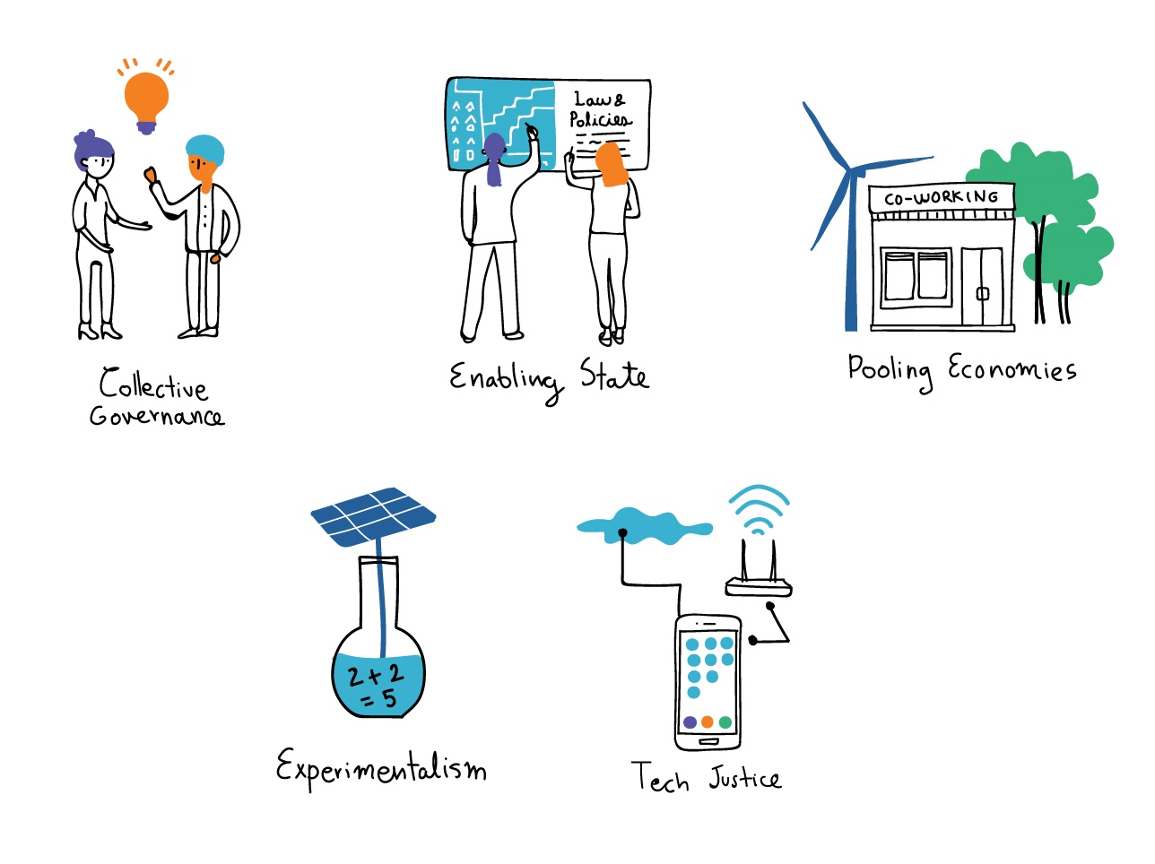
Co-City Design Principles (1)
The five design principles are the dimensions that, in different contexts, may enable the transition from urban commons projects to urban co-governance > Applying Ostrom in the City

Slide 4
Co-City Design Principles (2)
COLLECTIVE GOVERNANCE
This dimension refers to the presence of a multi-stakeholder scheme where the community (organized or not) emerges and partner up with public institutions and the private sector in the management of the urban commons. It also signals the the typology of urban resource, asset, infrastructure that is co-governed.
ENABLING STATE
It expresses the role of the State supporting and making the collective urban management possible.
POOLING ECONOMIES
It reveals the presence of autonomous institutions, managed or owned by local communities, operating within non-mainstream economic systems, such as collaborative, cooperative, circular economies, for the creation of new job opportunities and services in dsitressed neighborhoods or cities.
TECH JUSTICE
Open access to technological and digital urban infrastructure and data is an enabling driver of cooperation and co-creation of urban commons.
EXPERIMENTALISM
This principle links to the presence of a site-specific and iterative bottom-up approach to design legal and policy innovations for the co-governance of the local urban commons.

Slide 5
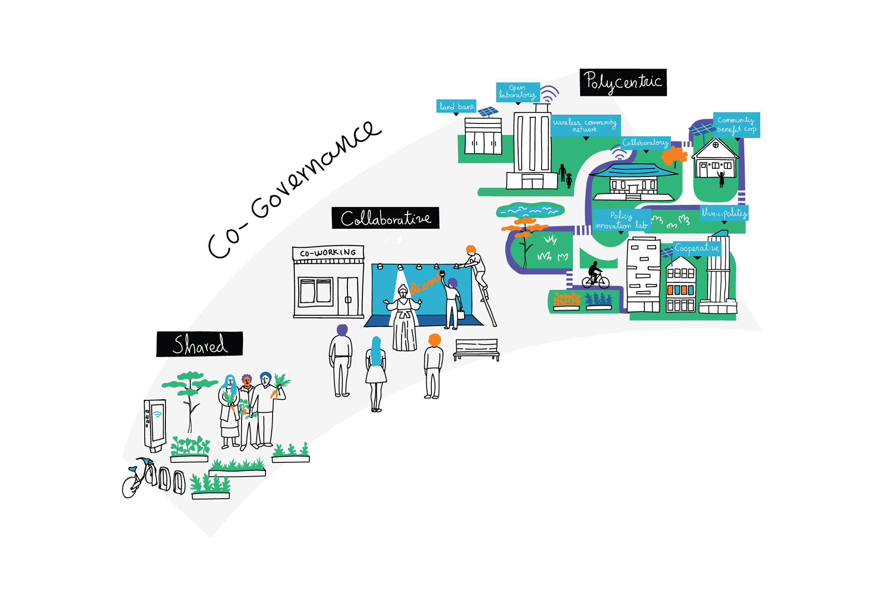
Co-City – Design Principles (3)

Slide 6
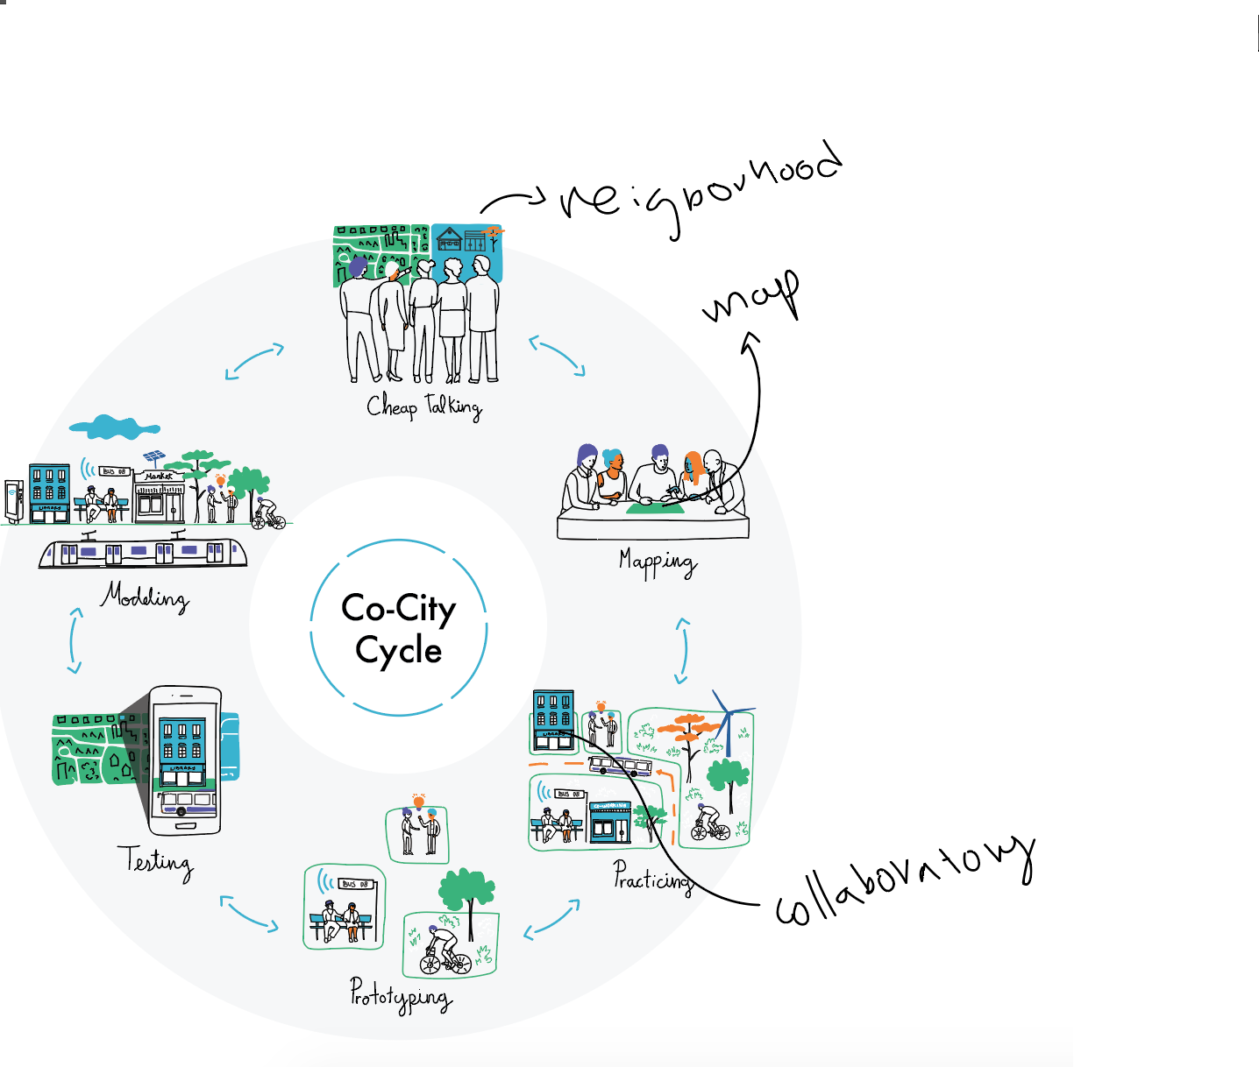
Co-City Project Cycle
Six-step Project Cycle + Five professional skills (an integrated task force)

Slide 7
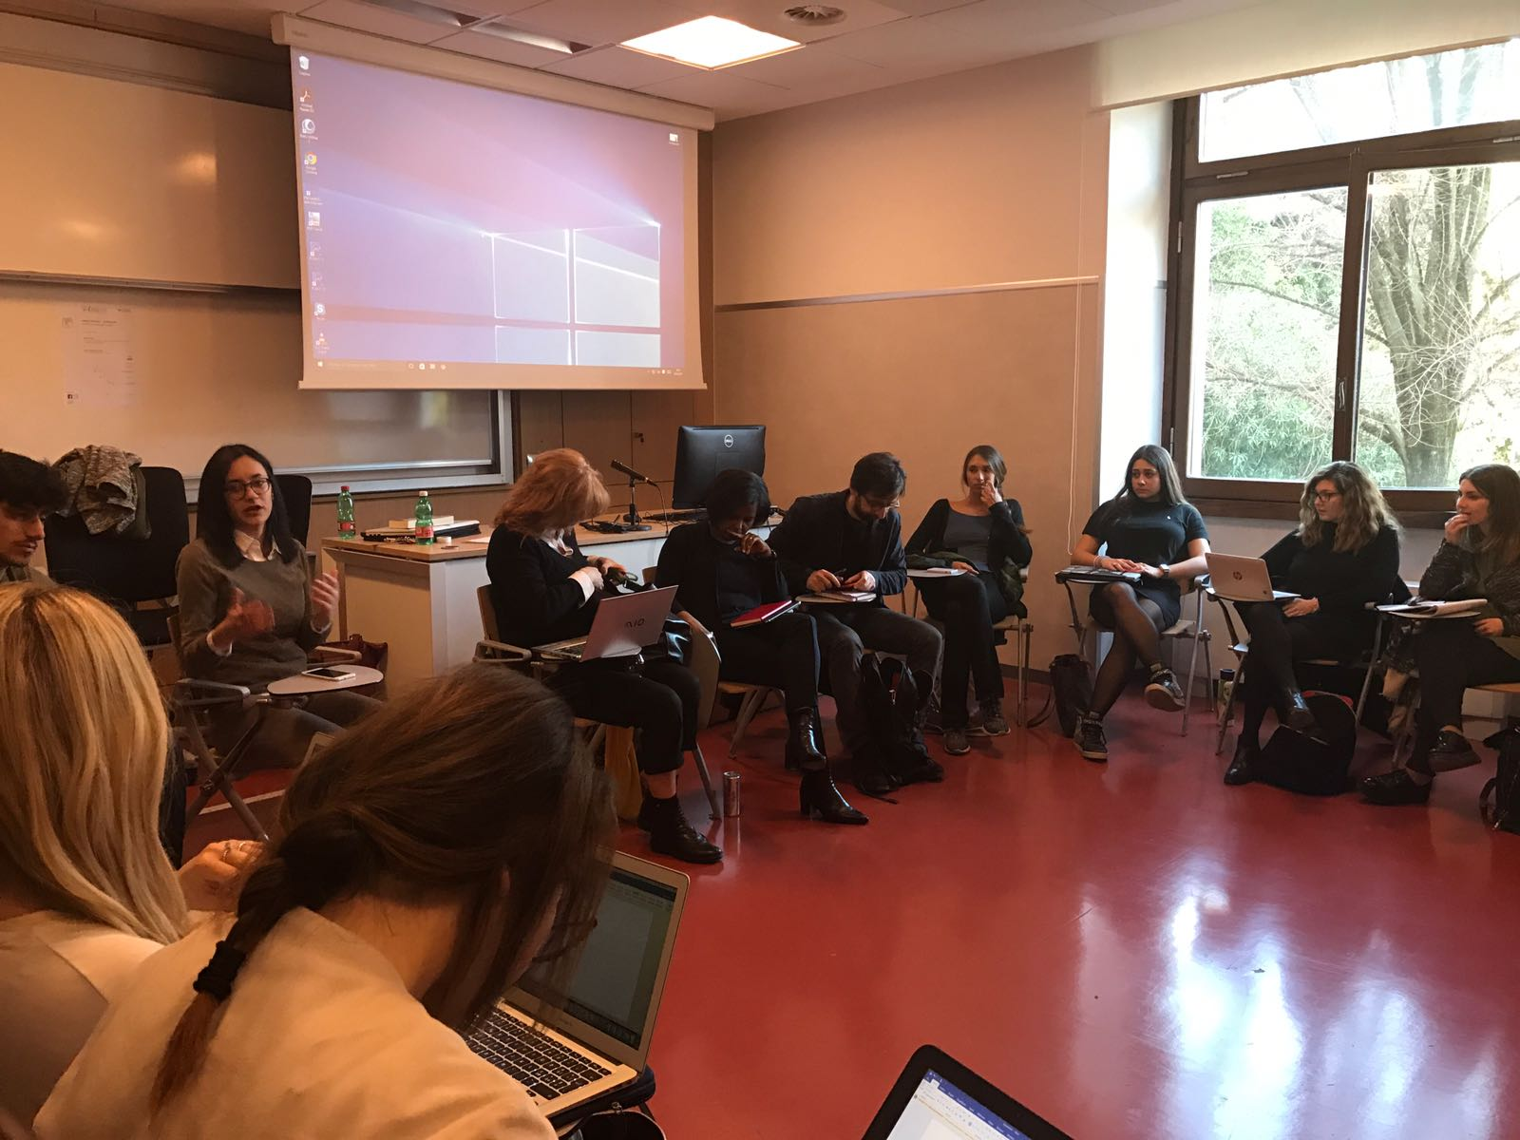
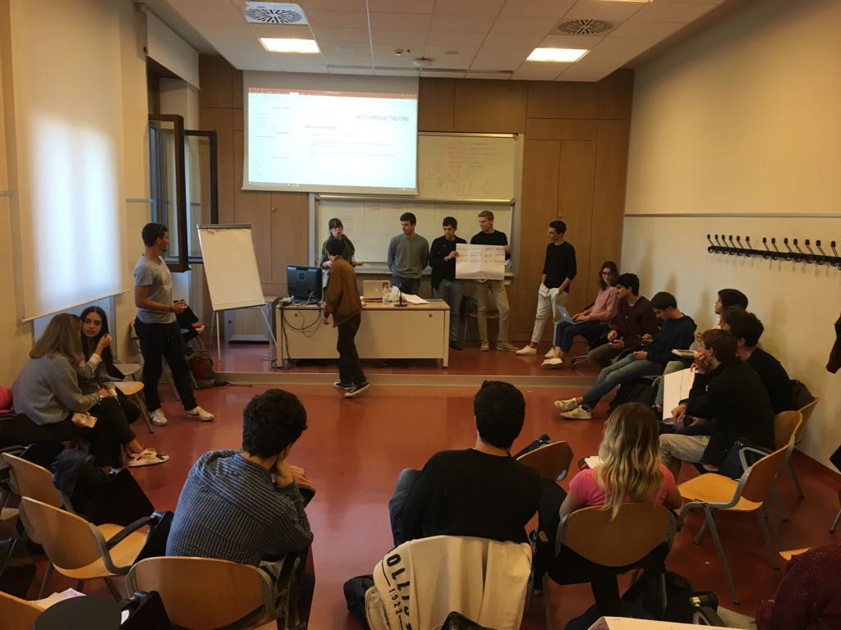
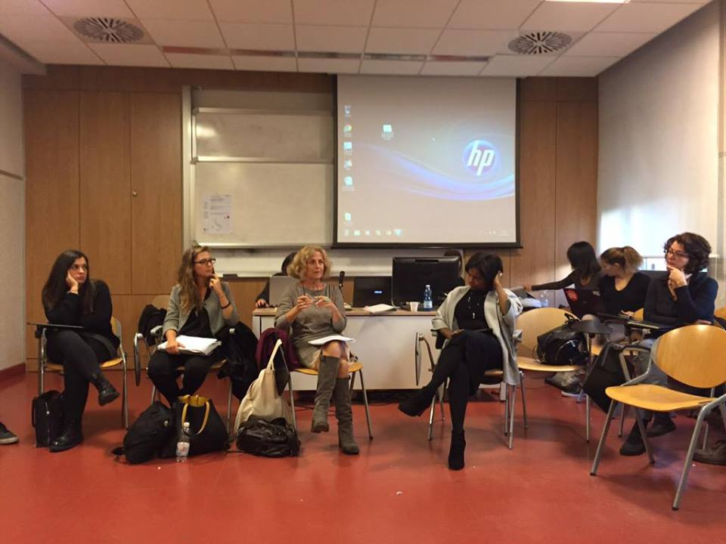
Co-Rome Project
Cheap talking at LUISS University - localizing urban commons and activating local actors (scholars, experts, practitioners) through dialogue interactions.

Slide 8
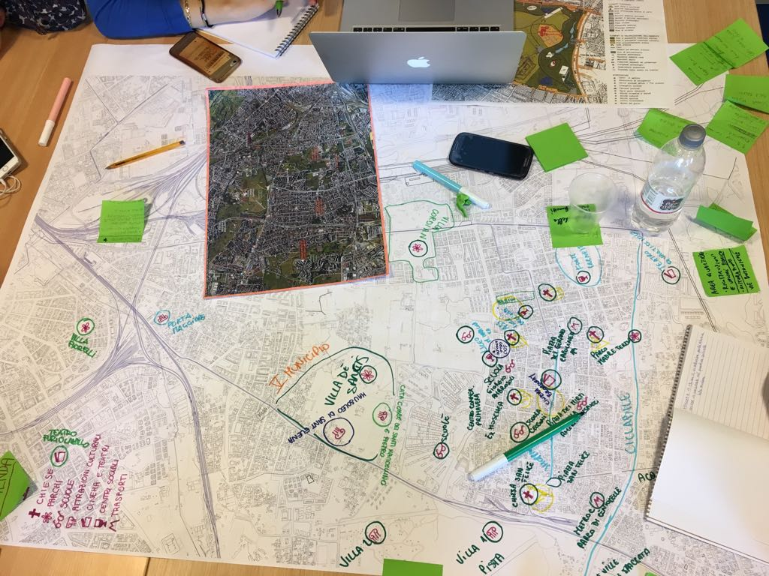
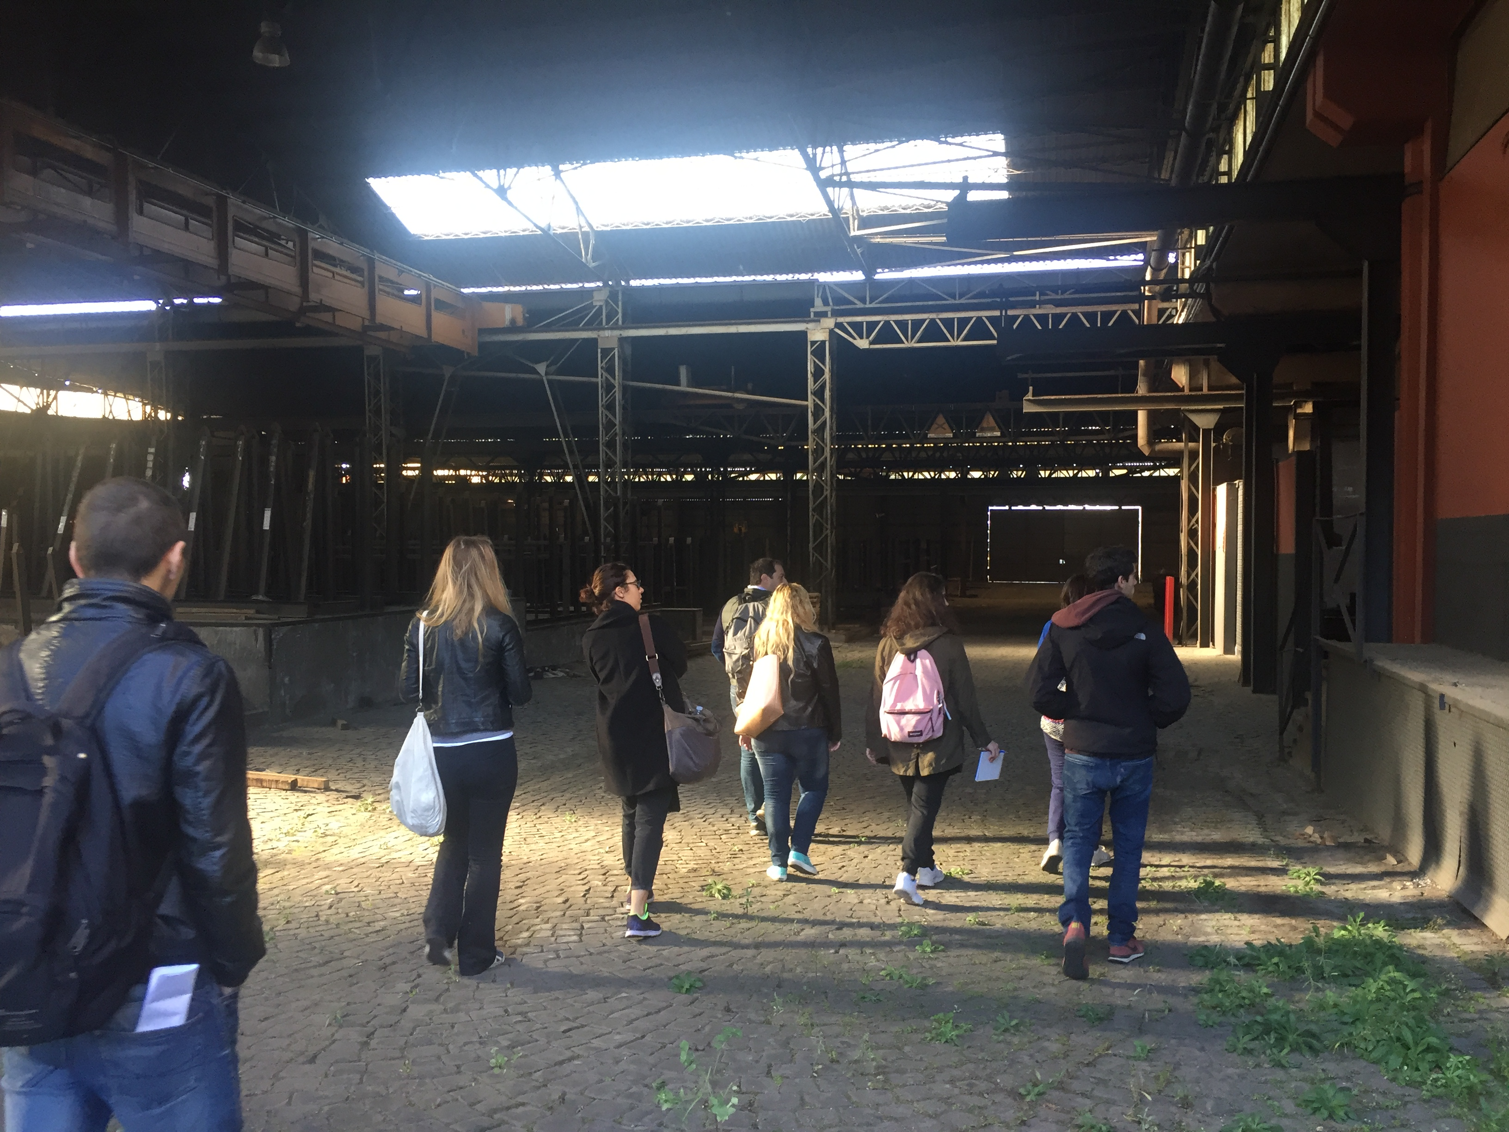
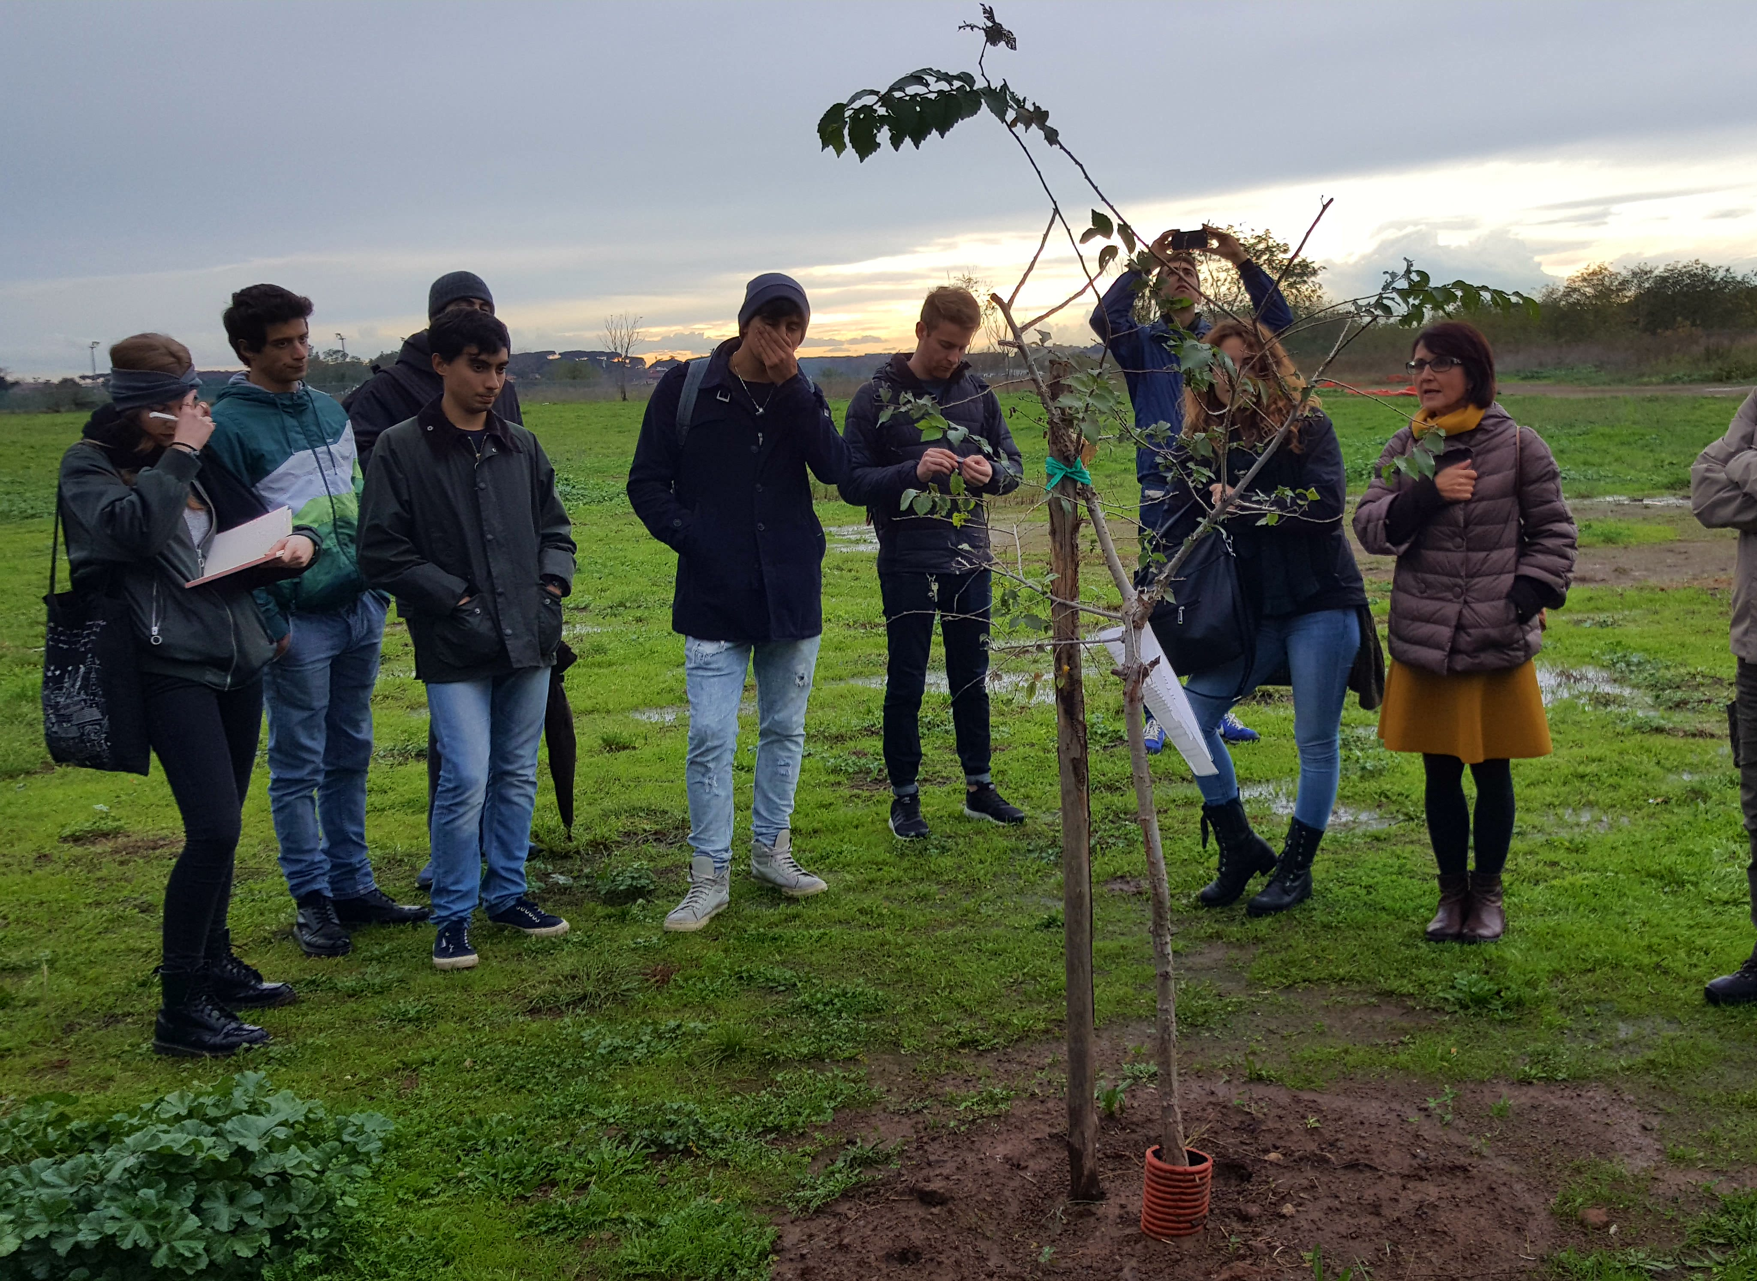
Co-Rome Project
2. Mapping: mapping activities at LUISS University and on field

Slide 9
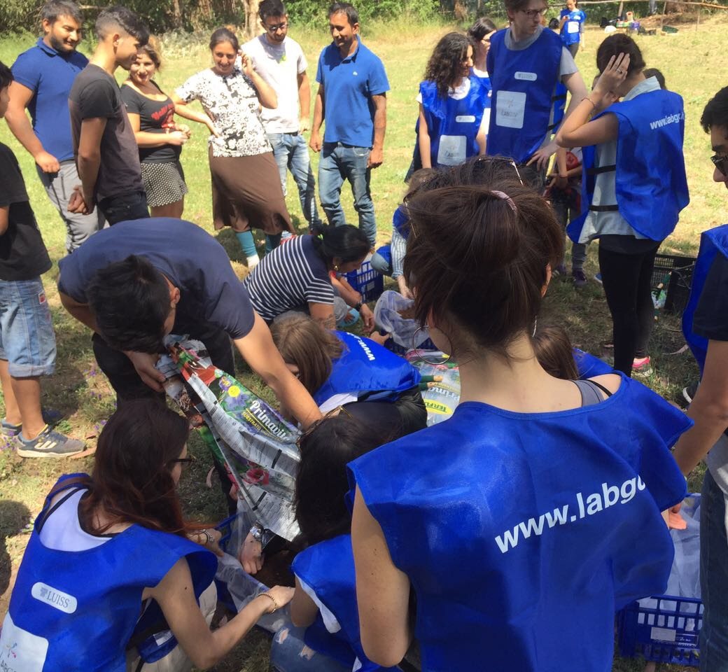
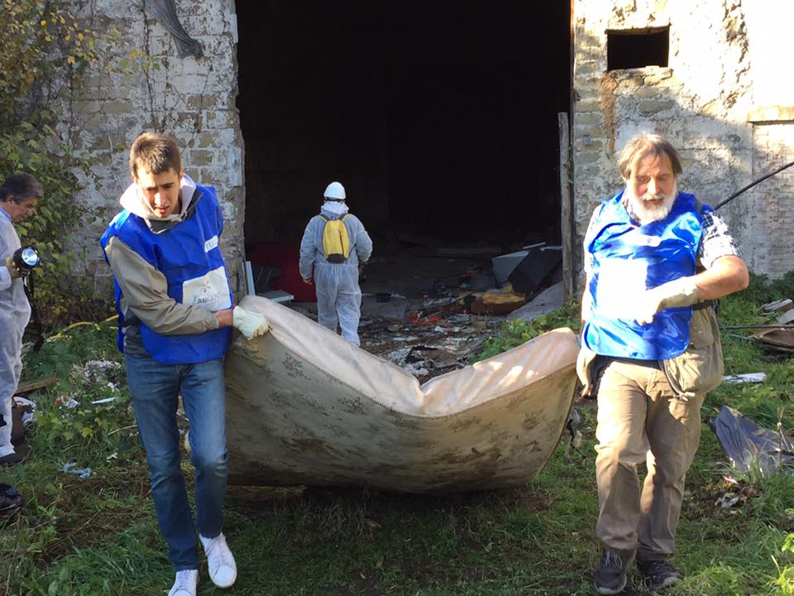
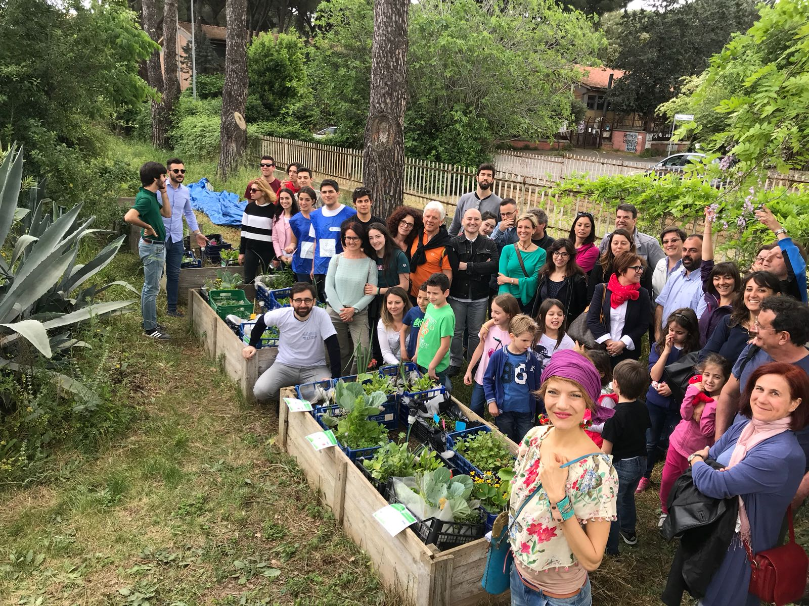
Co-Rome Project
3. Practicing in the Co-District

Slide 10
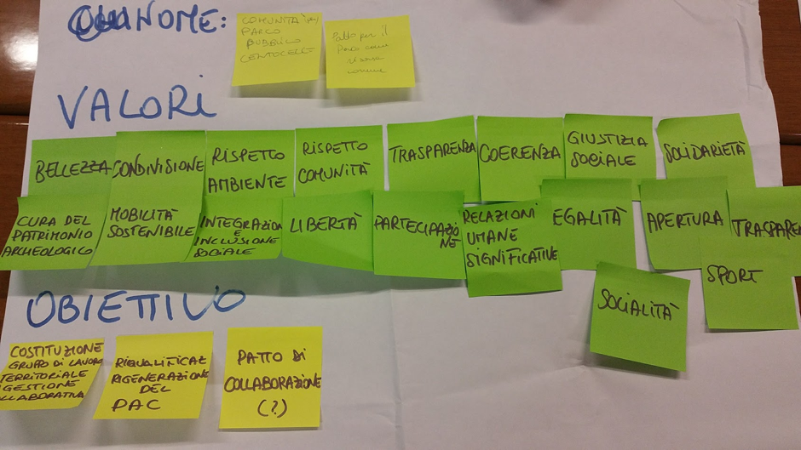
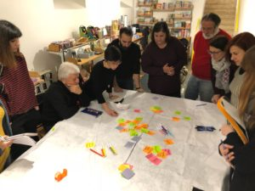
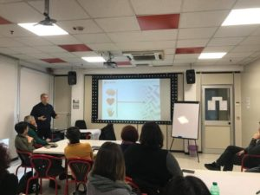
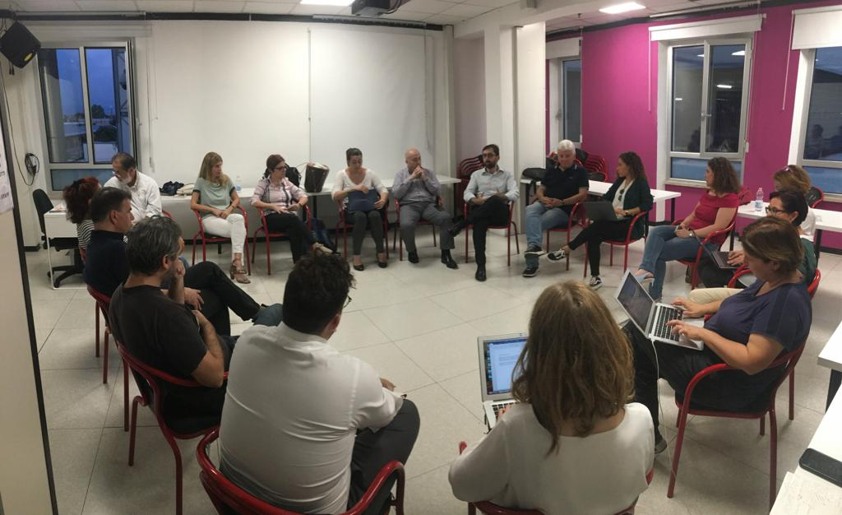
4. Prototyping: co-design labs

Slide 11
A community coop as a ‘hood level multiutility
3 strands of activities of the Community Cooperative of the Rome Co-District:
COMMUNITY ENERGY AND COLLABORATIVE SERVICES
CIRCULAR ECONOMY
CULTURE
CULTURE

Slide 12
Smart Home
Centoc’è
DIGITAL COMMUNITY SERVICES AND INFRASTRUCTURES TO MONITOR THE ENERGY CONSUMPTION

Slide 13
Future Lab (Francesco d’Assisi High School)

Slide 14
Laboratory of circular economy
Co-design lab to incubate projects to reduce energy consumption in the co-district through the use of circular economy (re-use of waste; learning hubs to transfer knowledge on how to use smart district devices for different purposes (security; monitoring) and how can they contribute to save energy in the district)

Slide 15
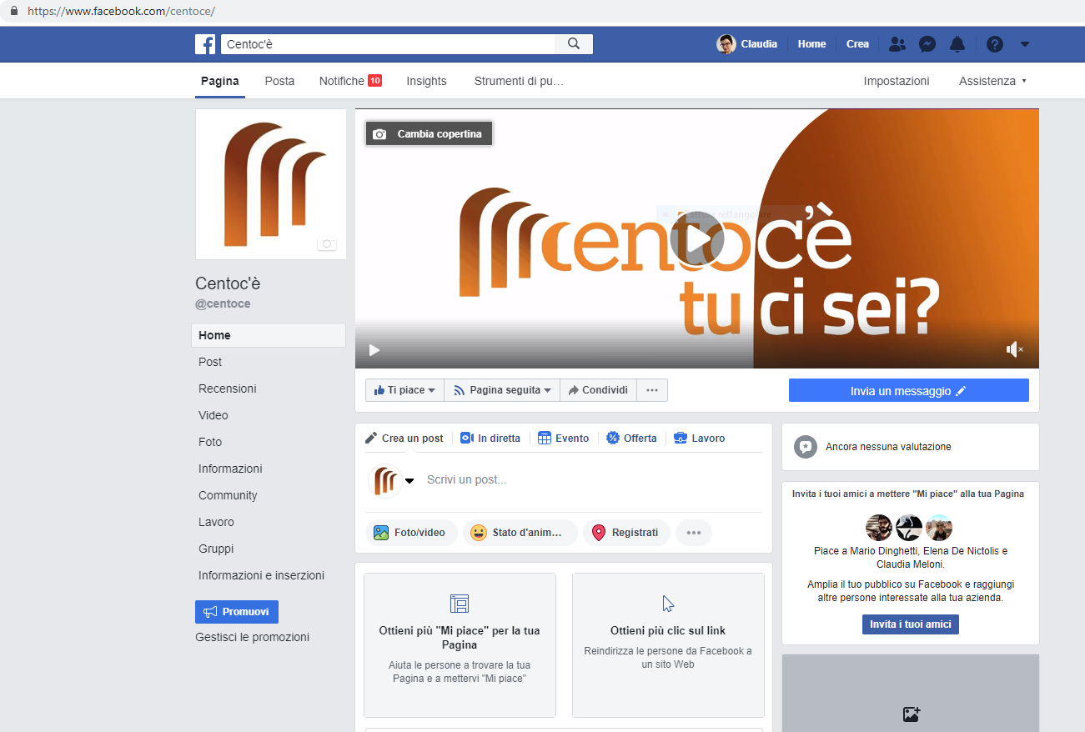
A social community for the Co-District: the Centoc’è platform

Slide 16
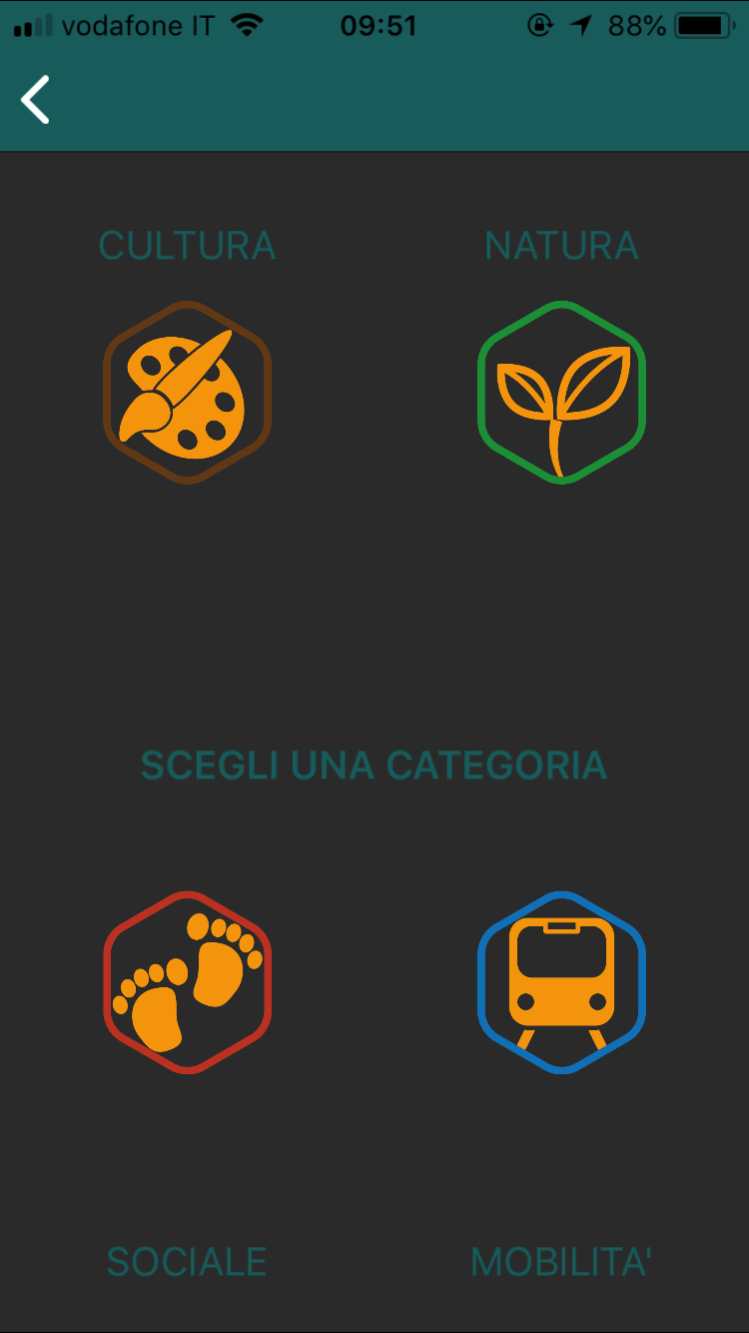
A mobile application to trigger collective action within the neighborhood: the TryBee app

Slide 17
Lessons learned and way forward for the new EU law
Principle of self-organization needs to be restated as the defining principle of innovative and responsible procurement > Urban Partnership on Innovative and Responsible Procurement
New legal tools should be shaped to enable P5s > new public partnerships: public-community > communities as risk takers + reinvestment clause > LTIs investment (finance)
Communities need to be mentored, accompanied, accelerated
Urban experimentation is needed. No need now for a very detailed national legislation. Adaptive and iterative urban law to implement EU law

Slide 18
References
Christian Iaione, Local Public Entrepreneurship, Whashington Global Studies Law Review, 2008
The Tragedy of Urban Roads, Fordham Urban Law Journal, 2010
Sheila Foster, Christian Iaione, The City as a Commons, 2016
Christian Iaione, Elena De Nictolis, Urban Pooling, 2017
Sheila Foster, Christian Iaione, Ostrom in the City, 2018
Christian Iaione, Elena De Nictolis & Anna Berti Suman, The Internet of Humans (IoH): Human Rights and Co-Governance to achieve Tech Justice in the city, forthcoming in Law & Ethic of Human Rights.
Christian Iaione, Elena De Nictolis, Chiara de Angelis & Chiara Prevete, I quartieri come beni comuni. Il caso di Roma. In BENI COMUNI, CONFLITTUALITÀ, E INFORMALITÀ URBANE, Planum Publisher forthcoming 2018.
Co-Rome process is available here: http://co-roma.it/ (IT) and here (EN) http://commoning.city/co-roma/.
Protocollo metodologico per la costruzione di quartieri e comunità collaborative urbane (il protocollo CO-Città) P. Cannavò, C. De Angelis, E. De Blasio, E. De Medici, L. Morlino, E. De Nictolis, C. Iaione, C. Prevete, P. Santoro, M. Sorice, E. Susanna, M. Zupi available at http://www.enea.it/it/Ricerca_sviluppo/documenti/ricerca-di-sistema-elettrico/adp-mise-enea-2015-2017/smart-district-urbano.
Thank you!
ciaione@luiss.it - design@labgov.it

