Slide 1
Non-hierarchic polycentric regimes facilitating intelligent Distributed Energy Systems: The Common-Pool Resource Nature of Renewables
“Local Communities and Social Innovation for the Energy Transition” Workshop European Commission - Joint Research Centre 22-23 November 2018
Ispra, Lago Maggiore, Italy
Maarten Wolsink
Dep. of Geography, Planning and International Development Studies University of Amsterdam

Slide 2
1st Q workshop: Local communities’ SI (social innovation) potential for the energy transition under both a theoretical and practical lens. Starting points
Transforming energy systems: ‘Social Innovations’
This is not replacing technology by another technology,
but rather “institutional change” (includes ‘regime change’) Geels, 2014
Institutions (definition) … behavioural patterns as determined by societal rules…… "the rules of the game in society" North, 1990.
Renewables are natural resources.
Common Pool Resources theory on sustainable resources use (Ostrom) is also an institutional theory

Slide 3
Social-Technical Systems
Power supply system(s) is an STS def. A system be made up of scientific and technological, as well as socio-economic and organizational components.
Transforming this STS into renewables based, zero-carbon is innovation…. ……… including creative destruction
Key innovation is: Move the STS away from centralized design & hierarchical and centralized management

Slide 4
Definition ’distributed’ goes beyond ‘decentralized’
Distributed Generation more broadly: Distributed Energy Resources extended: Distributed Energy Systems (DES) is an electric power source Ackermann, 2001; Dondi et al 2002 - connected directly to the distribution network - at the customer side of the meter

Slide 5
Distributed (renewable) Energy Systems
DES also - distributed storage - internal demand response (DR) - infrastructures: connection and distributed control - of the capacities (storage, generation, transmission), - of energy flows in all directions - of distributed accounting Wolsink, 2019
Geograhically dispersed → huge spatial requirement
Numerous locations → spatial decisions, land use crucial Wolsink, 2018a
Huge variety of systems (social & techno variety)

Slide 6
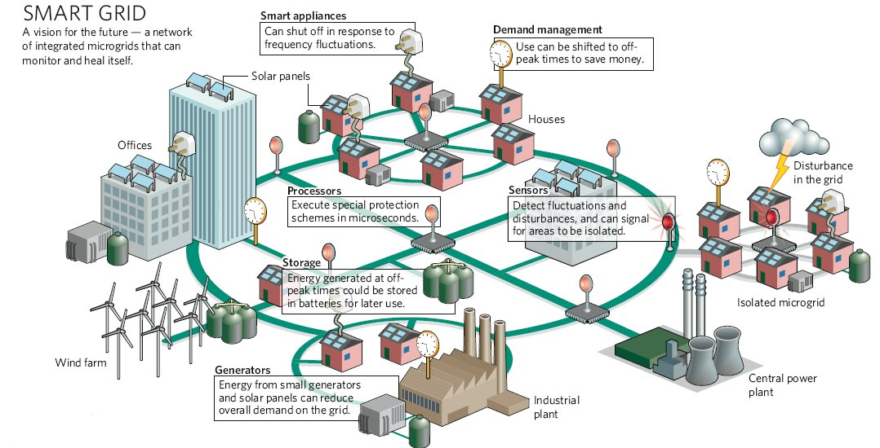
Decisions to take (SA) in the intelligent grid

Slide 7
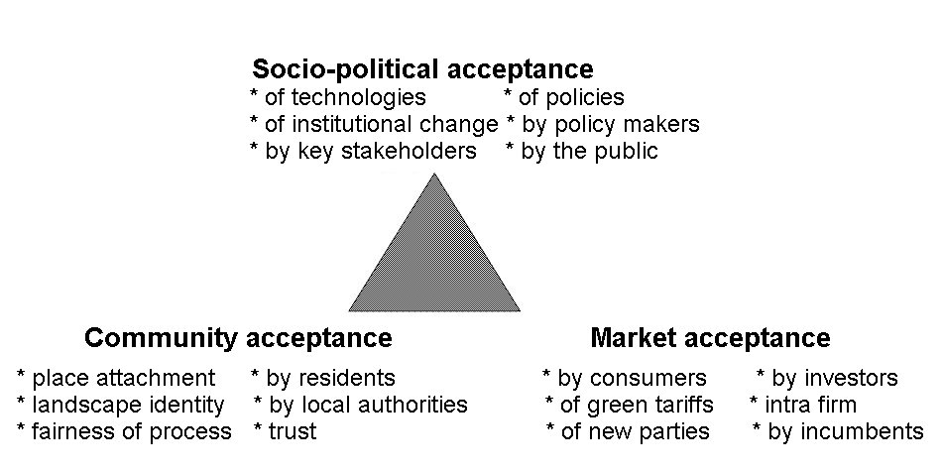
Decisions about all elements ‒ social design (pol., cult., econ.), techno design, space for infrastructures, processes of Social Acceptance (SA 2.0) Wüstenhagen et al. 2007 (≠ public acceptance, SA1.0)

Slide 8
both market acceptance and socio-political acceptance are not currently regarded as key limiting factors, but it is increasing levels of community acceptance that are becoming the key issue. Ellis & Ferraro The Social Acceptance of Wind Energy: Where we stand and the path ahead (p.14) EC, JRC, Dir. for Nuclear Safety and Security doi: 10.2789/696070
is it ?

Slide 9
“The social dimension of Smart Grids” EU JRC report 2013
Citizen acceptance: behavioral response to situations where the public is faced with the placement of a technological object in or close to one's home which is decided about, managed or owned by another;
Socio-political acceptance: involves people's responses to regional, national and international events or policy making, relevant but not necessarily affecting the own situation of the citizens/consumers or their backyard.
?

Slide 10
Social Acceptance, advanced (SA 3.0) Wolsink, 2018b
prosumers institutional conditions information

Slide 11
Centralized Grid connecting RES, storage, DSM Current model / Dominant discourse (in policy and e-sector)

Slide 12
Another way to define SA ‒ in terms of Common Pool Resources theory
Social acceptance of renewables’ innovation is the process of organizing ‘co-production’ Ostrom, 1996; Wolsink 2018a
The inclination to cooperate in varying SES (Social Ecological Systems ←→ STS’s)
among multi-level actors (community, market, policy making)
to establish, maintain, operate
socio-technical systems of power supply and shared use
based on natural resources of renewables

Slide 13
Co-production in DG and DES
- in establishing infrastructure investing, collectively or individually, as input in larger STS
- in cooperation to make required space available / land use for infrastructure / different kinds of property Schlager & Ostrom, 1992
-co-production, distribution and adaptation of consumption (DR) of electricity

Slide 14
General framework Social Ecological Systems, 4 subsystems Ostrom, 2009

Slide 16
Fundamental features
Social-Ecological Systems exist with huge variety (→ essentially geographical variety)
Complex, almost never simple; natural variety and social variety (pluralism, polycentrism)
Internal variety is good (supports resilience)
These notions run counter to common sense views, …… widely held in policy, governments, and technocratics more broadly

Slide 17
How to imagine co-production for this community ?

Slide 18
Intelligent Microgrid-community DG, co-production, storage, DR

Slide 19
Examples RS (Resource system) variables RU (resource units) variables
RS2 System boundaries → boundaries of microgrid
RS4 Human constructed facilities → all infrastructure
RU4 Economic value → peer-to-peer delivery (to collective storage, or directly, download from collective storage)
RU7 Spatial and temporal distribution → all buffering, storage capacity, demand response

Slide 20
ExamplesVariables defined in the Governance Sub-system
GS3 Network structure : network organization instead of company or public agency very important, ‘neither market nor state’ Ostrom, 2010 GS4 Property-rights systems GS5 Operational rules → DR system, distributed accounting (distributed ledgers)
GS8 Monitoring and sanctioning processes Advanced sensors and DR device (intelligent meter)

Slide 22
First DG solar microgrid Brooklyn, NY sept, 2017
DG with peer-to-peer connections
Cooperating prosumers
Operation based on intelligence
Mutual accounting based on internally collected and owned data (→ distributed ledgers)
‘Trust’ institutionalized by blockchain technology

Slide 23
Scheme microgrid based on DG with peer-to-peer delivery Mengelkamp et al 2018
Intelligent meters crucial: in the system sensor + processor + managing device for demand response (e.g. loading vehicles) for controlling use of storage capacity mutual accounting of P2P delivery New development : accounting blockchain ‘credit’ based on Artificial Intelligence Pop et al 2018 → no DSO or energy company control

Slide 24
Social Acceptance SA 3.1 for prosumership and DES in microgrids

Slide 25
2nd Q. workshop: Formulating policy and research recommendations allowing to better exploiting this potential
Institutional settings should foster, create, maintain ‘trust’,
no overruling, consistency, no hierarchy
For co-production ‘Trust’ is crucial: generalized Paxton 2007 + transactional trust; Molm et al 2000
No policy / legal prescriptions: - how to do it - where to do it - who should do it - debunk privileges companies - do not define prosumership as market activity - establishing DGRenewables is a public good, not private - create optimal conditions for cooperation in network organisations

Slide 26
Restrict policy/legislation to general public values only - safety; guaranteed access; ecological values; non-fossil - take away all uniformityand standards for powersupply - abandon all restrictions to collective storage and as a consequence, to P2P delivery
Does it happen ? New elements of STS not accepted easily…… → particularly socio-political acceptance of institutional change
Institutional “lock-in” Unruh, 2000 EnergPol ‘carbon lock-in’
Existing configuration energy sector emerged in history (path dependency)
Including governments / politics
to serve other objectives than current needs
Now vested interests, and centralism is paradigm
→ resistance, creating barriers; → inertia

Slide 27
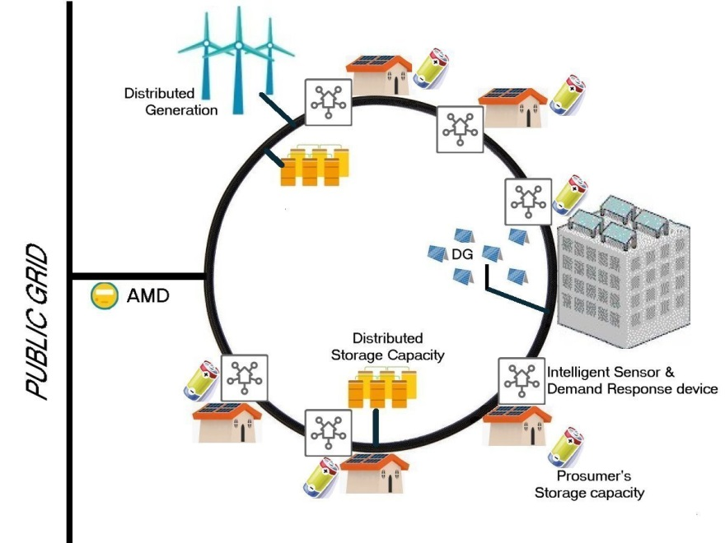
Thank you

Slide 28
References Dondi, P., Bayoumi, D., Haederli, C., Julian, D., Suter, M. (2002). Network integration of distributed power generation. Journal of Power Sources, 106, 1–9. Geels, F.W. (2014) Regime resistance against low-carbon transitions: power into the multi-level perspective. Theory, Culture & Society, 31 (5), 21-40. Mengelkamp, E., Notheisen, B., Beer, C., Dauer, D., Weinhardt, C. (2018) A blockchain-based smart grid: towards sustainable local energy markets. Computer Science - Research and Development, 33, (1-2), 207-214. Molm, L.D. , Takahashi, N., Peterson, G. (2000) “Risk and Trust in Social Exchange: An Experimental Test of a Classical Proposition” American Journal of Sociology, 105, 1396-1427 North D, (1990) Institutions, Institutional Change and Econonmic Performance. Cambridge University Press. Ostrom, E. (1996) Crossing the great divide: coproduction, synergy and development. World Development, 24, 1073-1087. Ostrom, E. (2009) A General Framework for Analyzing Sustainability of Social-Ecological Systems. Science, 325, 419-422. Ostrom, E. (2010) Beyond markets and states: polycentric governance of complex economic systems. American Economic Review 100, 641-672. Paxton, P. (2007) Association Memberships and Generalized Trust: A Multilevel Model across 31 Countries. Social Forces, 86, 47-76. Pop, C, Cioara, T., Antal, M., Anghel, I., Salomie, I., Bertoncini, M. (2018) Blockchain based decentralized management of demand response programs in smart energy grids. Sensors, 18(1), 162. Schlager, E., Ostrom, E. (1992). Property-rights regimes and natural resources: a conceptual analysis. Land Economics, 68, 249-262. Wolsink, M. (2012). The research agenda on social acceptance of distributed generation in smart grids: Renewable as common pool resources. Renewable Sustainable Energy Reviews, 16, 822–835. Wolsink, M. (2018a). Co-production in distributed generation: renewable energy and creating space for fitting infrastructure within landscapes. Landscape Research, 43(4), 542-561. Wolsink, M. (2018b). Social acceptance revisited: gaps, questionable trends, and an auspicious perspective. Energy Research & Social Science, 46, 287-295. Wolsink, M. (2019). Social Acceptance, obsessions with the 'public', and fading objects - The critical need for improved conceptual and methodological rigor Energy Research & Social Science, 49, acc.

