Slide 1
Community (Grassroots) Innovation for Sustainable Energy: Analytical lenses
Innovation and Sustainability
20th March 2017
Sabine Hielscher
Science Policy Research Unit (SPRU), University of Sussex, UK
November 2018

Slide 2
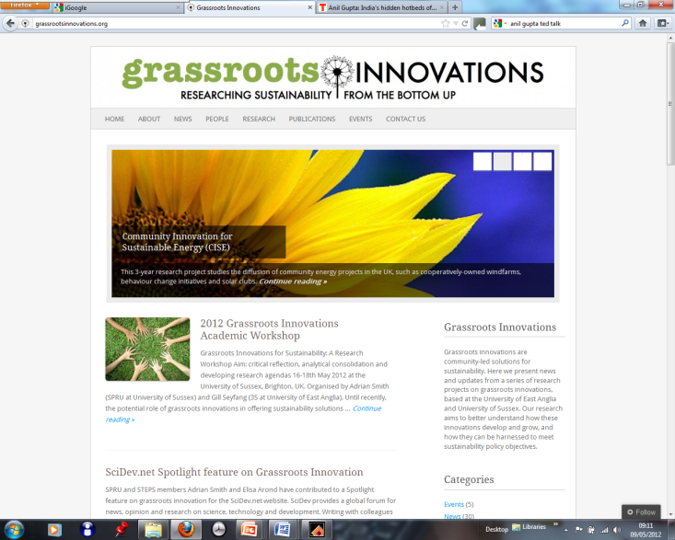
OVERVIEW
Three analytical perspectives, ways to understand grassroots (community) innovation
Empirical work conducted in the UK – community energy (CE)
Three dilemmas that grassroots innovation face
Team of researchers from the University of Sussex and the University of East Anglia as part of the Community Innovation for Sustainable Energy project (2010-2013) https://grassrootsinnovations.org.

Slide 3
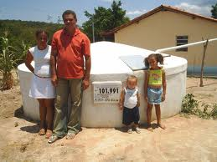
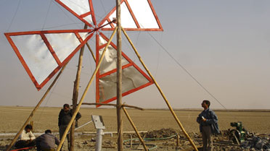
WHAT ARE GRASSROOTS INNOVATION?
Diverse contexts of use:
Grassroots initiatives experiment with practical approaches for sustainability
Innovations coming from the ‘grassroots’ (Gupta 2013), not about bottom up/ top down dichotomy (Smith et al. 2016)
Innovations ‘respond to the local situation and the interests and values of the communities involved’ (Seyfang and Smith 2007)
Existing systems and practices fail to serve people’s needs (Gupta 2013)

Slide 4
OVERVIEW UK: DIVERSE COMMUNITY ENERGY INITIATIVES
ENERGY GENERATION
Brighton Energy Coop: Community solar cooperative
Demand Energy Equality:
DIY solar panels
Eigg Electric:
RE generation, not connected to grid
ENERGY EFFICIENCY
Bristol Green Doors:
Installation of energy efficiency measures: Insulation measures
Open eco-home tours
ENERGY DEMAND REDUCTION & ENERGY JUSTICE
Carbon Conversation
Carbon Rationing Action Groups
Notes:
To start looking at this empirically…

Slide 5
OVERVIEW UK: INTERMEDIARIES WHO SUPPORT COMMUNITY ENERGY INITIATIVES
initiate community work (such as CORE)
maintain community networks (such as the EST)
share experience, good practice, expertise and advice (such as CSE)
lobby and advocate community energy in the policy context (such as LCCN)
provide specific products to community initiatives (such as revolving funds)
create an interface between initiatives and policy-makers/ business actors (such as the CCAA)
create partnerships with community energy initiatives

Slide 6
OVERVIEW UK: INTERESTS FROM POLICYMAKERS
Since 2000s, ‘community’ has become central in government rhetoric
The term has been mobilised flexibly in policy narratives: ‘role in energy transition’ to ‘Big Society’ to ‘social enterprise’
Piecemeal approach: policies often uncoordinated, creating a shifting policy context
Interest mainly rests in scaling-up and rolling-out preferred CE models

Slide 7
THREE ANALYTICAL PERSPECTIVES
Compare three ways of framing (help to understand) the development of community energy – three analytical perspectives
Interpreting relations between policy and CE: How is the CE influencing policy, an how is policy attention shaping the development of CE? In relation to more transformational possibilities
Highlight different processes and forms through which CE have been influential
Draw on the sustainability transition literature: Attempting to explain niche developments (CE initiatives) and regime transformation (existing energy systems)

Slide 8
FIRST PERSPECTIVE: STRATEGIC NICHE MANAGEMENT (KEMP ET AL. 1998)
Analysis focuses on:
Sharing and aggregation of learning
Networking & institutional infrastructure
Shared visions
Innovation becomes robust enough to influence or displace existing energy regime
Offering effective solutions for sustainable energy
Smith, A et al. 2016 A Making the most of community energies. Environment and Planning A

Slide 9
STRATEGIC NICHE MANAGEMENT ANALYSIS: CE ACTIVITIES
Accumulation & aggregation of practical knowledge and technical experience: Toolkits, how to guides, case studies, etc.
Developing standard model for rolling out CE – cooperative model
Offering practical and credible energy solutions to policymakers

Slide 10
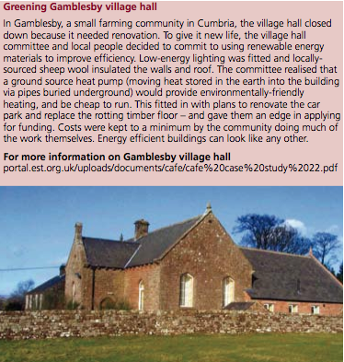
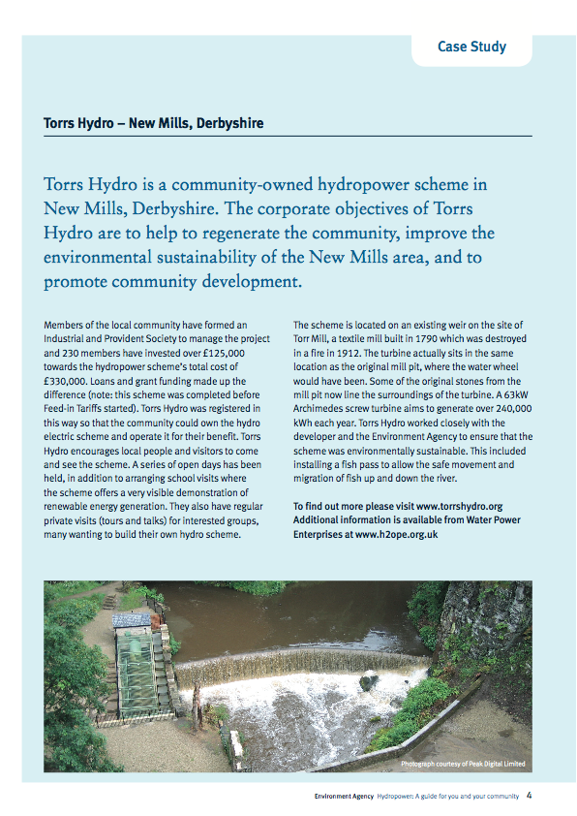
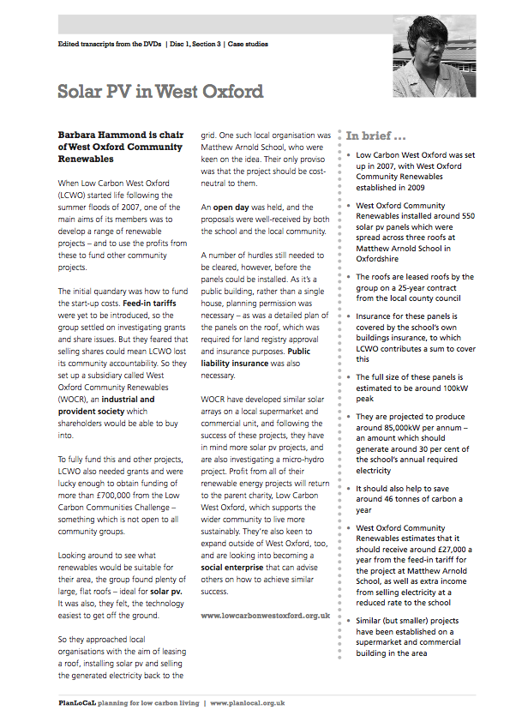
STRATEGIC NICHE MANAGEMENT ANALYSIS
PERSPECTIVE FAILS TO ACKNOWLEDGE
Diverse set of energy activities not included in standard models
Not all experience can be dis-embedded and turned into mobile lessons
Transfer of knowledge grounded: face to face interactions, building of trust and confidence
Scarce resources means networks are fragile
Enormous difficulties involved in finding a ‘common or coherent voice’: Disagreements over exactly what the CE sector is trying to achieve

Slide 11
SECOND PERSPECTIVE: NICHE POLICY ADVOCACY (SMITH AND RAVEN 2012)
Analysis focuses on:
Political dimensions of niche developments: Advocacy and political work
Discursive activities to convince policymakers to support CE activities
Activity that make niche solutions matter and spread
Smith, A et al. 2016 A Making the most of community energies. Environment and Planning A

Slide 12
NICHE POLICY ADVOCACY ANALYSIS: CE ACTIVITIES
Coalitions of groups advocating for CE
Developing credible and compelling narratives about how well CE is performing
Skillfully aligning CE performance with prevailing policy discourses, utility needs and local authority interest
Smith, A et al. 2016 A Making the most of community energies. Environment and Planning A

Slide 13
CE AS PART OF WIDER ENERGY MIX?
“The new pot of money is a useful first step in helping more people to generate their own clean power, but more needs to be done if we are going to make community projects more than a sideshow in the UK’s energy mix.” (Friends of the earth)
“12 months prior to cuts to the FIT… community groups and schools installed 209.7MW of new solar PV. In the 12 months after the cuts that fell radically – to just 1.4MW” (Brighton Energy Coop blog, drawing on OFGEM)

Slide 14
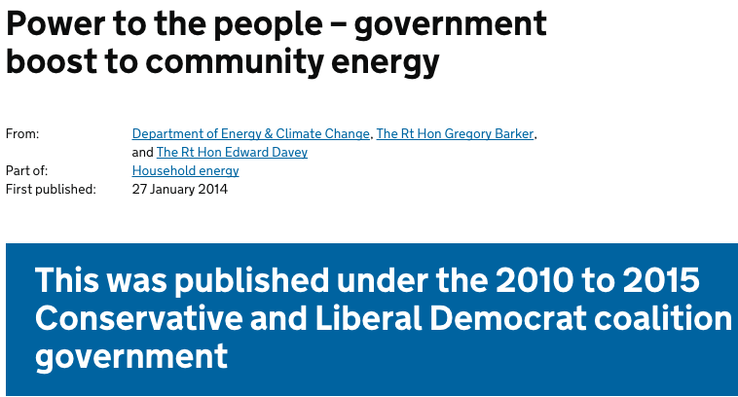
NICHE POLICY ADVOCACY
PERSPECTIVE FAILS TO ACKNOWLEDGE
Not all wish to scale: professionalization and alignments with conventional energy policy discourses
Limitations to lobbying: over more challenging issues of opening energy markets

Slide 15
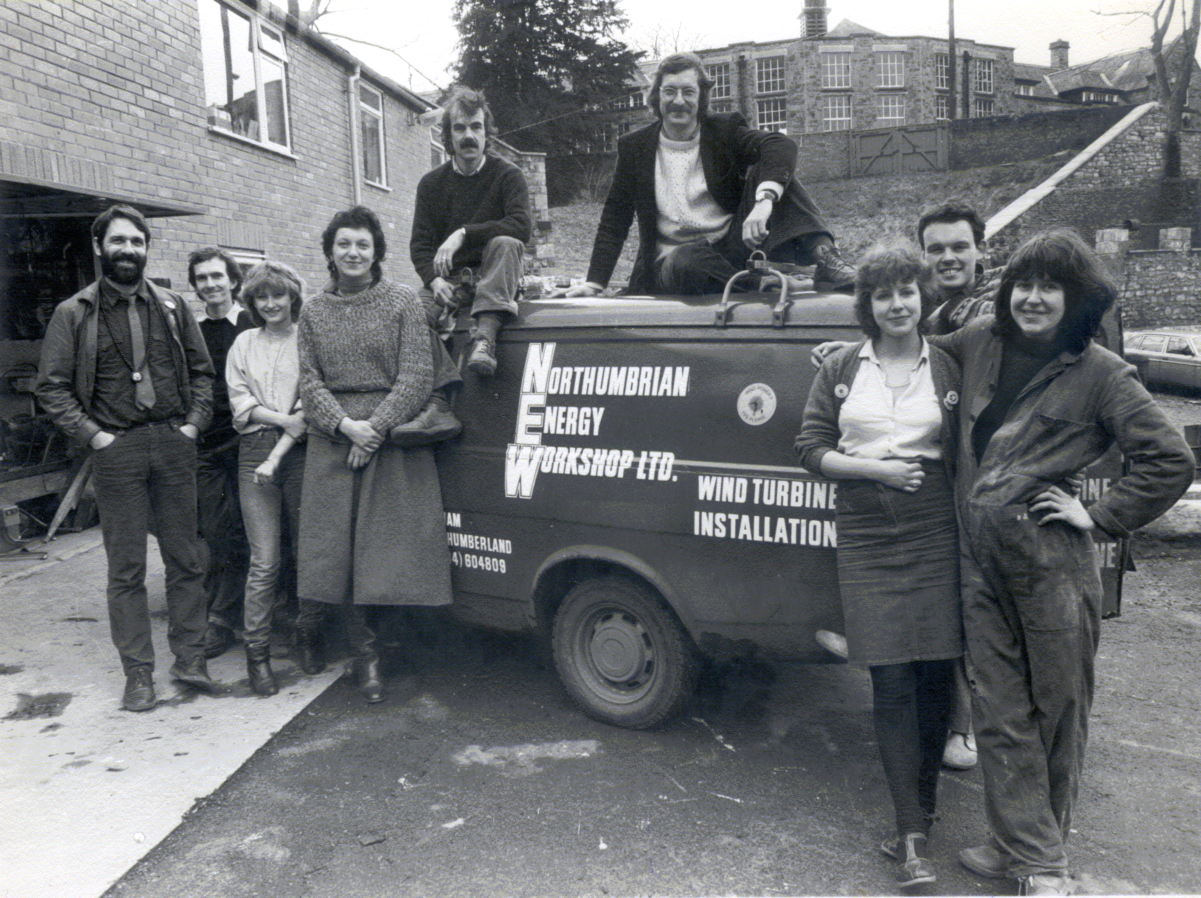
THIRD PERSPECTIVE: CRITICAL NICHES (ADAPTED FROM RATTO 2011)
Analysis focuses on:
CE is not solely understood in terms of instrumental solutions, nor convincing others such solutions matter
But rather ways niche challenges regimes conventions
Spread critical insights and transformative politics
Smith, A et al. 2016 A Making the most of community energies. Environment and Planning A

Slide 16
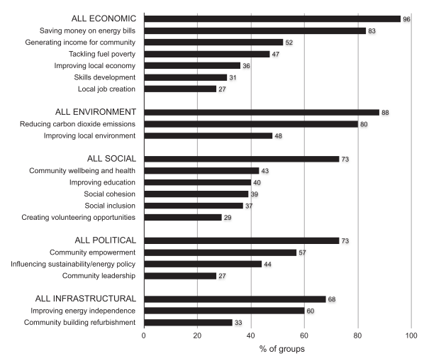
DIVERSE AIMS LINKED TO CE
Not only address: problems of carbon emissions, demand reduction, and market competition
Our survey of 190 CE groups identified political, social, economic, and infrastructure objectives – do not align all with policy aims
Seyfang, G., Park, J.J. & Smith, A., 2013. A thousand flowers blooming? An examination of community energy in the UK. Energy Policy, 61, pp.977–989.

Slide 17
CRITICAL POLTICAL AND SOCIAL ISSUES
CE projects identifying limits to changing energy systems: planning, regulations, etc.
Critical issues of exclusions, social justice, narrowness of funding criteria become visible
The critical niche perspective highlights experiences provoking debate about, for instance, how citizens are involved in current energy systems
Smith, A et al. 2016 A Making the most of community energies. Environment and Planning A

Slide 18
THREE DILEMMAS THAT GRASSROOTS INNOVATION FACE
Community energy initiatives, like all civil society projects, still face immense challenges in surviving, let alone diffusing
Draw on three dilemmas - common to grassroots innovations historically and comparatively, looking at examples from across the UK, India and Latin America

Slide 19
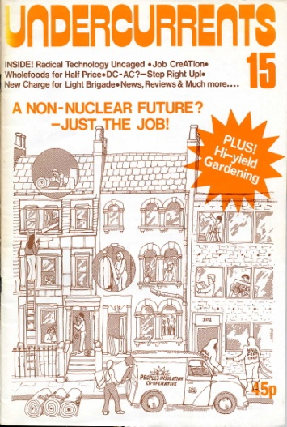
THREE DILEMMAS THAT GRASSROOTS INNOVATION FACE
Attending to local specificities whilst simultaneously seeking wide‐scale influence;
Being appropriate to existing situations that one ultimately seeks to transform;
Working with project‐based solutions to goals that require structural change

Slide 20
SUMMING UP
Sometimes it’s more about the community than the energy - policymakers need to be sensitive to the fact that CE projects may be addressing multiple policy agendas
Sudden policy changes can have dramatic effects on the viability of different community energy projects - there is a need for a long-term perspective
Community energy is neither a single entity nor a straightforward lever for government to pull – the community energy sector is not a single thing to be instrumentally governed

