Slide 1
Citizens energy communities: social innovation potential for Europe’s energy transition
Presentation for JRC Workshop on energy communities
by Josh Roberts, Advocacy Officer
22 November2018
josh.roberts@rescoop.eu / @AttyforEarth

Slide 2
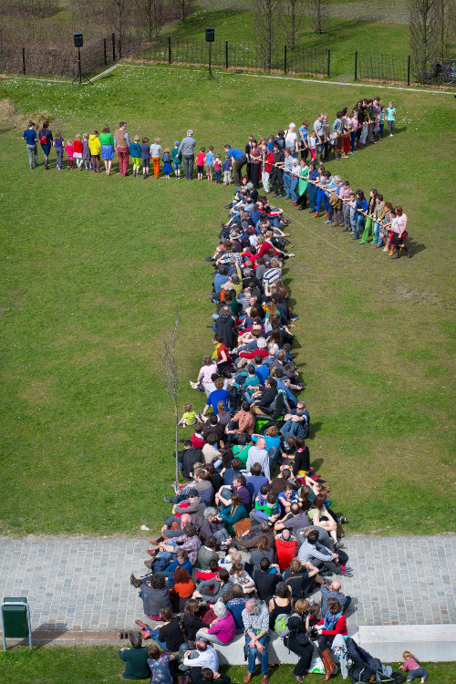
Who do we represent?
Renewable Energy Sources cooperatives, Community power, or community energy initiatives (i.e. energy communities)
Groups of citizens who cooperate on RES or EE
Production
Supply
Distribution
Storage
Services
E-transport
Legal entity < ICA principles

Slide 3
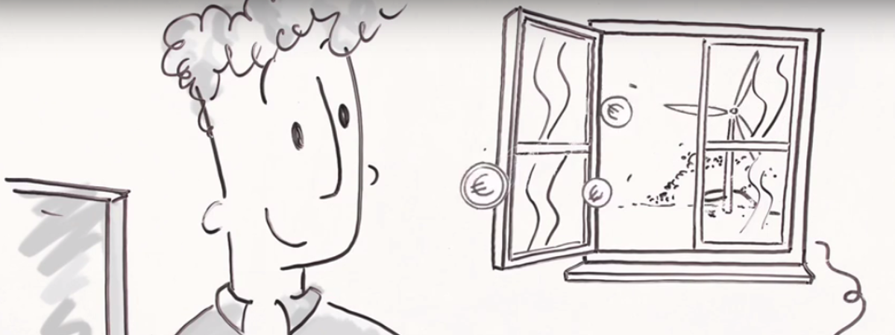
REScoops: a different way to do business
Voluntary & open membership
Economic participation
Democratic ownership
Autonomy and independence
Training & education
Cooperation amongst cooperatives
Concern for community

Slide 4
Just some of the benefits of energy communities
1 revenues from local renewables to meet local needs
Local supply of cheap, clean renewables
Renovation of local infrastructure
Buildings renovation
Energy poverty
Housing needs
Electrification of transport
Etc.
2 Collaboration between local actors
3 Democratic community ownership
4 A gateway drug into the energy transition: benefiting the system in time of change

Slide 5
Hvide Sande Community Foundation, Denmark
Established by local tourism association, along with local unions, industry and utilities
Established community foundation to use revenue from 3 MW wind turbine to renovate harbor
Foundation owns 80% of the project
20% owned by citizens
Association represented by local members, with independence from establishing members
Harbour benefits from annual rent of DKK 4.8 million
Contributes €1.2 million per year to local development

Slide 6
Community energy in Scotland
Partnership between charities: Berwickshire Housing Association + Community Energy Scotland
Expected revenue: 30 m to around 500 homes over next 10-15 yrs
Financing: supported by loans from Renewable Energy Investment Fund and bank loan

Slide 7
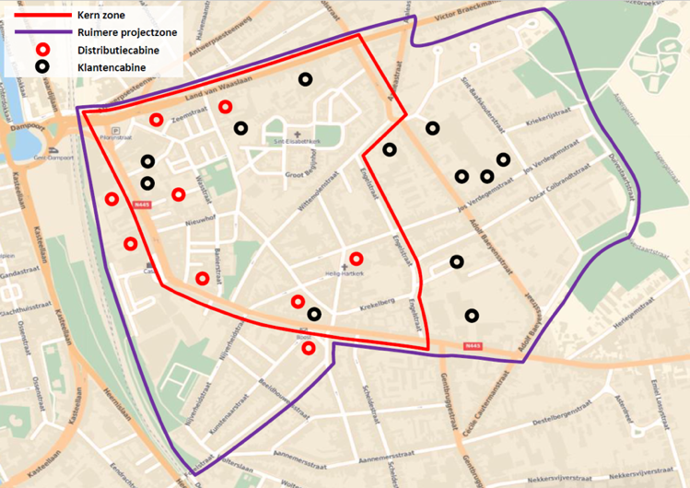
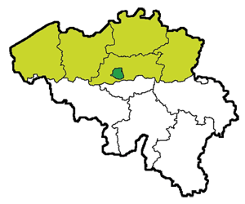
WiseGRID pilot site Ghent
Main demo site Flanders : Sint-Amandsberg,Ghent.
Neighborhood with 2.500 residents.
The WiseGRID demonstrator will join an initiative of the city of Ghent, DSO Eandis, Energy supplier Ecopower and REScoop Energent in ‘Buurzame stroom’.
7
This project has received funding from the European Union’s Horizon 2020 research and innovation programme under the grant agreement No 731205.

Slide 8
Financing energy poverty: Micro-donations on energy bills
Energy consumers can donate 0,01 €
for each kWh consumed
A household consuming
3 000 kWh per year...
...donates 30 € per year, 10€ after tax reduction
Donations are then disbursed to local fuel poverty mitigation programs

Slide 9
Financing energy poverty: Allowing generators to donate
Allow energy producers to donate the money they earned by selling their energy produced in surplus to an energy supplier
1. Energy surplus bought by Enercoop (or another supplier)
3. Donations disbursed to local fuel poverty mitigation programs
2. Money given in exchange is donated to Énergie Solidaire

Slide 10
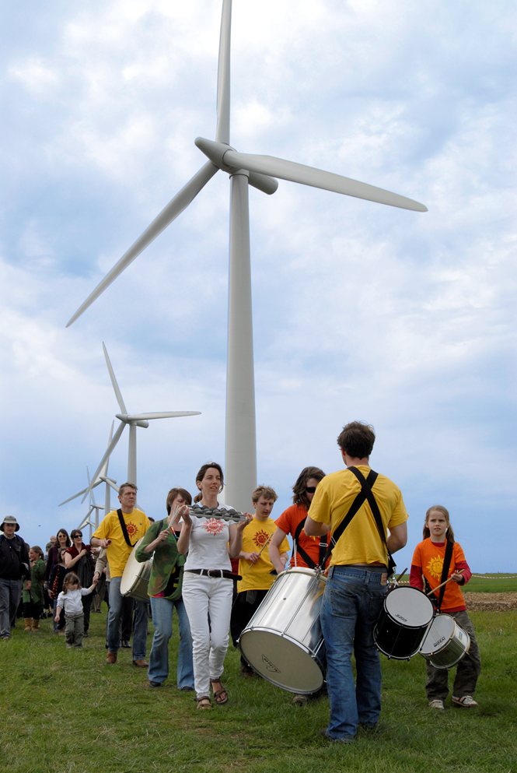
Current challenges
Practical
Governance, decision making efficiency
Lack of information, reliance on volunteers
Access to finance
Policy
Unstable / changing national support schemes for renewables towards more market-based system
No recognition of / plan for supporting renewable energy communities
Overburdensome licensing requirements / barriers to competition
Complex administrative and regulatory burdens / procedures (e.g. planning, grid connection)

Slide 11
The Clean Energy Package: a policy foundation for energy communities
Governance Regulation
Acknowledgment: ‘renewable/citizens energy community’ definitions
Ensure a set of basic rights
Enabling Framework
Equal footing in accessing support schemes
Proportional treatment/ simplification

Slide 12
Definition of ‘Renewable Energy Communities’ in the Renewables Directive
Members/shareholders that are:
Natural persons
Local authorities (including municipalities)
SMEs
Primary purpose = environmental, economic, social community benefits for members or local areas of operation rather than financial profits
Concern for community (alternative to for-profit)
Democratic governance & ownership
Open & voluntary memership
Eligibility
Participation must be voluntary
Participation must be open - Participation in renewable energy generation projects should be open to all potential local members based on non-discriminatory criteria.
Autonomy - no disproportionate control by individual members/outside partners
effective control by members/ shareholders that are in ‘proximity’ to RES projects

Slide 13
Definition of ‘Citizens Energy Communities’ in the Electricity Directive
Any entity
Primary purpose = environmental, economic, social community benefits for members or local areas of operation rather than financial profits
Concern for community (alternative to for-profit)
Democratic governance & ownership
Open & voluntary memership
Eligibility
Participation must be voluntary
Participation must be open - Participation in renewable energy generation projects should be open to all potential local members based on non-discriminatory criteria.
Autonomy (?) - no disproportionate control by individual members/outside partners
effective control by members/ shareholders that are natural persons, local authorities (including municipalities) and small and micro-enterprises

Slide 14
If you want to know more, please contact us!
Josh Roberts
Advocacy Officer
josh.roberts@rescoop.eu
@REScoopEU

