Slide 2
An insight into community oriented approaches in EU demand side management projects
Anna Mengolini
Ispra, 23 October 2018

Slide 3
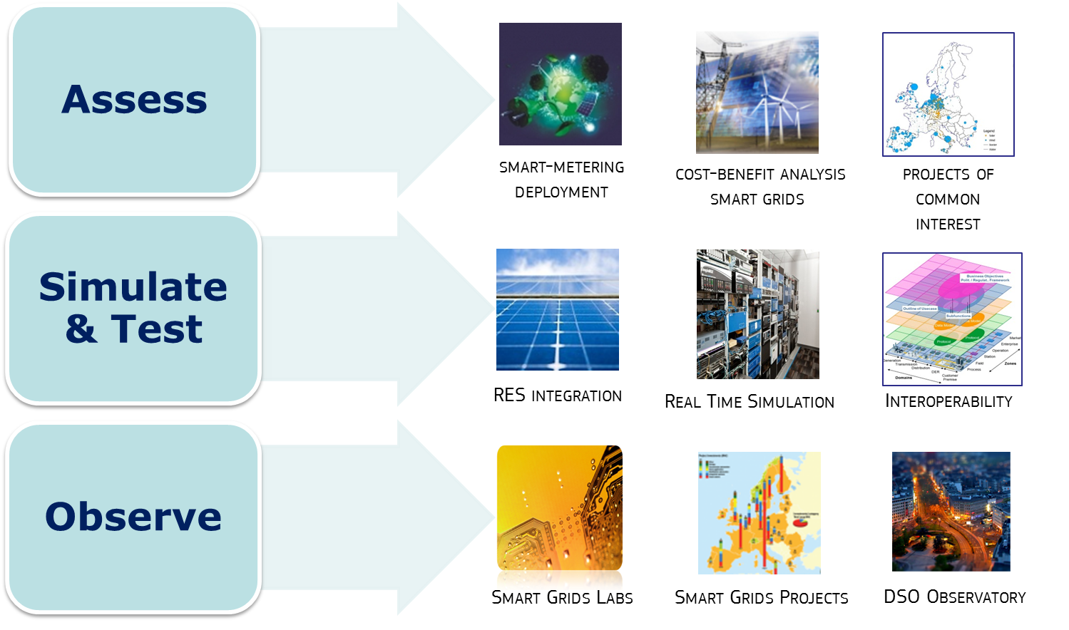
JRC Smart Electricity Systems & Interoperability

Slide 4
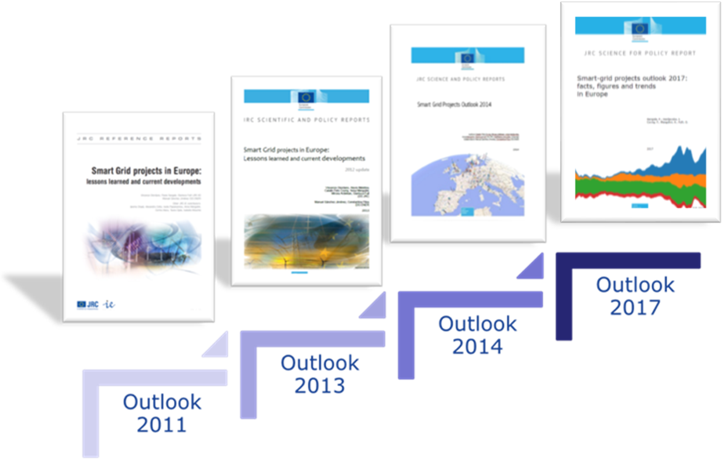
Smart grids projects Outlook
Since 2011 the JRC has been providing policy makers and different stakeholders with a tool to better understand the rapidly changing smart grid scene

Slide 5
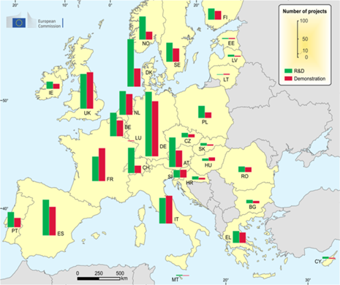
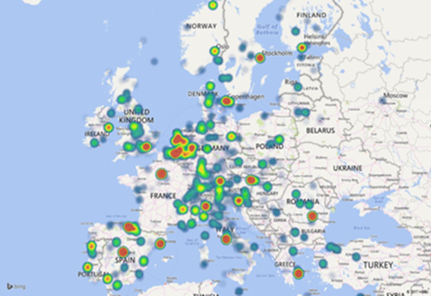
Smart grid projects Outlook
Number of projects, level and pace of investment
Sources of financing of SG projects
Main stakeholders and emerging synergies
Main areas of investment
http://ses.jrc.ec.europa.eu/smart-grids-observatory
Notes:
Inserire figura su stakehgold

Slide 6
Demand side management in SG pilots – Trends
Is there a new trend towards a more collective approach to energy consumption?
Which partners are involved?
Which end-users sectors are addressed?
Which services are targeted?
Which engagement strategies are used?
Exploring Community-Oriented Approaches in Demand Side Management Projects in Europe, Sustainability 2016, 8(12)

Slide 7
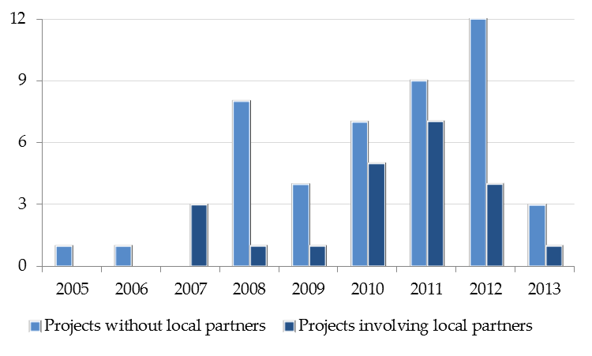
Demand side management in SG pilots – Trends
Which partners are involved?
Local project partner | No.
Municipalities | 10
Housing associations | 9
Public agencies | 6
Consultancies | 4
Local development organizations | 2
Exploring Community-Oriented Approaches in Demand Side Management Projects in Europe, Sustainability 2016, 8(12)

Slide 8
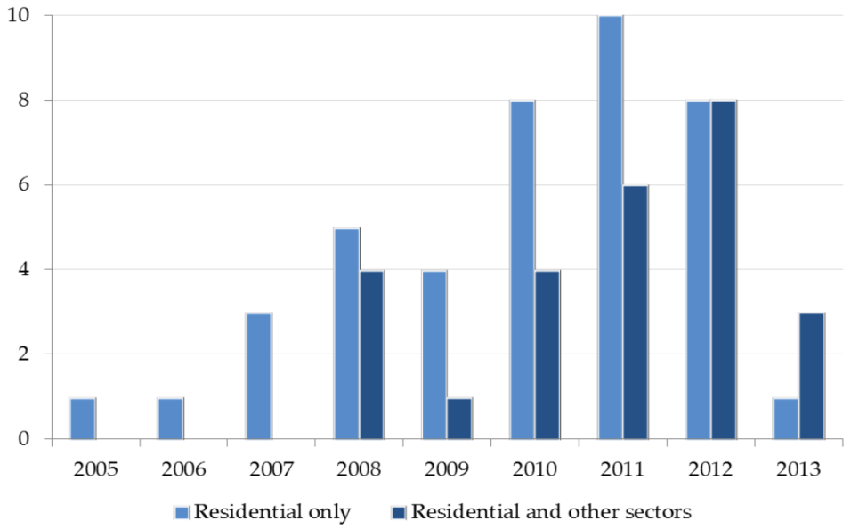
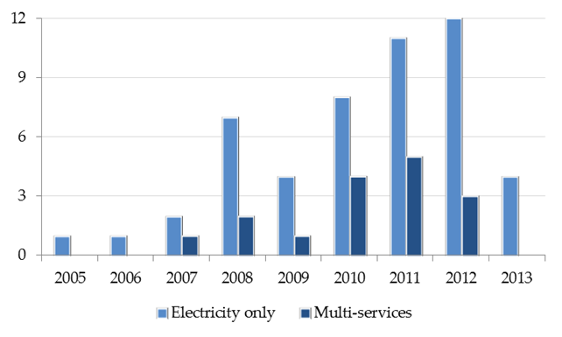
Demand side management in SG pilots – Trends
Which end-users sectors are addressed?
Which services are targeted?
Exploring Community-Oriented Approaches in Demand Side Management Projects in Europe, Sustainability 2016, 8(12)

Slide 9
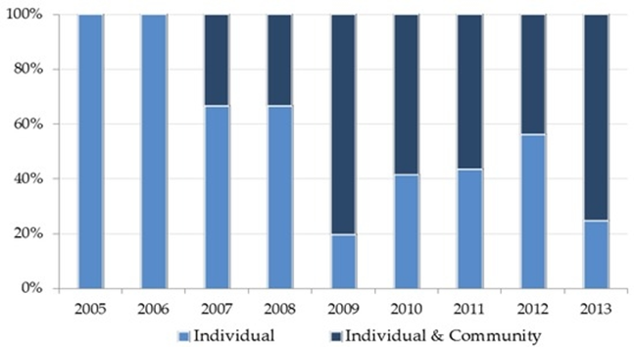
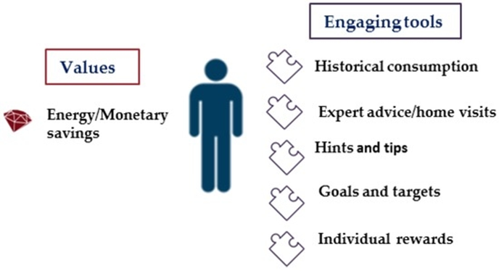
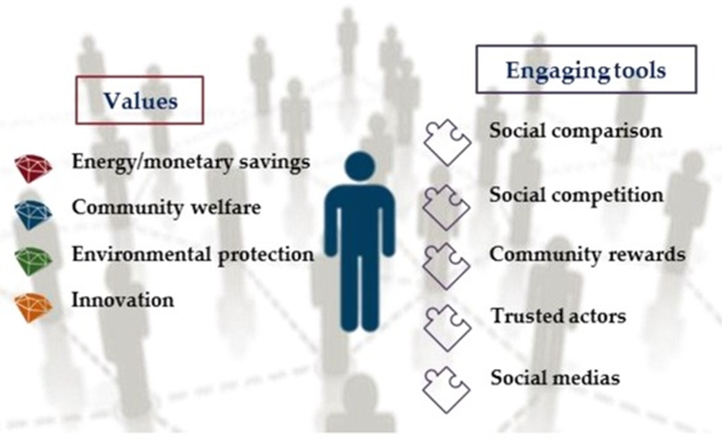
Demand side management in SG pilots - Trends
From…
self-enhancing values
… To
self-transcendent values
Exploring Community-Oriented Approaches in Demand Side Management Projects in Europe, Sustainability 2016, 8(12)

Slide 10
Demand side management in SG pilots – engagement strategies
Engaging tools | Objective | Examples from the projects
Social comparison | Comparing consumption level with that of a similar household; indicating that the desired behaviour is approved | Red, orange, green lights; Colour-coded smileys
Social competition / community rewards | Leveraging on team dynamics; linking different stakeholder; rewarding the community | Energy Team Challenge; Eco Points; Community Project Prize
Community based social marketing | Identifying barriers to adoption; reinforcing community dynamics; exploiting potential for behavioural change in a community context; informing on the progress of the project | Community events (e.g: green picnics, winter fairs); Living Labs
Community trusted actors | Overcoming resistance and scepticism; building trustworthy relationship; exploiting non material resources of local actors | Intermediary organizations; Fellow tenants; Proactive local community members ("local champions")
Social media | Reaching a wide audience; addressing questions and concerns; providing information | Twitter messages
Exploring Community-Oriented Approaches in Demand Side Management Projects in Europe, Sustainability 2016, 8(12)

Slide 11
Community-based approaches and energy poverty
Community engagement strategies (e.g. social comparison and competition, community events) help to involve the harder to reach consumers through a participatory approach e.g. eSESH
Local communities can be instrumental in addressing social issues such as energy poverty (e.g. through energy cooperatives and social innovation projects) e.g.: energie solidaire, atelier solidaire

Slide 12
Conclusions
DSM projects designed with a collective approach to energy consumption
Increasing number of local organizations participating in DSM projects
Different end-use sectors and integration of multiple services
From individual engagement strategies to community strategies
Yet not possible to link these trends to project results

Slide 13
Way forward
Updated analysis with the new dataset of DSM projects (2019)
Energy poverty study with analysis of role of community dynamics
Explore link between community-oriented approaches and project results
New ways to asses European project results

Slide 14
Thanks
Questions?
anna.mengolini@ec.europa.eu

