Slide 1
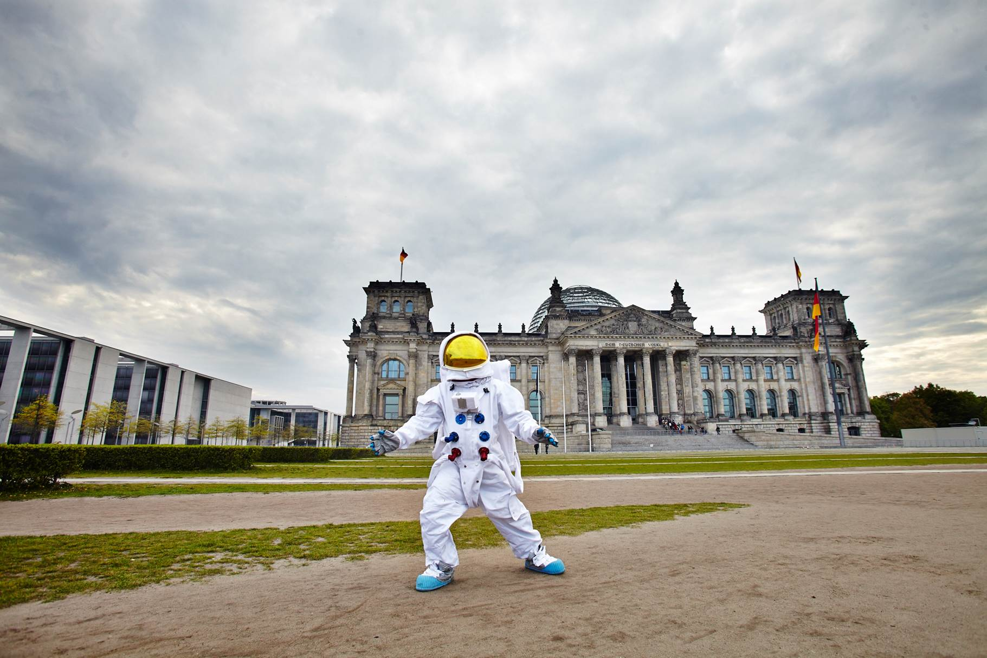
Against and with the wind Local Opposition to and support for the German Energiewende (ET)
Fritz Reusswig
Potsdam Institute for Climate Impact Research (PIK) Research Domain IV: Transdisciplinary Concepts and Methods
Workshop on Local Communities and Social Innovation for the Energy Transition 22-23 November 2018, JRC Ispra

Slide 2
National governments/ EU policies
Populism
(Decentralized) renewables
Local protests

Slide 3
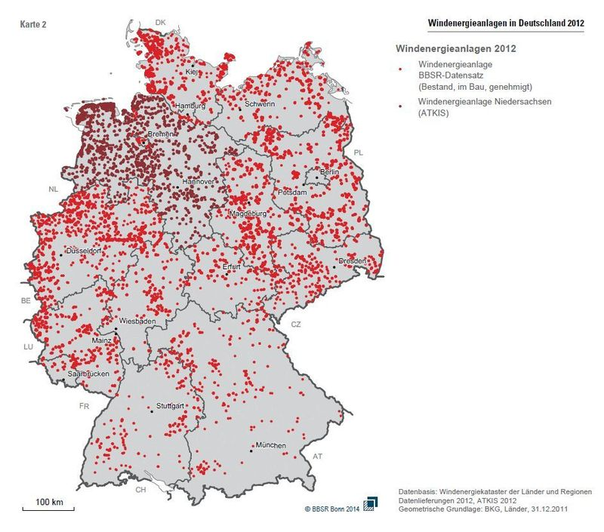
Windkraftanlagen in Deutschland (BBSR 2014)
Wind power in Germany
Local protests against wind power in Germany

Slide 4
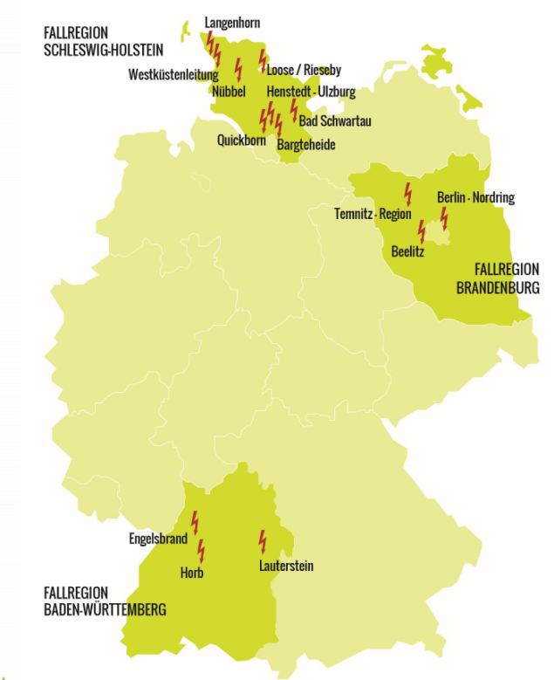
Laufzeit: 2013-2017
Projektleitung:
Potsdam-Institut für Klimafolgenforschung (PIK)
Dr. Fritz Reusswig, Ines Heger, Eva Eichenauer
Projektpartner:
Christian-Albrechts-Universität zu Kiel, Umweltethik
Prof. Dr. Konrad Ott, Florian Braun
Universität Potsdam, Verwaltungswissenschaft
Prof. Dr. Jochen Franzke, Thomas Ludewig
Institut Raum und Energie, Planung, Kommunikation, Prozessmanagement
Katrin Fahrenkrug, Dr. Michael Melzer, Teike Scheepmaker

Slide 5
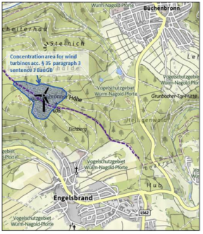
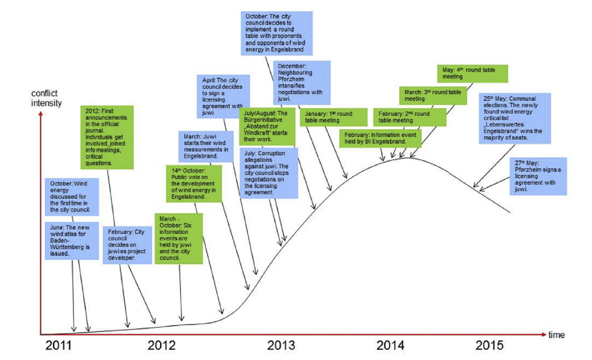
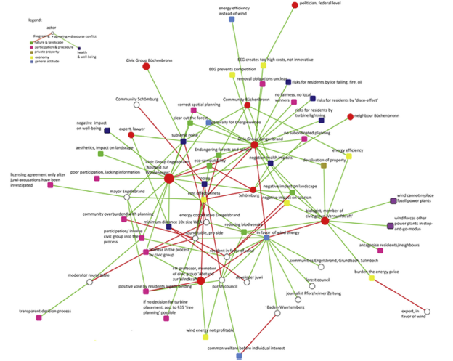
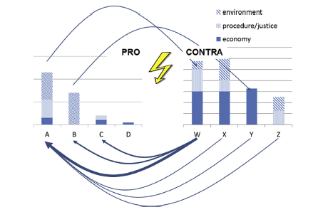
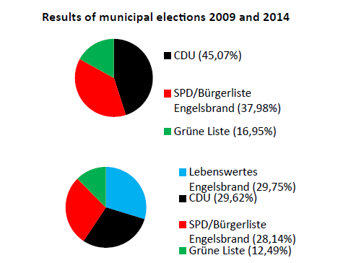
Engelsbrand wind power plant: Conflict intensity over time
Citizen involvement
Adminsitrative process

Slide 6
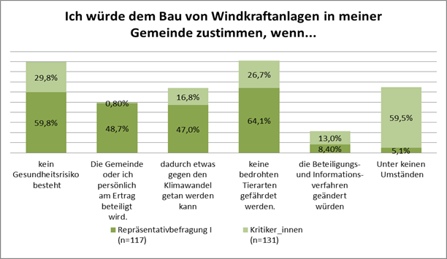
‚I would accept wind power in my neighbourhood if….‘
No health risks
Monetary benefits for me or my community
Climate change mitigation
Nature conservation ensured
Reform of public participation
Never
ET critics at a general level
Local activists

Slide 7
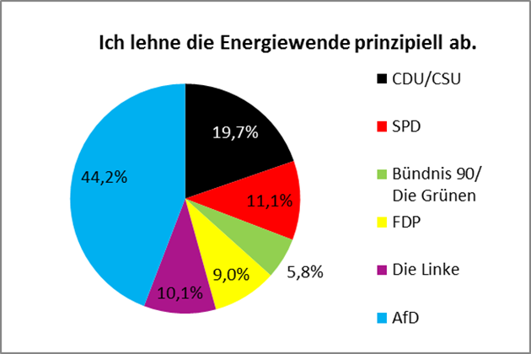
Political party preferences of ET critics
Pro ET in general ≈ 90%, contra ET in general ≈ 10%

Slide 8
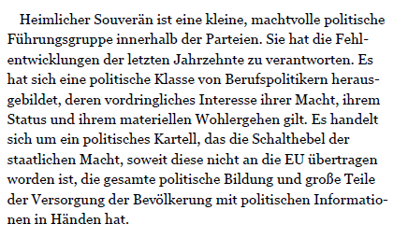
Populism and AfD
Criticism of politics without alternative (anti TINA)
Anti elitism (detached, incompetent, corrupt korrupt…)
Anti intellectualism („Common sense is allright“, „debunking“ science, no experts)
Anti politics/ institutional skepticism
„(Only) we are the people“ – even against majorities
Polarisation, personalisation, emotionalisation
De-bunking mass media (mainstreamed, manipulated…)

Slide 9
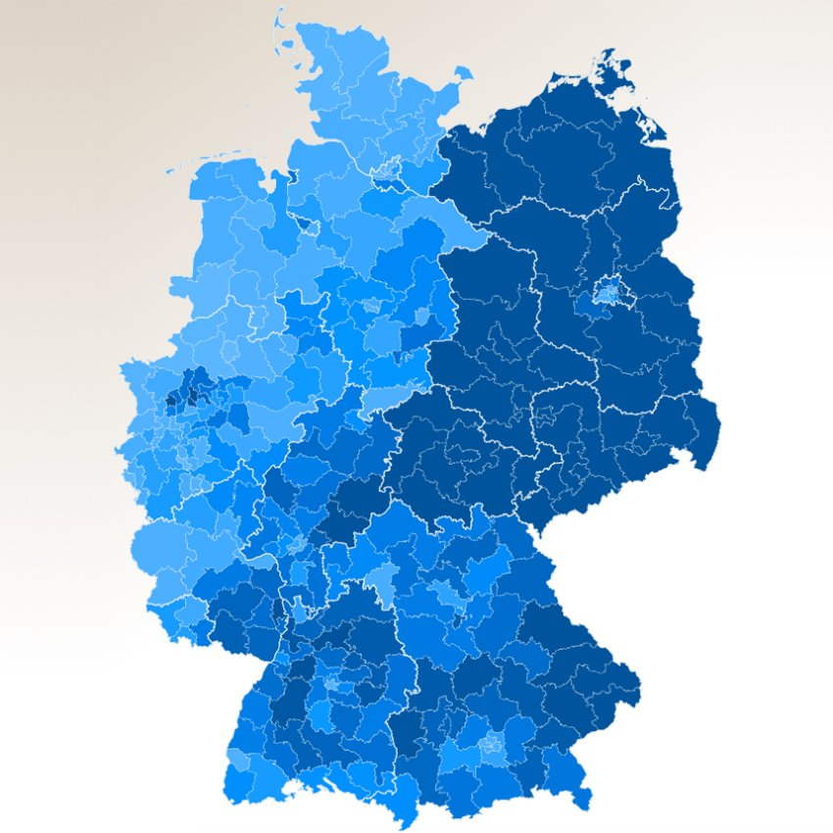
Federal elections 2017, AfD results
Source: SPIEGEL Online

Slide 10
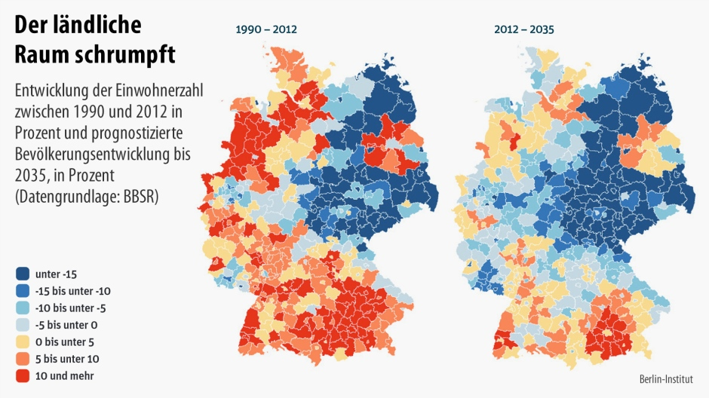
Population development 1990-2012 and 2012-2035

Slide 11
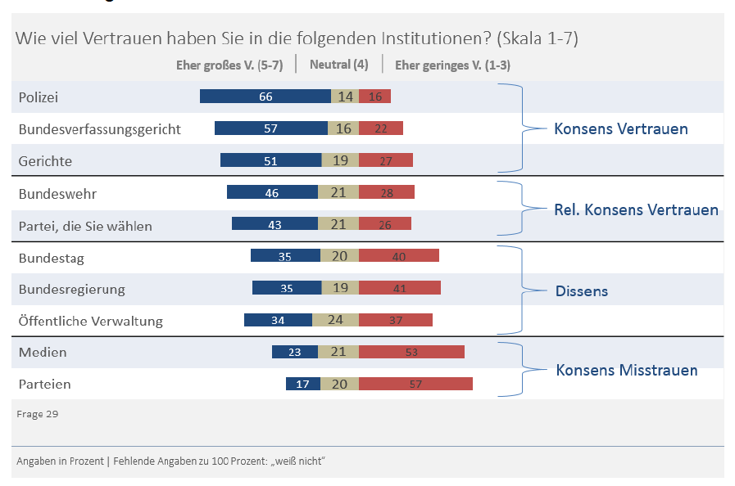
How much do you trust the following institutions?
A lot neutral not at all
Police
Federal Court of Justice
More trust
Courts
Army
Some trust
Your party
Parliament
Government
Some distrust
Public Administration
Mass media
More distrust
Other parties

Slide 12
Structural fit
German Energiewende fits to populist criticism in general
A government project in 2011 (→ anti elitism)
All other parties (‚Old Parties‘) support it (→ anti TINA)
‚There is no anthropogenic climate change‘ (→ anti science, anti experts)
EEG is ineffective and expensive (→ market liberal element ; ‚we want our good old energy system back‘)
Process/ conflict level
Deepening of conflicts due to ‚over-determination‘ (fundamental criticism, links to other populist issues)
Discrediting of expertise
Discrediting of public authorities/ common good assumption
De-legitimation of rule of law/ public procedures in the name of direct democracy
Lowering the threshold for violence

Slide 13
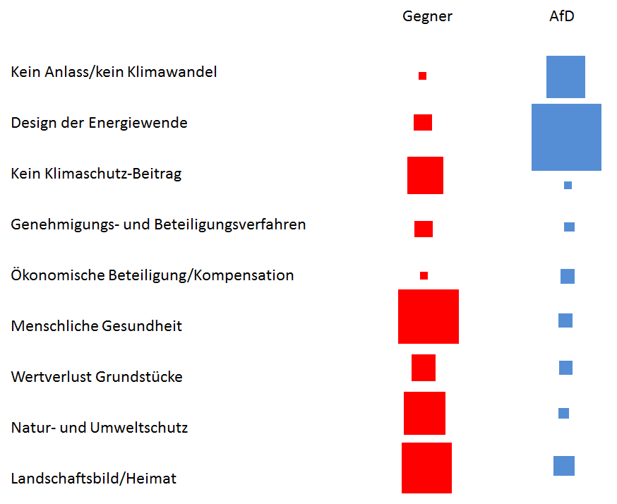
Local activists
AfD
No reason/ no climate change
Institutional design of Energiewende
No climate change mitigation effect
Procedures and participation
Compensation/ economic participation
Human health
Loss of value of homes
Nature conservation issues
Landscape visual value/ Heimat

Slide 14
Populism as a chance?
Populism reveals deficits of political system/ ‚crisis of representativity‘ (→ new ‚grounding‘ of parties and state actors necessary)
Populism has managed to mobilize non-voters (→ cater to this new clientele)
Populism asks for more democracy (at least verbally) (→ Strengthening of participation)
Populismus is strong in ‚weak‘ regions (→ democratic forms of Energiewende; strenghten links to regional development)
Make use of the variability of populism in Europe (→ e.g. FPÖ and renewable energy)

Slide 15
Desk top
Expert interviews
Political analysis
National and local populism
Narratives/ Discourse Analysis
Practices/ Activities
Networks
Energy conflicts
Power grid extension
Wind Power
Coal exit/ decarbonisation of regions
Energiewende (Federal & Länder level)
Arguments/ Narratives
Instruments & Institutions
Actors
Desk top
Case studies
Expert interviews
Desk top
Expert interviews
Discourse analysis
Political analysis
(Local) activists & „Silent majority“
Mentality & Discourse
Performance (conflict culture)
Networks
Interviews
Discourse analysis
Participatory observation
Surveys (sociology, social psychology)
Interventions (e.g. planning games)

Slide 17
CO2- Tracking

Slide 18
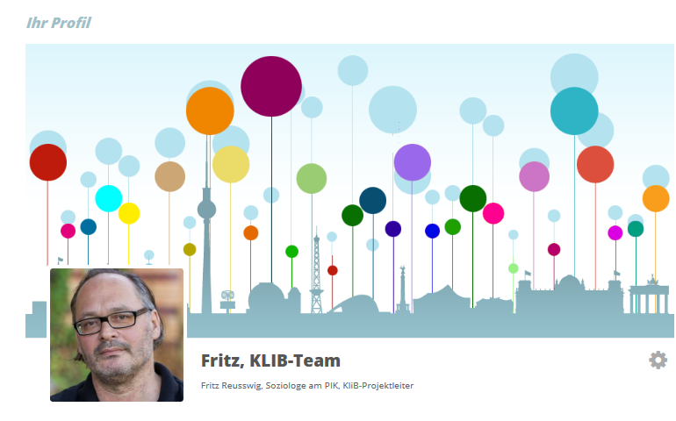
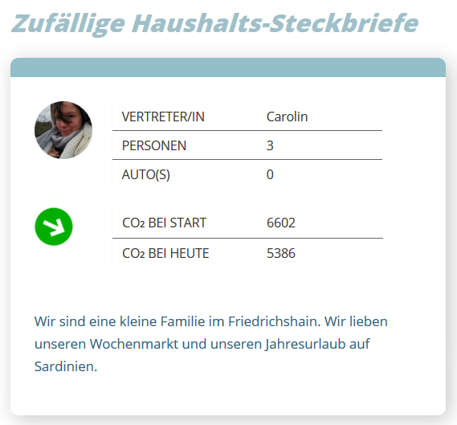
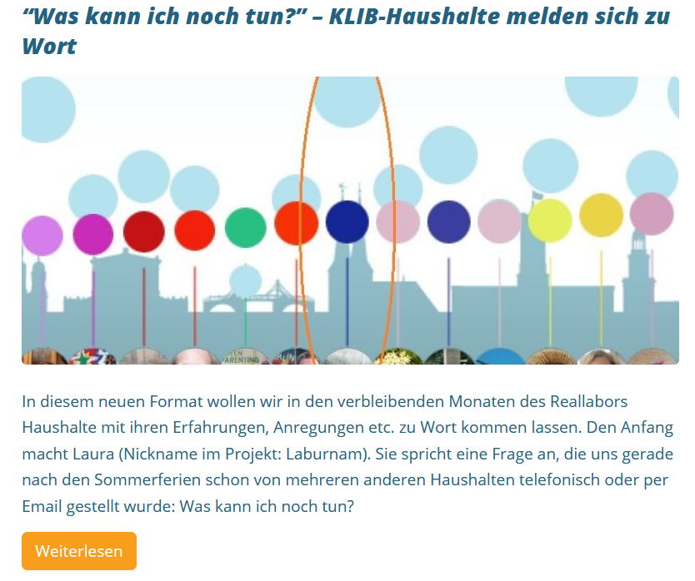
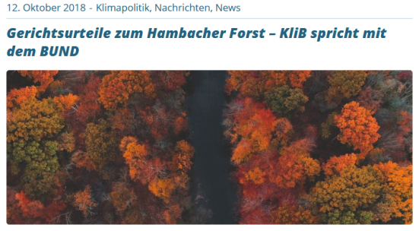
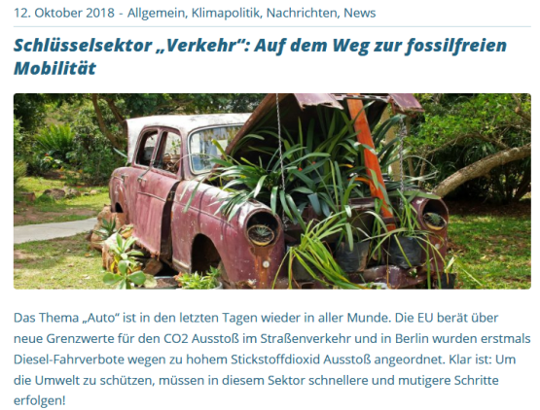
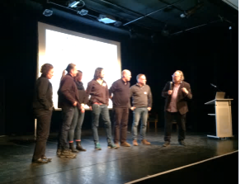
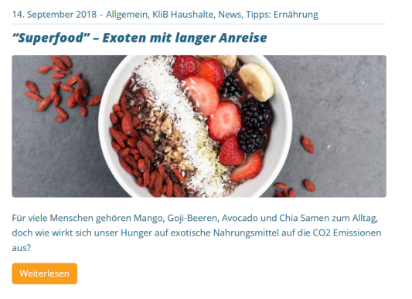
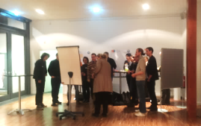
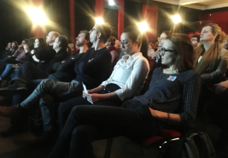
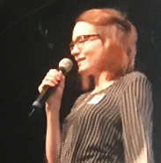
Interaktionen im KLIB-Reallabor
AP 2

Slide 19
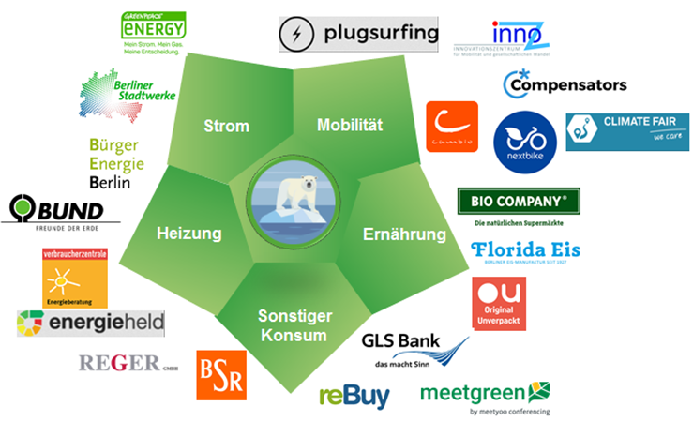
Stakeholder-Netzwerk (Stand 7.10.2018)
Fokus: Unternehmen + Organisationen

Slide 20
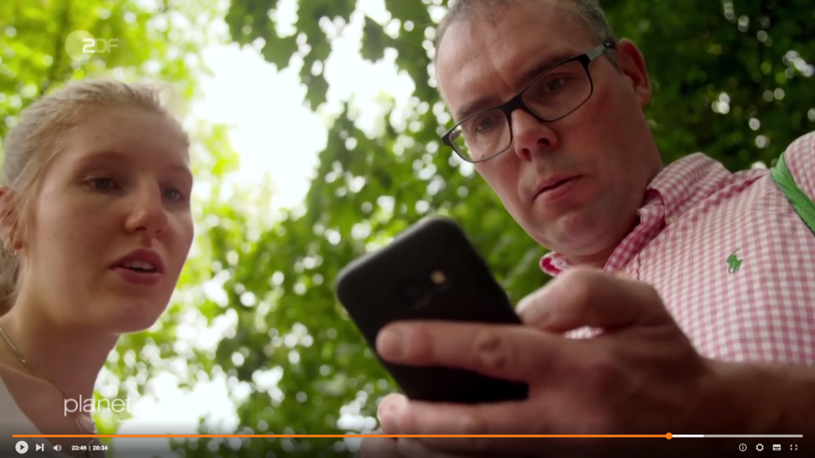
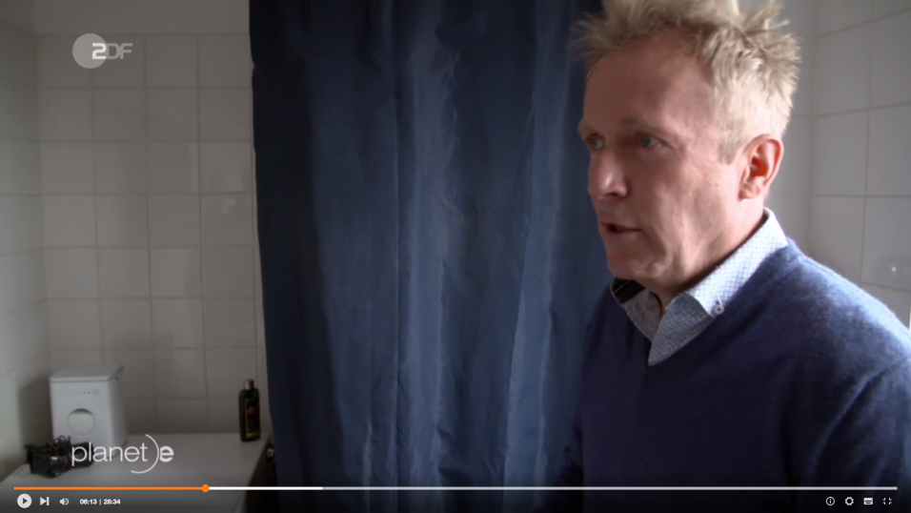
Erste Antworten…
…in unterschiedliche Sektoren fallen spürbare Verhaltensänderungen unterschiedlich schwer/ leicht
Individuelle Ebene

Slide 21
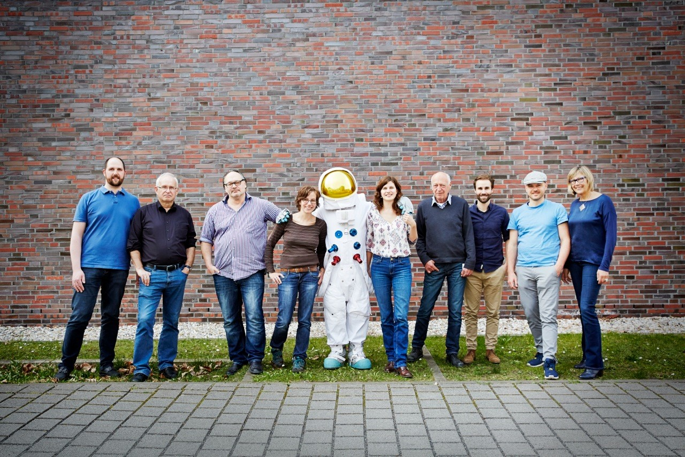
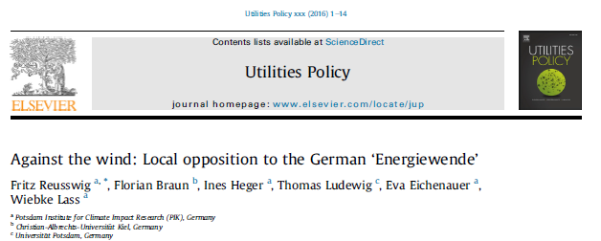
Thank you!
Thank you!
fritz@pik-potsdam.de
fritz@pik-potsdam.de

