Slide 1

Using the ESCO model for the residential sector: challenges and barriers
Vlasta Zanki, PhD
18.10.2017. Varese, Italy
7.11.2017. Bratislava, Slovakia

Slide 2
SUMMARY
HEP ESCO background and experience
Why ESCO project in residential sector?
Regulatory framework
Barriers
Energy services for residential buildings implemented and developed by HEP ESCO

Slide 3
About HEP ESCO
HEP ESCO (ESCO = Energy Service Company)
HEP ESCO – Established in 2003 as implementation agency for energy efficiency program. Owned by Croatian utility company HEP
Development, implementation and financing of ESCO projects – energy efficiency projects repaid from savings and RES integrated in buildings/facilities
14 years of experience (2003-2017)
First ESCO company in Croatia
More than 70 finished on more than 90 projects
24,8 million EUR of investments

Slide 4
Results (2003 – 2017)
More than 90 modernized objects:
  More than 60 EE projects (heating, lighting, building envelope in schools, kindergartens, hospitals and office buildings)
  EE public lighting in 10 cities
  16 EE projects in industry
  More than 70 energy certificates
  One biomass cogeneration plant in wood industry 3,5 MWel
  12 thermal solar and photovoltaic projects
Total investments 24,8 mil EUR
Total energy savings
over 49 GWh/a
Total CO2 savings
over 19 millions kg/a
Total savings per year
over 35 millions kuna (471.000 EUR)

Slide 5
Residential buildings
- Regulatory framework-

Slide 6
Regulation on the maintenance of buildings
Official Gazette 64/97
Article 2. (unofficial translation)
Amount of money for building management fund co-owners uses for :
– regular maintenance of common spaces and common systems (pump, lighting, elevators….)
Urgent repairs
Necessary repairs and retrofit
Building insurance
Building loans
Building management fee
Money is paid on separate building account
Minimum monthly fee is defined by official gazette
.

Slide 7
BARRIERS FOR ENERGY EFFICIENCY PROJECTS IN RESIDENTAL SECTOR
There is still not sufficient level of education
There was no interest from facility management companies – no know how
Insufficient maintenance fee in order to finance development of energy efficiency projects
No grants – no projects
Low energy prices - high payback period
Apartments owners low income – social status
Low ratio of committed owners
No knowledge about ESCO companies

Slide 8

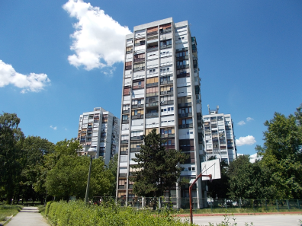
HOW TO IMPLEMENT EE PROJECT?
???

Slide 9
CHANGES IN LEVEL OF ENERGY EFFICIENCY PROJECTS IMPLEMENTATION IN RESIDENTAL SECTOR
Changes started due to:
implementation of energy certification of residential buildings
obligation to install heat allocators
energy efficiency advertising campaign and media - citizens were educated enough to start asking for implementation
grants schemes for energy performance certificates and project documentation from national Fund for energy efficiency
grants for EE project implementation from national Fund
new services from facility manager are developing (building certification organization, project organization, application to EE Fund, coordination, negotiation with financial institutions for EE financing)

Slide 10
ESCO regulations (history)
December 2008 Energy efficiency low was adopted defining energy services. There was no by-low for energy services.
June 2012 Regulation on contracting and implementation of energy services in the public sector (Official Gazette 69/12). Public sector can publish tenders for energy services.
November 2014: EED transposed: Energy Efficiency Act (Official Gazette 127/14)
February 2015: Regulation on contracting and implementation of energy services in the public sector (Official Gazette 11/15)

Slide 11
RESIDENTIAL BUILDINGS – Energy Efficiency Act
Energy Efficiency Act (Official Gazette 127/14):
Article 29. – summary (unofficial translation)
  (Paragraph 1) The decision on the conclusion of the energy performance contract of multi residential buildings, with the energy services provider, co-owners of buildings bring on the basis of the majority of the votes of the co-owners of buildings accounted for by co-ownership and by the number of co-owners of real estate,
  (Paragraph 2) A person authorized to conclude contracts on behalf of and for the account of the co-owned community shall be determined by the decision referred to in paragraph 1 of this Article. If the decision is not determined by a person authorized to conclude an energy efficiency contract for a multi residential building, such contract shall be signed by the building manager.
  (Paragraph 3) Energy performance contract shall contain directives witch stipulate:
    that the value of the guaranteed savings is greater than or equal to the cost of the contract for the energy service contracted with the energy service provider,
    That the risk of realization of the guaranteed savings is borne by the energy service provider,
    that energy services are fully provided by the energy service provider,
    That the value of the guaranteed savings is greater than or equal to the cost of the contract for the energy service contracted with the energy service provider

Slide 12
RESIDENTIAL BUILDINGS – Energy Efficiency Act
Energy Efficiency Act (Official Gazette 127/14):
Article 29.
  (Paragraph 5) Each co-owner of the building may request energy verification from the National Coordination Body
Article 30.
  (Paragraph 1) The energy renovation of a multi residential building is carried out in accordance with the national programs for the renewal of multi residential buildings. Beneficiaries of the energy renewal program of multi residential buildings are co-owners of these buildings, unless otherwise agreed between the co-owners service providers and contractors for energy renewal,
  (Paragraph 2) The decision on the conclusion of the contract for the energy renewal of multi residential buildings shall be made by the co-owners of the building, on the basis of the majority of the votes of the co-owners of buildings accounted for by co-ownership and by the number of co-owners of real estate,

Slide 13
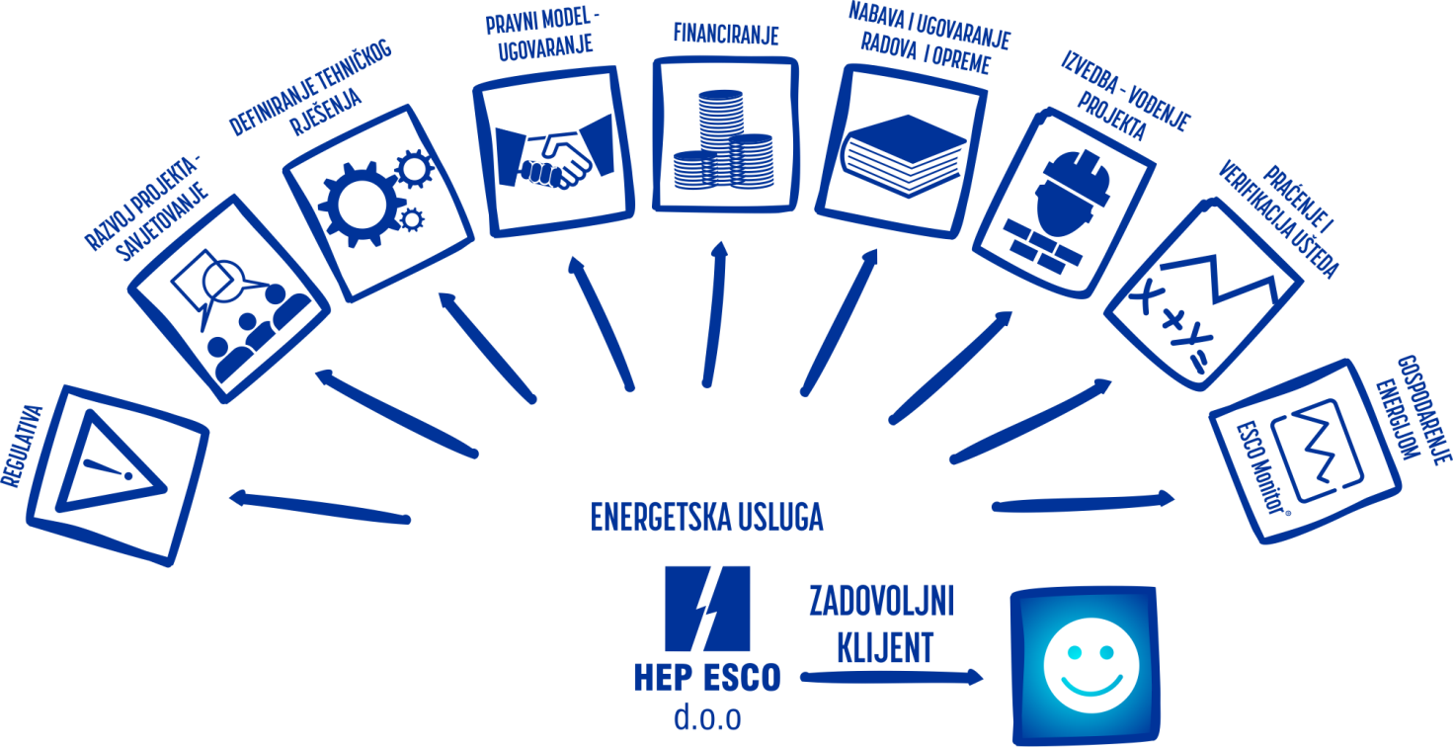

WHAT IS ESCO PROJECT?
How to implement energy efficiency project?
ESCO model

Slide 14
BARRIERS FOR ESCO PROJECT IN RESIDENTIAL SECTOR
Residential building side:
No knowledge about ESCO companies
Wrong perception - ESCO is not a bank
Citizens will not pay additional services – Facility managers are already performing coordination activities
No previous experience from both sides
Social status – low income families or pensions
No trust in savings

Slide 15
BARRIERS FOR ESCO PROJECT IN RESIDENTIAL SECTOR
ESCO company side:
Long pay back period/ Low energy prices – feasibility of projects
At the moment no combination of grants and ESCO model
To many administrative actions if ESCO company is dealing with each owner of apartment – costly preparation and long negotiation
Owners commitment
Risk of payments even from owners who voted for renovation– lack of security instruments for ESCO companies
  The bill for the energy services should go with facility management service bill or energy (heat, gas, electricity) bill
M&V protocol – how to measure and verify saving?

Slide 16
Energy services for residential buildings implemented and developed by HEP ESCO

Slide 17
HEP ESCO position in the HEP group
Publicly owned company
Different position from other newly established ESCO companies:
  Positive: experience, know-how, certified experts, trust, possibility to manage big projects of any type, financing should not be a problem, contact to customers;
  Negative: complicated procedures for project permission, part of big and slow system, higher costs, complicated public procurement procedures what is not suitable for private clients and preparation for tenders

Slide 18
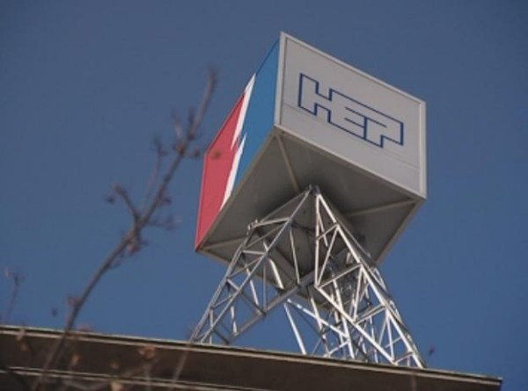
HEP ESCO opportunities
Opportunities:
  Responsibility of HEP as utility company towards customers to offer energy services (ESCO project for bug consumers, advisory services for citizens)
  Obligations and responsibility of HEP towards new energy efficiency directives (1,5% savings) – Article 7 EE Directive
  Closer cooperation with sister companies HEP Opskrba, HEP Toplinarstvo, HEP Plin dealing with supply of electricity, heat and gas
  Transition toward „Energy as a service” business model

Slide 19
Energy services for residential sector
Consulting services:
  Preliminary investment studies
  Detailed investment studies
  Project management
ESCO projects:
  Energy efficiency measures
  Renewable energy sources
  Energy optimization
Energy management services:
  In cooperation with facility managers (ESCO monitor, HEP smart applications
Training and education (building capacity and rising awareness for ESCO and EE):
  Facility managers education
  Citizens education

Slide 20
RESIDENTIAL BUILDINGS – consulting services
2 Residential Buildings in Zagreb – Laginjina street and Vojnovićeva street
  Phase of the project: Official Bid sent to client
  Proposed EE measures: Connection on the Central Heating System (HEP Toplinarstvo) of the city of Zagreb
4 Residential Buildings in Varaždin – Novakova street
  Phase of the project: Official Bid sent to client
  Proposed EE measures: Walk through audit (WTA)
5 Residential Buildings in Zagreb – Dobri Dol and Jordanovec street
  Phase of the project: Official Bid sent to client
  Proposed EE measures: Walk through audit (WTA)
1 Residential Building in Rijeka
  Phase of the project: Official Bid sent to client
  Proposed EE measures: Walk through audit (WTA)

Slide 21
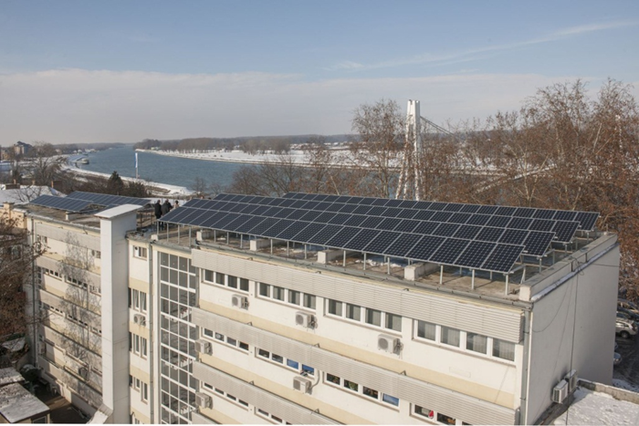
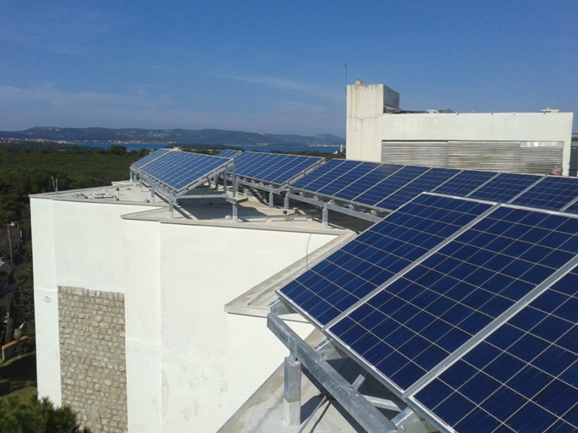
RESIDENTIAL BUILDINGS – PV Power Plant
Residential Building in Zagreb – Radnička street
  Phase of the project: Official Bid sent to client
  Proposed EE measure: Installation of Photovoltaic power plant 19,5 kW
Residential Building in Zagreb – Antona Augustinčića street
  Phase of the project: Official Bid sent to client
  Proposed EE measure: Installation of Photovoltaic power plant 23,75 kW

Slide 22
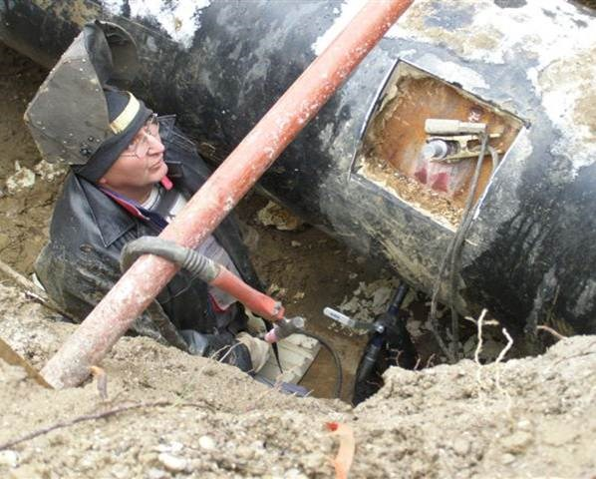
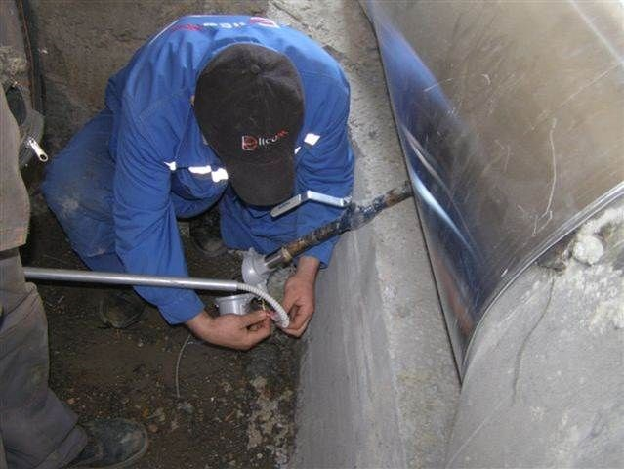
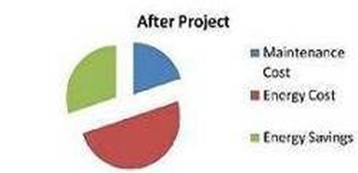
HEP TOPLINARSTVO (district heating)
Technical and economical optimization of the central heating system in Zagreb
Energy efficiency measures included:
Installation of a software tool that collects necessary data, processes and uses it to optimally manage the distribution system,
Installation of equipment on the distribution network (manholes, substations) with permanent monitoring of parameters ,
Static modeling of the distribution hot water network, hydraulic and thermal calculation, critical point analysis (pressure analysis, temperature, transport time, etc.), rationality and functionality of the drive with optimization proposals
Dynamic Modeling and Real-time Drive Management, which includes monitoring of current flows, pressures and temperatures across the network, predicting future conditions, hot-line network simulation and identifying operational problems before they occur in real time,
Investment value: 1,67 mil EUR
Return of Investment: 4,2 years

Slide 23
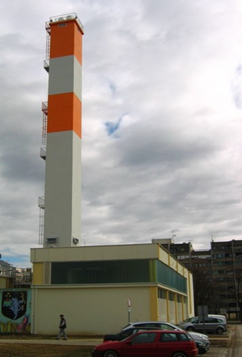
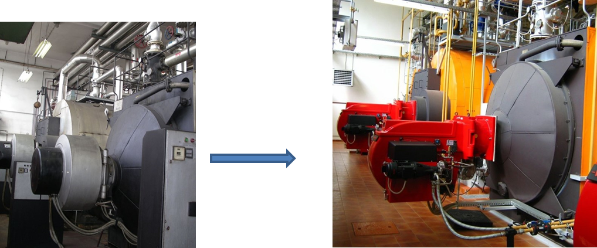
THERMAL POWER PLANT VELIKA GORICA
Reconstruction of the boiler room and construction of the hot water pipeline between GI and GIII boiler rooms
Energy efficiency measures included:
Fuel change (light fuel oil, fuel oil extra light → natural gas)
Installation of a new gas burners (replacement of old burners)
Automatic regulation (for 4 boilers)
New electrical installation with a new electrical cabinet
Reconstruction of a piping network inside the boiler room
Construction of a new chimney
Implementation of this project provided economical and reliable heat energy production and favorable environmental impact
Investment value: 2,11 mil EUR
Return of Investment: 2 years

Slide 24

Energy management – new energy service
ESCO company needs
ESCO monitor software - Tool for improvement of ESCO projects
Monitoring of ESCO projects – EPC contracts
Measurement and verification of savings
Alarming
New services of energy management:
  Smart metering of energy and water
  Energy consumption analysis
  Energy optimisation

Slide 25
ESCO monitor – tool for implementation of ISO 50001
Customer needs
Establishment of property registry (buildings, industry halls, outside lighting systems)
Collection, monitoring and analysis of energy data (on monthly, daily and hourly basis)
Alarming
Support in energy management and implementation of ISO 50001
Tool for identification of energy efficiency measures
Tool for development of energy efficiency action plans and reporting

Slide 26
Who is it for?
Intended for all institutions and companies that want to systematically manage energy:
Private sector (industry, hotels, offices, retail chains etc.)
Large consumers
Consulting company
ESCOs
Facility management company

Slide 27
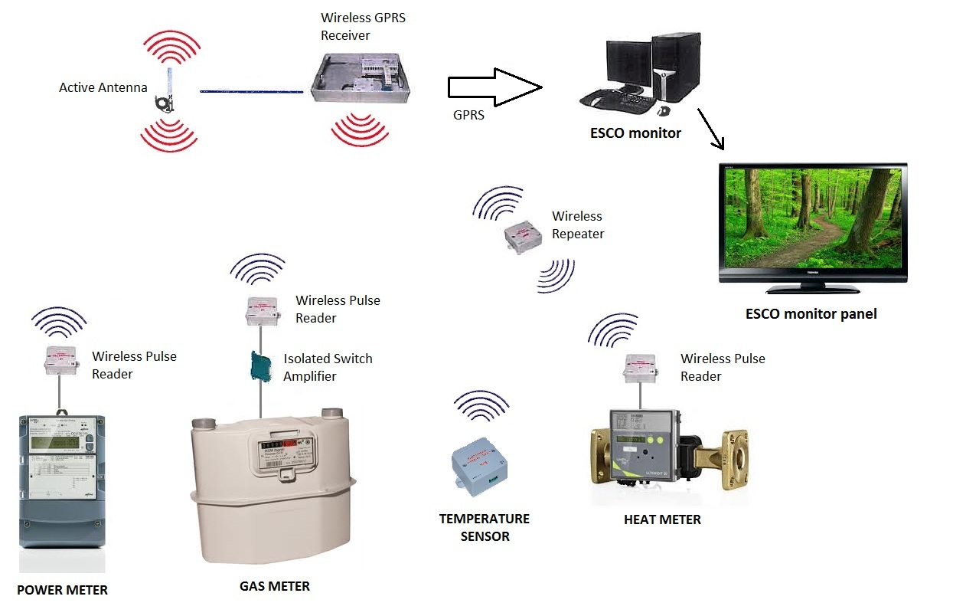
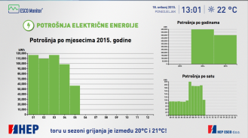
ESCO monitor & ESCO monitor panel

Slide 28
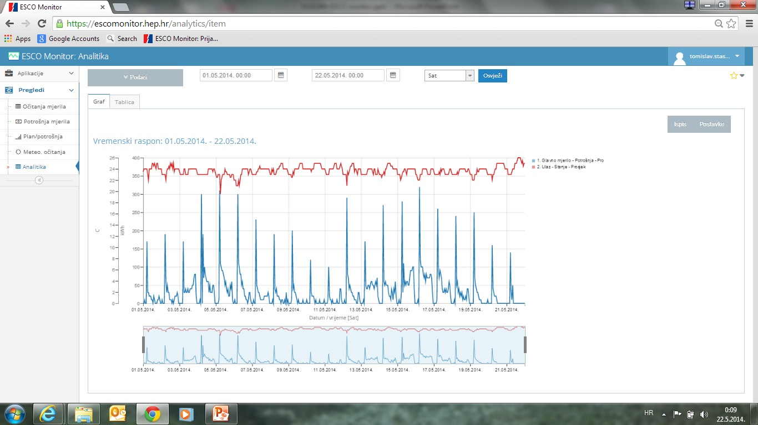
Heat consumption and inside temperature

Slide 29



HEP ESCO – NEW ENERGY SERVICES
SPECIALIZED COURSES
HEP ESCO TRAINING CENTAR
New energy services in the Croatian market
Long term sustainable approach to energy management
Education of clients and partners for the implementaton of EE and RES projects
BUILDING UP CAPACITIES FOR IMPLEMENTATION OF ESCO PROJECTS
All info available at www.hep.hr/esco/tecajevi

Slide 30



HEP ESCO SPECIALIZED COURSES
CERTIFIED PROFESSIONAL FOR MEASUREMENT AND VERIFICATION
Measurement and verification (M&V) of savings is becoming essential for proving the success of energy efficiency projects.
CERTIFIED PROFESSIONAL FOR THE USE OF RETScreen®
Internationally recognized ® Clean Energy Project Analysis Software for evaluation of clean energy production projects.
ENERGY MANAGEMENT ACCORDING TO ISO 50001
The approach based on HRN EN ISO 50001:2012 enables energy costs management in a long term manner and reduce them with the optimal ratio between investment and achieved.
TRAINING PERSONNEL TOWARDS OPERATIONAL EE OF THE BUILDINGS
The training program for the personnel in charge of facility maintenance (caretakers) towards operational energy.

Slide 31

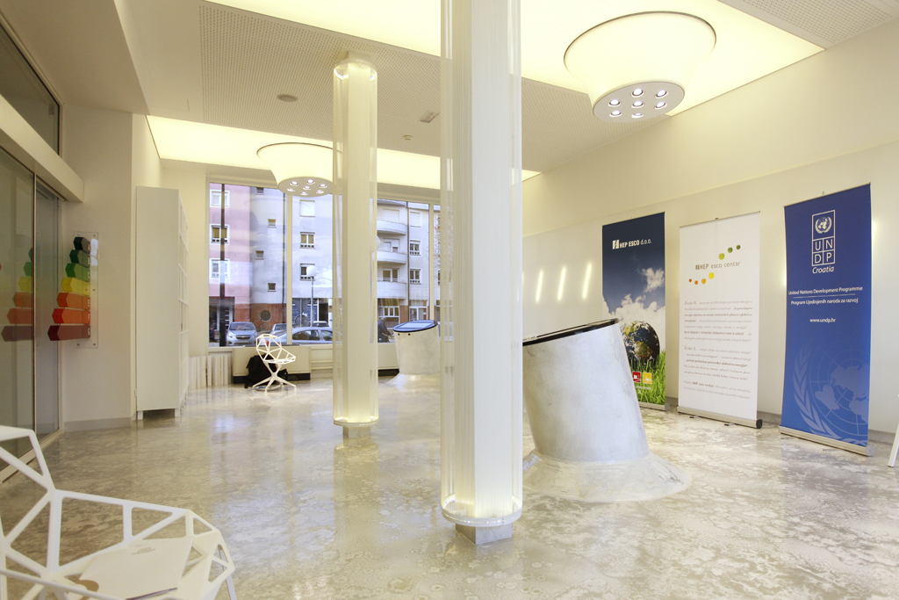
HEP ESCO for citizens –awareness rising
First pilot centre open in Varaždin 24.11.2012.
(not operating today)

Slide 32
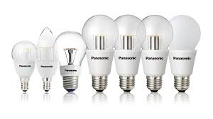
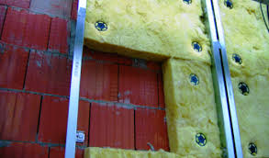
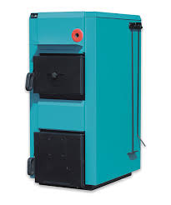
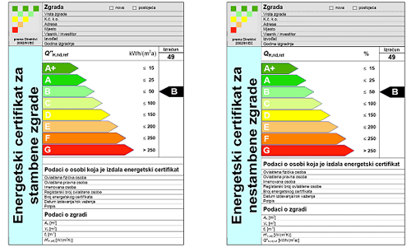
EE PRODUCTS AND SERVICES PROMOTION

Slide 33
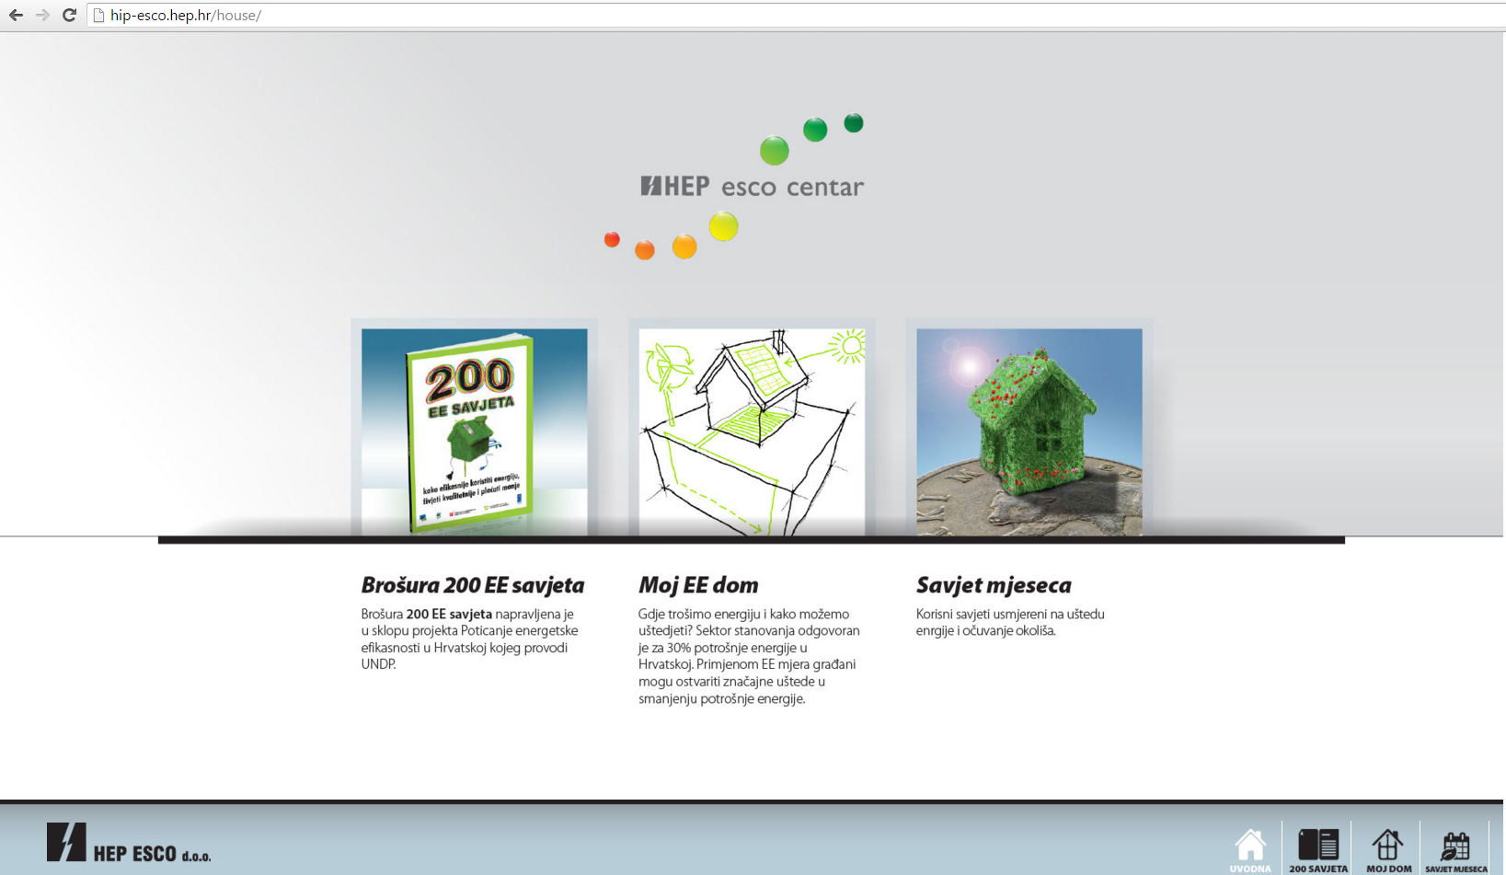
ENERGY EFFICIENCY ADVICES
http://hip-esco.hep.hr/house

Slide 34
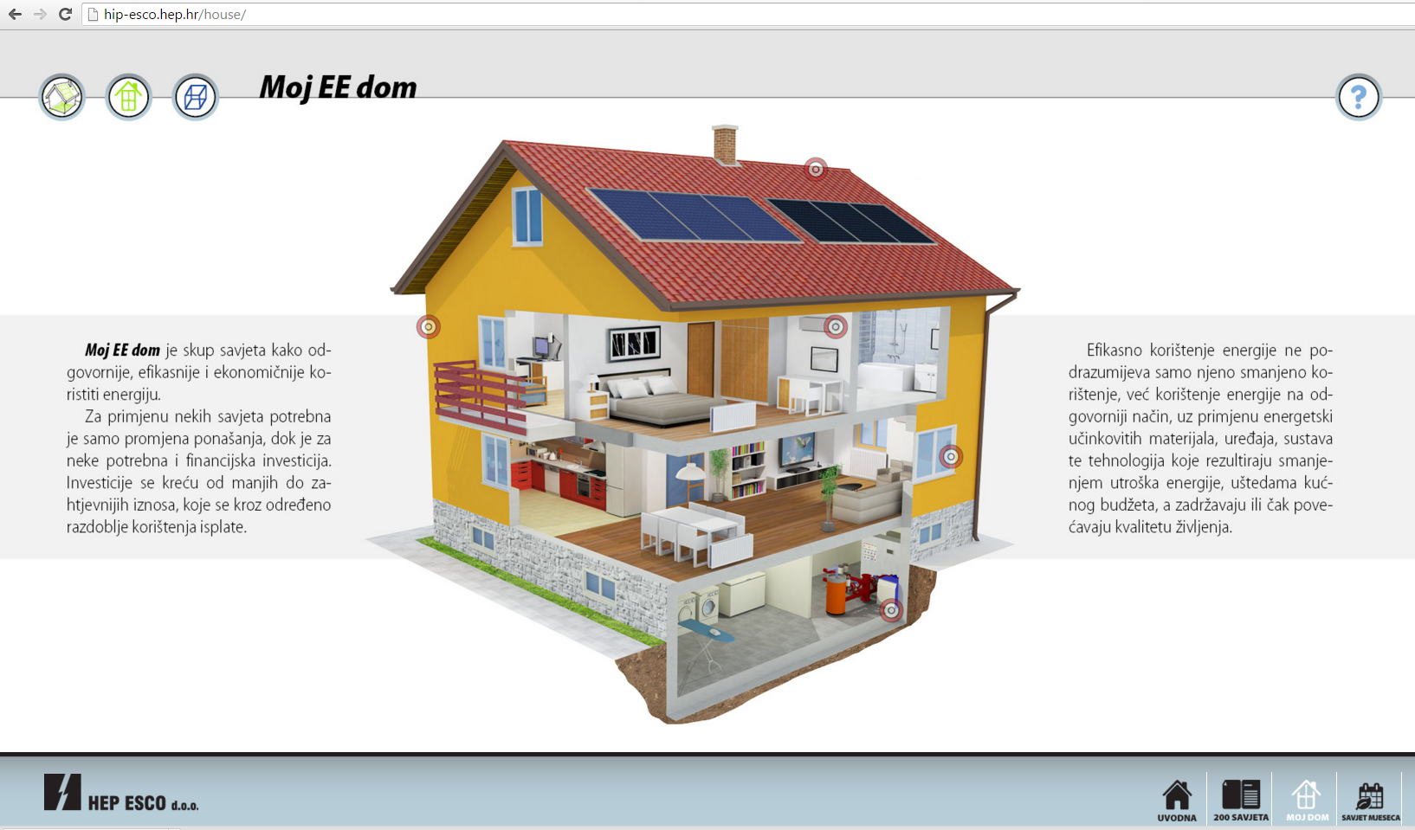
HIP APLICATION
HEP Information Panel
Notes:
Edukacijski modul koji pruža savjete građanima o energetskoj učinkovitosti u kućanstvima te daje savjete o korekciji vlastitih navika potrošnje energije

Slide 35
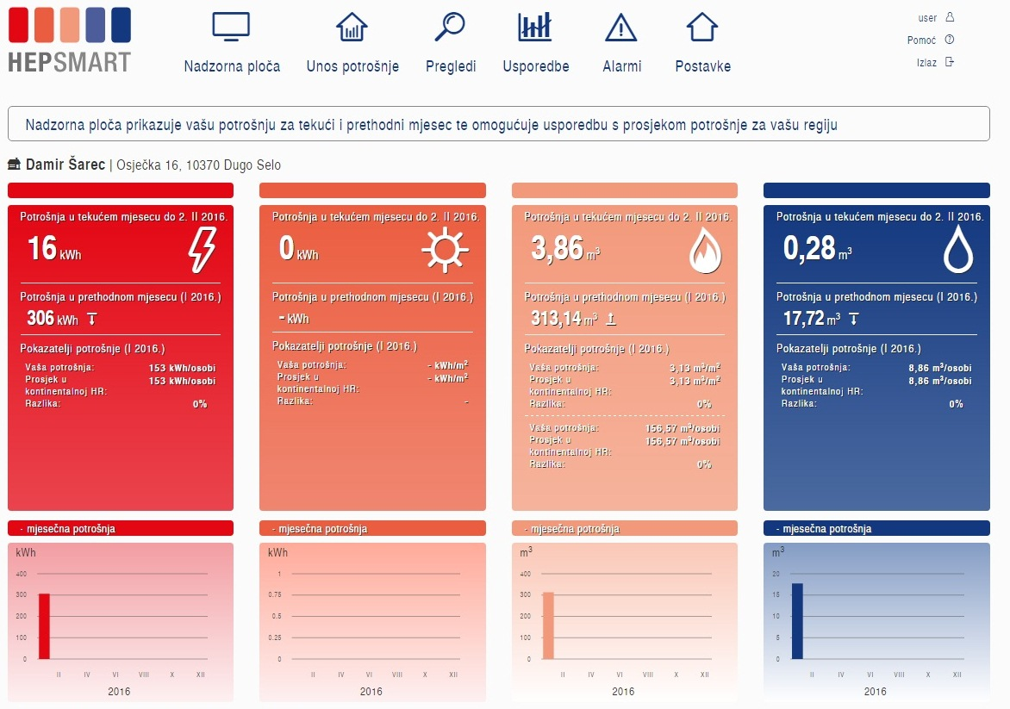
HEP SMART energy management for households

Slide 36
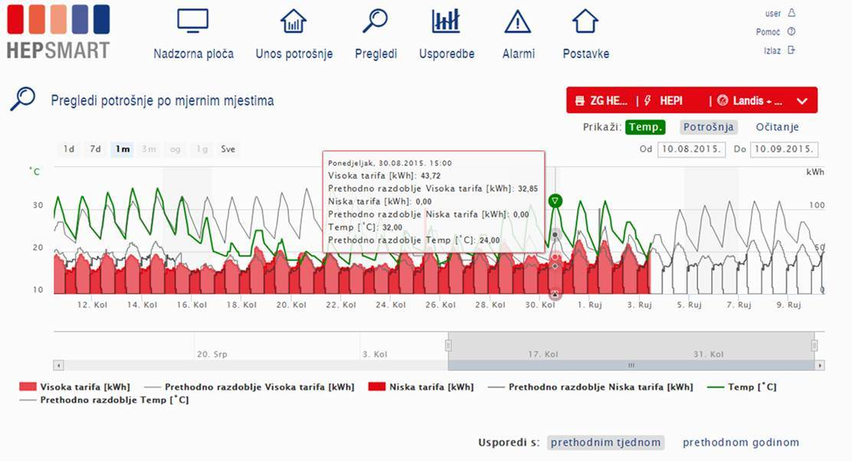
HEP Smart® energy monitoring

Slide 37



What is important for households?
To fulfill legal requirements in area of environmental protection and energy
To have safe supply
To decrease cost of energy
To have trust in supplier
To feel that someone care for him as a customer
Energy efficiency
=
Higher living standards

Slide 38
Opportunities and challenges
Understanding ESCO – co-owners
ESCO is not bank – lack of understanding
Education about energy efficiency
Trust in ESCO model – template contract should be supported by government
M&V protocol should be defined through template contract – state owned body should give support to citizens and overtake the cost of measurement and verification of savings
Not all energy efficiency project can be implemented with ESCO model
Development of ESCO projects in private sector last from 3-12 months – costly preparation

Slide 39
Opportunities and challenges
Understanding ESCO – co-owners
ESCO model is not primarily developed for residential buildings
New ESCO companies on the market – cooperation between ESCOs and Facility management companies….necessary maintenance and operation of buildings…back to ruts of ESCO
Risks
Payment risks
Long term contract and relations (change of ownership, change of social status…..)
Measurements and verification protocol - which? Who will do and who will pay?
Behaviour change
Level of grants for energy renovation

Slide 40
Opportunities and challenges
Article 7 Utility obligation schemes – opportunity for utility ESCOs
Implementing EE Directive - fulfilling part of 1,5% of savings from utility companies
Development of loyalty Programme with energy suppliers within the group
Developing new business models by Utilities: „energy as a service”
Combining EU grants and ESCOs

Slide 41

Thank you!
vlasta.zanki@hep.hr

