Slide 1
Building Residents: Vulnerable Consumers or Demanding Clients?
“Provision of Highly Efficient Heating and Cooling Solutions for Residential Buildings with Focus on Eastern EU Member States”
Workshop Bratislava, 7-8 November 2017
Carmen Pavel – ESCOROM - Vicepresident

Slide 2
SUMMARY
ESCOROM: Who are we & what we do?
Vulnerable Consumer – Definition
RO Buildings - Status
Perspective 1: RO EPC
Factual data
Client’s perception (residential energy consumer)
Perspective 2: RO Energy Audit
Factual data
Client’s perception (residential energy consumer)
Perspective 3: RO Building Residents
Present status
Future status with regard to "Energy Revolution“
Perspective 4: RO ESCOs in buildings
activity field for ESCOs.
definition needed;
Conclusions

Slide 3
Who are we & what we do? (1)
Born in 2015
8 members active in the ESCO industry + independent EE consultants
Communication with national bodies (National Regulatory Energy Authority, Energy Commission of the Management Authority of the Large Infrastructure Operational Programme, Chamber of Deputies - Committee for Industries and Services etc.) having as main goal removal of legal barriers hampering the activity of ESCOs in the RO public sector;
Awareness and capacity building campaigns (EDUESCO project) on EPCs dedicated to public authorities, specifically on development and implementation of energy efficiency action plans and capacity of ESCOROM to provide of tailored advice in design and implementation of energy efficiency improvement programs; Training of ESCOs professionals in M&V procedures - in progress;
Elaboration of procedures for ESCOs certification in RO – in progress

Slide 4
Who are we & what we do? (2)
Contribution in Energy Efficiency Directive 2012/27/EU revision and in different surveys, analysis of relevant EPC related issues;
Activities at national level for assessing the impact of the Eurostat Guidance Note from 07/08/2015 on national EPC markets;
Ally of eu.ESCO, The European Association of Energy Services Companies for promoting Energy Performance Contracting as the economically sustainable solution for improving the energy performance in existing buildings;
National Co-administrator of the European Code of Conduct for Energy Performance Contracting (EPC).
Nominees at Romanian Energy Awards 2016 – to recognize the achievements of non-profit organization (NGO) whose activities have had a positive impact on the energy sector.

Slide 5
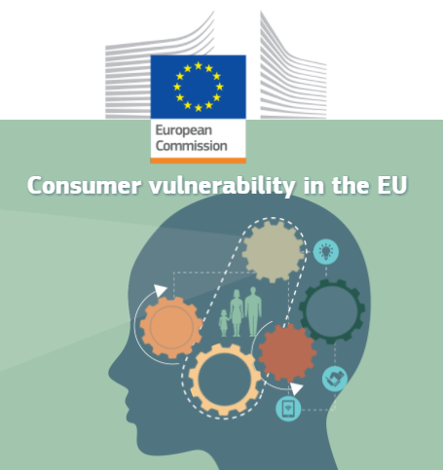
Vulnerable Consumer - Definition
“A vulnerable consumer could be defined as:
A consumer, who, as a result of socio-demographic characteristics, behavioural characteristics, personal situation, or market environment:
Is at higher risk of experiencing negative outcomes in the market;
Has limited ability to maximise his/her well-being;
Has difficulty in obtaining or assimilating information;
Is less able to buy, choose or access suitable products; or
Is more susceptible to certain marketing practices.
This definition takes into account that consumer vulnerability is situational, meaning that a consumer can be vulnerable in one situation but not in others, and that some consumers may be more vulnerable than others.”
Understanding consumer vulnerability in the EU's key markets (EC research project, Nov 23, 2016)

Slide 6
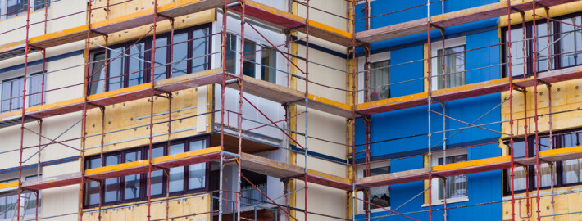
RO Buildings - Status
Factual data
Existing buildings: 493,000,000m², ≈86% residential buildings; ≈9 million apartments, ≈60% single-family dwellings;
Ownership: ≈85% private property, ≈7% public property and ≈8% mixed property;
≈4 million apartments were built before 1985 and require thermal renovation (according to new standards);
Public buildings: 3,500,000m² counts for 24% energy consumption;
ROP 2007-2013: 41,311 apartments; 182.4 mil euro allocated;
Results of the renovation programmes in Bucharest (started in 2009): ≈3,000 block of flats out of 8300.
ROP 2014-2020: 129,000 apartments; 2074 mil euro allocated

Slide 7
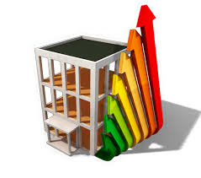
Perspective 1: RO EPC (1)
Factual data
EPC is the main component of the EA;
Does not include the primary energy consumption;
EPCs are collected in a centralised database on a voluntary basis;
Private software tools are available on the market for EPC related calculation but there is no clear evidence that they have been established in line with the Methodology Calculation in force (only software tools for EPC of apartments need to be certified);
- EPCs are required according the law:
- individually for:
- buildings (apartments) transactions;
- in EA of buildings (apartments) for:
- description of existing situation;
- description of planned measures result;
- commissioning of new buildings & major renovation of old buildings
EPC is currently under revision.

Slide 8
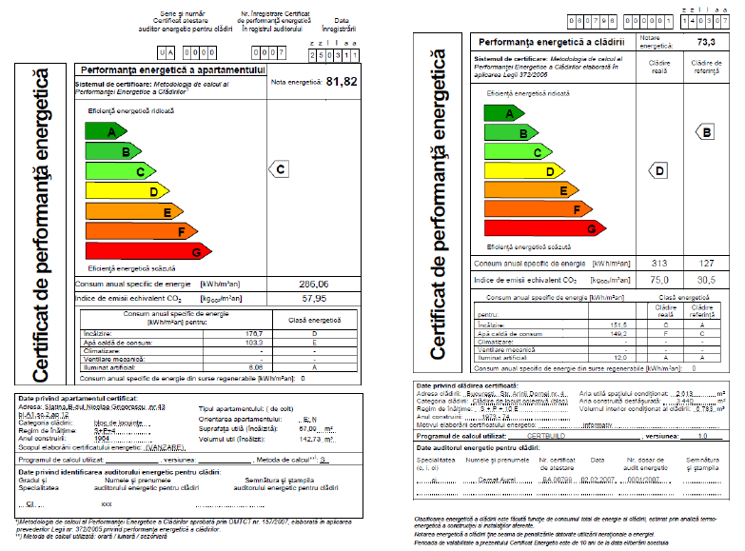
Perspective 1: RO EPC (2)

Slide 9
Perspective 1: RO EPC (3)
Client’s perception (residential energy consumer)
Lack of trust;
Lack of interest in reading and understanding the EPC information excepted they are involved in a Law suit;
Not so much concerned about energy use;
Does not have many options to change the energy use pattern.

Slide 10
Perspective 2: RO Energy Audit (1)
Factual data - Scope: 1st design phase of thermal rehabilitation projects;
technical evaluation of applications for projects financing
10 years old Calculation Methodology (CM);
CM comprises 850 pages out of which:
170 dedicated to EPC related calculations for apartments in block of flats;
650 dedicated to EPC related calculations for all type of buildings;
30 pages dedicated to the Energy Audit (EA) of buildings (as Annex);
CM is based on ≈100 related technical norms, technical guides, framework technical solutions etc.;
Does not include calculation methods or procedures related to the monitoring of thermal renovation results;
No direct verifiable criteria and/or connection between initial and final EPC is considered;
Very weak financial evaluation of solutions package – based on Cost Standard issued in 2010 (only 6 modernization measures are considered);
≈1,600 energy auditors for buildings certified by MDRAP (≈1,000 active);
No unitary training of the energy auditors for buildings.

Slide 11
Perspective 2: RO Energy Audit (2)
Client’s perception (residential energy consumer)
Individual needs not addressed:
individual comfort;
type of measures (closing of balconies);
quality of measures;
visual aspect of measures (new colour of the building);
information on project results;
etc.
Lack of access to technical documentation (during renovation works execution).
Bloc of flats renovation mechanism: Reversed PPP: public authority is financing the renovation of the private property!
Bad effects for ESCOs!

Slide 12
Perspective 3: RO building residents (1)
Present status
Q: Who is the energy consumer: the resident or the building?
Assessment based on Criteria:
More of less “captive clients”;
Lack of valuable information;
Lack of understanding of the information received – when available;
Concerned by the energy cost only;
Comfort and health depend on affordability;
Are not demanding.
Assessment Result: High level of Vulnerability!

Slide 13
Perspective 3: RO building residents (2)
Future status with regard to "Energy Revolution“
New definitions: no more “energy consumer” but “end-user” or “prosumer” or “energy citizens” on “demand side”;
New abilities needed;
New communication skills;
Behavioural (life style) changes – need to time shifting activities;
Switch between comfort priorities to financial (dynamic prices) priorities;
Switch between centralized control to individual control – is it 100% possible in block of flats?
Raised energy awareness required;
Smart technology will take the lead over end-users?
Big challenge: Adapting smart technology to end-users!

Slide 14
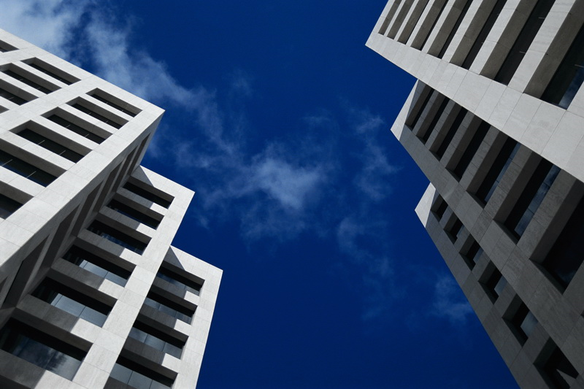
Perspective 4: RO ESCOs in Buildings (2)
Current situation:
proper definition needed: type of services supplied;
certification system needed;
measurement and verification procedure needed;
lack of dedicated legal framework (standard EnPC Contract; public procurement procedure; financial and fiscal treatment, guarantee instruments etc.);
bad behaviour of local authorities in terms of payments;
high amount of investment needed;
high level of burocracy when accessing ROP
Presently, EnPC public projects market is closed in RO

Slide 15
CONCLUSIONS
RO residential energy end-user:
Should be the core of the Renovation Strategy;
Should have access to attractive financial incentives;
Should have access to high quality data regarding energy use;
Should have confidence in energy assessment tools and renovation measures;
Should live in a healthy and safe building.
Renovation issues:
- EPCs content and CM should be carefully revised, based on the residential energy end-user needs;
- Renovation Strategy should provide sustainable solutions for the end user, building and energy efficiency market.

Slide 16
THANK YOU FOR YOUR ATTENTION!
Contact data:
www.escorom.ro
Carmen Pavel – ESCOROM Vicepresident
carmen.pavel@escorom.ro
Mob: +40 723 588 070

