Slide 1
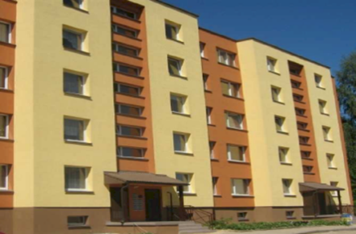
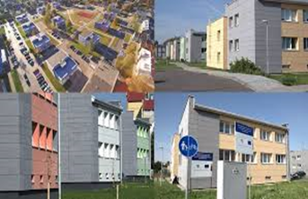
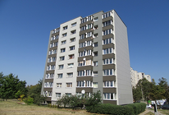
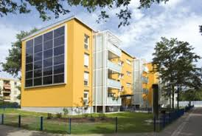
Energy efficient renewal of multi-apartment buildings in Lithuania
Bratislava,
November 2017
Notes:
My name is Marius Smaidžiūnas. I represent Housing energy efficiency agency in Lithuania

Slide 2
Housing energy efficiency agency
Housing energy efficiency agency is established at the beginning of 2001.
Founder: The ministry of environment
The main goal is to administrate energy efficiency programs and projects
Notes:
So who we are and what we do? Our agency was established in 2001, by the ministry of environment. Firstly this agency started with small separate energy efficiency projects, but later on it started administrating national program for the renewal of multi-apartment buildings and national program for public buildings.

Slide 3
Housing energy efficiency agency
Provides support and technical help to the administrators of the projects and municipalities;
Pays out the state subsidy for homeowners;
Prepares standard documents and other instrument needed for building modernization projects
Organizes capacity building programs and trainings;
Organizes public information activities for the change of attitude;
Notes:
If we focus only on the national program for modernization of multi-apartment buildings then the main activities we work on is that we are providing professional consultations and technical support for the administrators administering refurbishment projects. Ours agency pays out the subsidy for the projects.
We are also preparing standard documents and procedures needed for implementation of the multi-apartment refurbishment project.
We are also providing trainings and organizing public information activities to help people to change the attitude about energy saving and climate change.

Slide 4
Multi-apartment buildings renovation (modernization) program
Multi-apartment buildings renovation (modernization) program approved by the government of the Republic of Lithuania in 2005.
The program aimed to:
Increase energy efficiency in multi-apartment buildings
Ensure that the heating costs and the payment of the loan do not exceed the heating costs before the renovation
Notes:
Multi-apartment buildings renovation program was approved by the government in 2005.
It aimed to increase energy efficiency in multi-apartment buildings.
Also it had to ensure that heating costs and the payment of the loan do not exceed the heating costs before the renovation.
Today it still aims to increase energy efficiency in the buildings. We still are trying to reach the second aim, but it is optional, because some times people would like to invest very deep in their building

Slide 5
Results of the renovation program
99% of buildings implemented complex energy efficiency measures (insulation of walls, roofs, windows replacement, modernization of heating systems);
Avg. investment – 267.000 Eur/building (185 Eur/m²)
Energy savings (actual) 50-70%, in some buildings >70% (max.87%) or avg. 72,2 kWh/m² annually
More than 50% of homeowners wish to modernize their buildings according to the results of social survey done in 2016
Notes:
Some information about the results. 99 per cent of the buildings implement complex energy efficiency measures.
Average investment in the project is about 267 thousand eur. Its / about 185 Eur in to one square meter of the building. But it variates, smaller buildings cost more and bigger buildings cost less.
Average actual energy savings is about 50 per cent, but in some buildings we can reach much higher savings up to 87 per cent.
Also last year we organized public survey and according to the result about 50 per cent of homeowners would like to renew their buildings, this is much higher result then it was 5 years ago, about 20 per cent

Slide 6
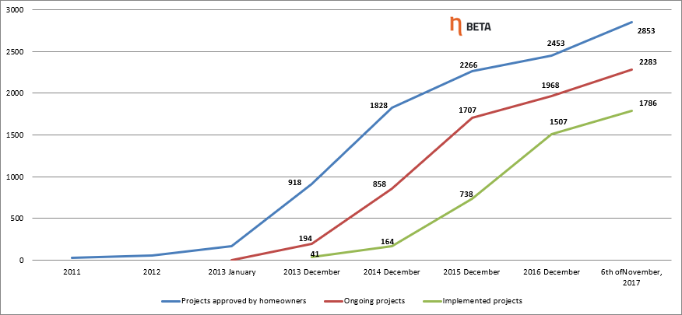
Results of the renovation program
Since 2013 - 1786 projects are completed. Since 2005 – 2234 projects are completed.
From 2005: energy savings 540.02 GWh and CO2 savings 127500 tons
Ongoing projects - 497
Notes:
During the period 2005 - 2013 there was only about 450 projects completed. But after 2013, when the mains break point happened we have already finished almost 18 hundred projects.
Total CO2 savings we have from 2005 until today is 127 thousand tons and the total energy savings are more than 540 giga watt hours.

Slide 7
Typical project
Distribution of expenses to apartment-owners before and after renovation, while using typical measures
100%
0 - 10 %
50 %
40 - 50%
Savings
50 - 40%
Repayment of
investments
Heating
Heating
Before renovation
After the renovation
Before renovation
After the renovation
Notes:
So how the typical project looks like?
By using typical measures, you can reduce your heating costs.
Mostly after the refurbishment of the building the heating costs together with the repayment of the loan should still give you a 10 per cent financial saving if we compare it with the heating costs before the refurbishment.
But still if homeowners decides to go into very deep renovation they will not always succeed To achieve this result.

Slide 8
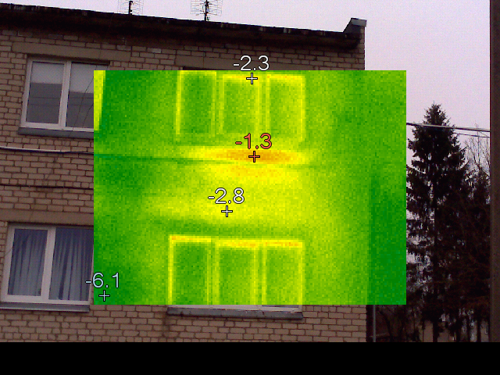
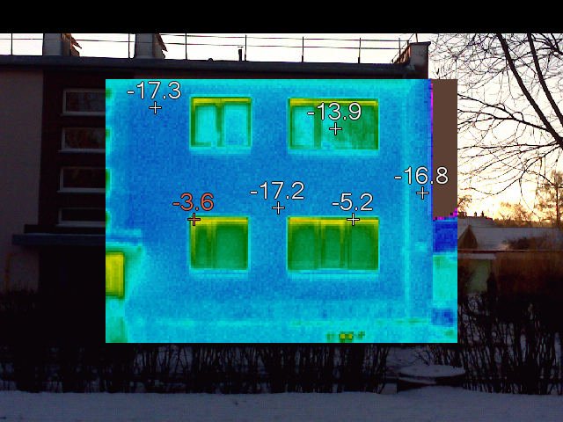
The typical measures
Typical measures for the renewal project are:
The insulation of the walls, roof and the floors
The changing of windows and doors
The modernization of the heating system
The renewal of the ventilation
The glazing of balconies
The renewal of other systems – elevators, electrical system and etc.
These measures guaranty the energy savings
Notes:
Here you can see a list of typical measures which are approved by the government. The most popular and mostly used package include the insulation of the walls, changing of the windows and outside doors, the modernization of heating system and the renewal of the ventilations. This is also the “smallest” package which allows you to reach 40 per cent of energy savings, this is the minimum savings needed for get the subsidy for the hard investment. This is not applied for heritage buildings, where for example you can not insulate walls.
Heritage buildings have to reach at least 20 per cent of energy savings.

Slide 9
How the scheme looks like?
Notes:
The scheme of the process looks like this:
First of all there has to be a investment plan prepared where there is foreseen what measures are going to be implemented, what will be the investment and what savings you will reach. We do not prepare energy audits, but we make energy performance certificates for the projects, this simplices and fastens the preparation of the project.
When the project is approved by the homeowners the administrator of the project has to start the procurement process for the preparation of technical project.
After the technical project is prepared the administrator has to procure the construction works and the technical supervision. The construction starts immediately after when the loan is provided for the project.
When the construction works are finished Housing energy efficiency agency will check if the project is implemented according to the investment plan and does it reached the energy savings planed. If yes the agency will pay out the subsidy for hard investment.

Slide 10
State subsidy
There is a state subsidy which covers 100 per cent of costs for:
The administration of the project (0,15 euro cents for the heated area of the building)
Preparation of the technical document (up to 5 per cent from total costs of the project)
The supervision of the construction works (up to 2 per cent from total costs of the project)
Notes:
You can get a state subsidy which covers 100 per cent for project administration, preparation of the technical project and the supervision of the construction works

Slide 11
Credit line
All project can get a credit for 20 years, where the interest rate will be fixed at 3 per cent for first 5 years.
Notes:
All project can get a credit for 20 years, where the interest rate will be fixed at 3 per cent for first 5 years.

Slide 12
State subsidy
Subsidy for hard investment in to refurbishment of the building:
100 per cent for all low-income families
Until 2012 it was 50 per cent from the total investment
After 2012 it was reduced in periods by 5 per cent and now it stays at 30 per cent and will not be reduced any more

Slide 13
Results of the renovation program
Notes:
Here I would like to show you the slide with the numbers I have showed you before.
As I mentioned the state subsidy was reduced from 50 to 30 per cent for hard investment, but still the interest of homeowners is grooving and we have more and more projects. This means that the subsidy is not the mains thing that effect the projects.

Slide 14
The role of the municipalities
In 2013 municipalities were encouraged to prepare municipal renewal programs:
By this programs municipalities appointed the administrator of the projects.
Municipalities prepared investment project for the homeowners.
80 per cent of the projects are implemented by the administrator appointed by the municipality
Notes:
After 2013 municipalities were included in the process. Municipalities were asked to prepare building renewal programs and to approve these programs in the municipal council.
Mostly all the municipalities in Lithuania own a maintenance company, which were assigned to administrate housing energy efficiency projects.
Municipalities also started preparing investment plans for the buildings renewal projects.
These two factors were the icebreakers.
Now 80 per cent of projects are implemented through municipal programs.
To make it clear I would like to explain, that municipal program only selects buildings for renewal and provides administrator, the subsidy is still coming from the national program for renewal of multi-apartment buildings

Slide 15
The different conception
Before 2013 the program was not very attractive to the homeowners, because there was:
No standardize documents
Only one payment request
No funding for the projects
Only chairman of the community could have been the administrator of the project
After the establishment of the new model in 2013:
Mostly all the documents are standardized
Interim payments can be done
There is an open credit line for the projects
Anyone can administrate the project

Slide 16
Success depends on the administrator
The administrator appointed by the municipality or approved by homeowners:
Takes the loan for the implementation of the project
Administrates the repayment of the loan
Organizes all the procurement needed for the implementation of the project
Is taking all the responsibility for the successful implementation of the project
Notes:
The success of project depends on the administrator who has to do lots of work to implement the project.
Administrator has to do all the procurements needed for the project.
Also the administrator takes the loan for the implementation of the project. Later on he has to collect the repayments.
It is the administrators responsibility that the project is implemented successfully.

Slide 17
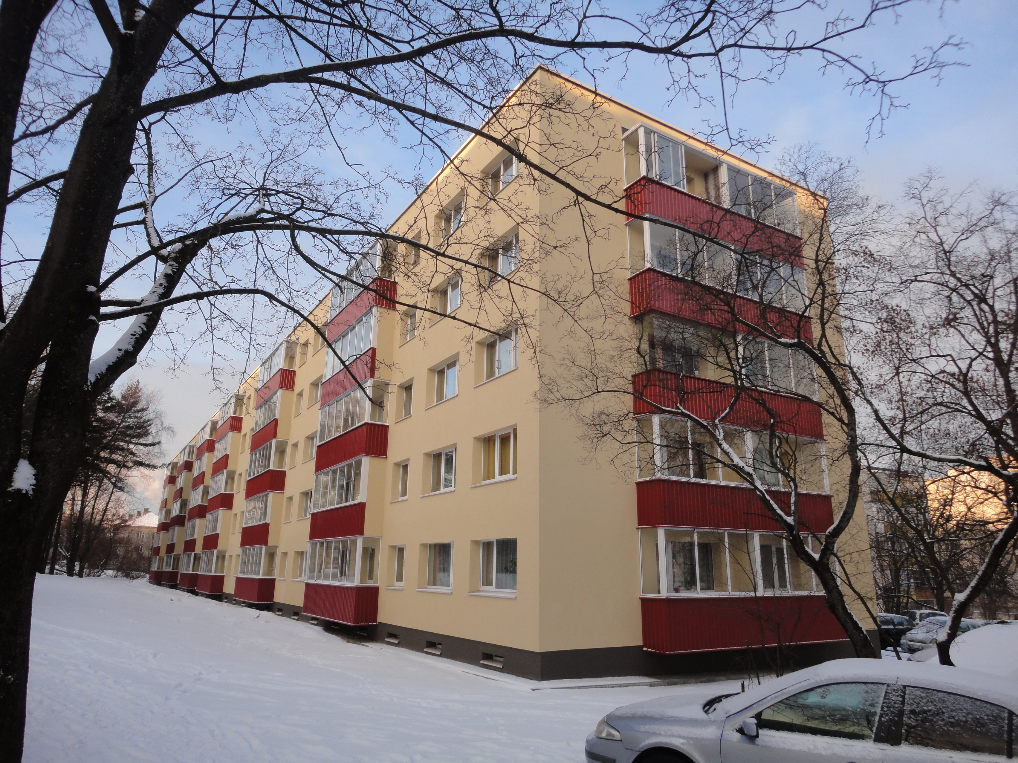
Some examples
Building built in 1964
Number of apartments: 101
Heated area: 5.670 m²
Investment: EUR 0,608 mill.
Implemented: insulation of walls, roof, windows replacement, glazing of balconies, modernization of heating system
Results:
energy savings 70%
before – class D
after – class B,
energy consumption – 60 kWh/m²

Slide 18
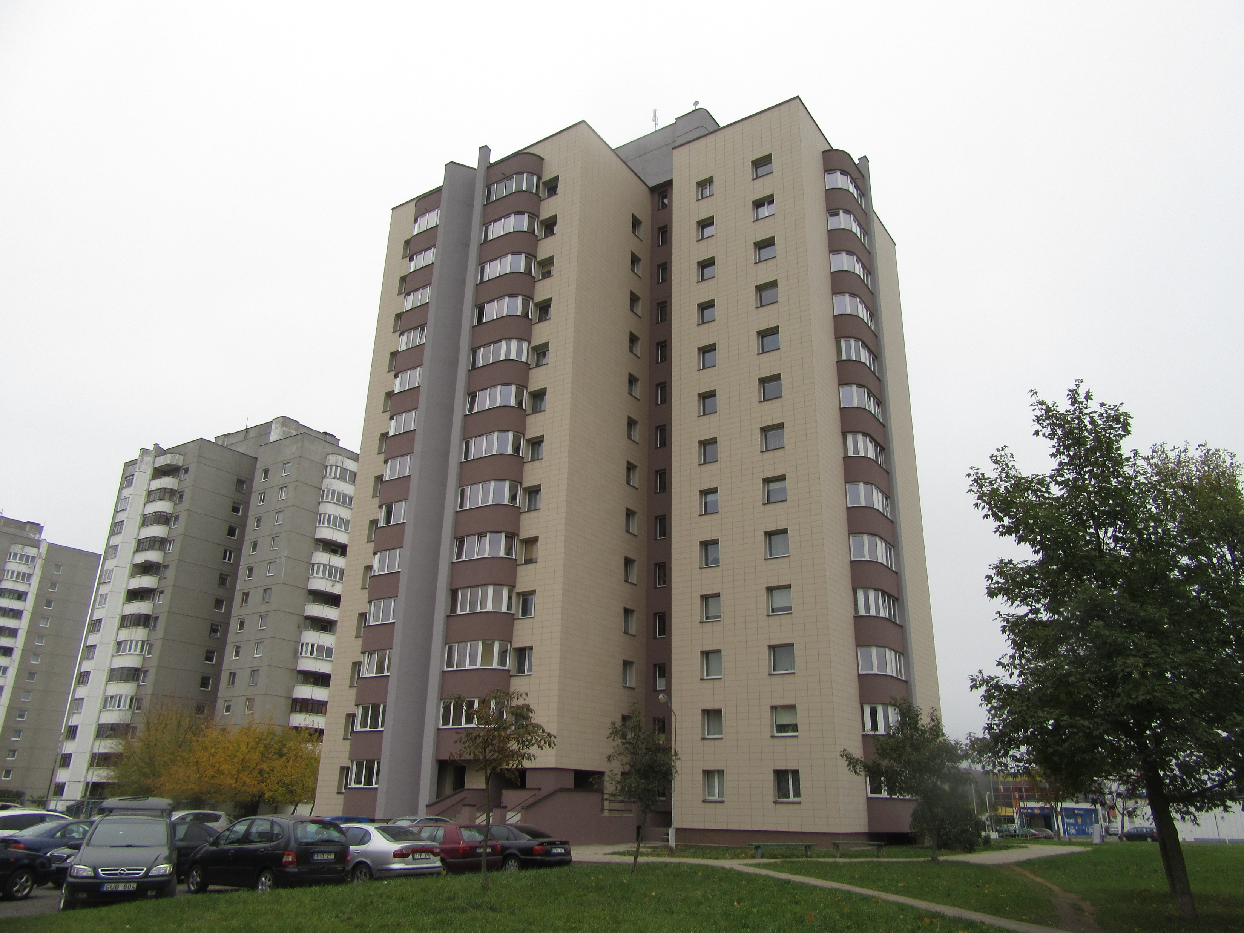

Slide 19
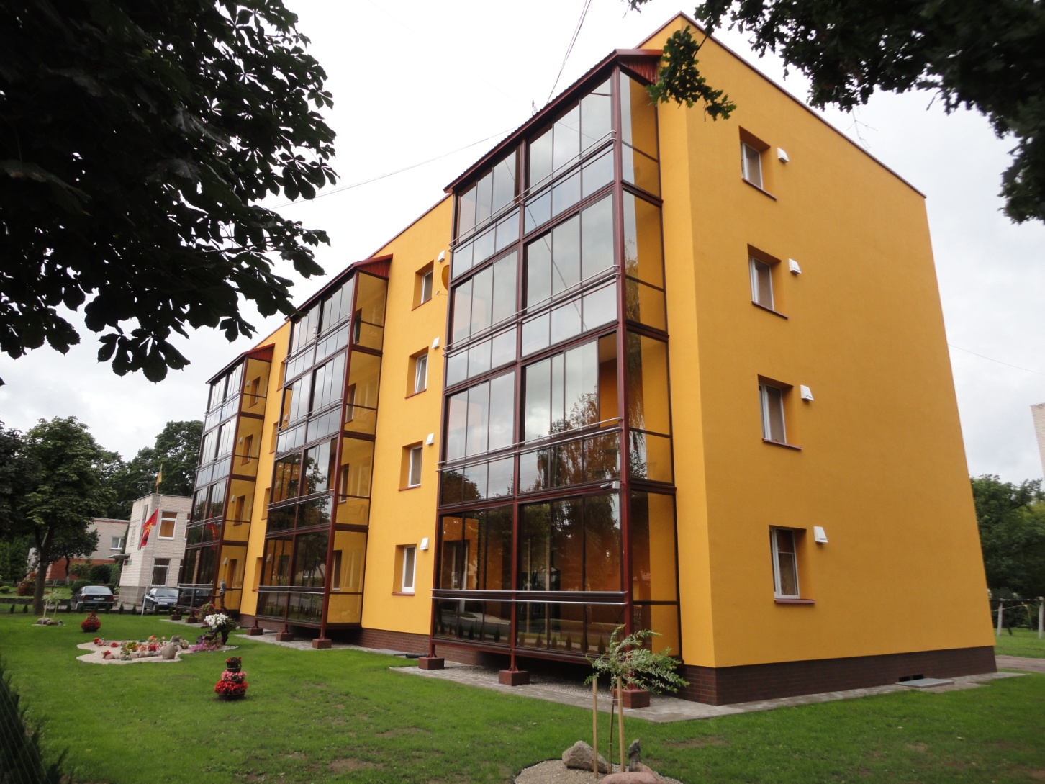
Marius Smaidžiūnas
+370 609 07505
m.smaidziunas@betalt.lt

