Slide 1
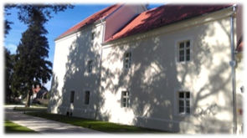
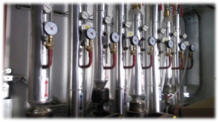
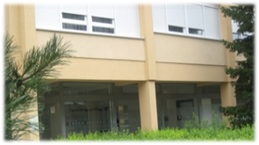
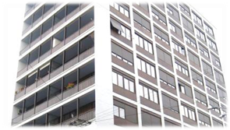

Croatia Residential Sustainable Energy Financing Facility
Goga Tropcic Zekan
Deputy Project Manager and Lead Engineer
EBRD Shareholder Special Fund
Bratislava, 7th November 2017

Slide 2
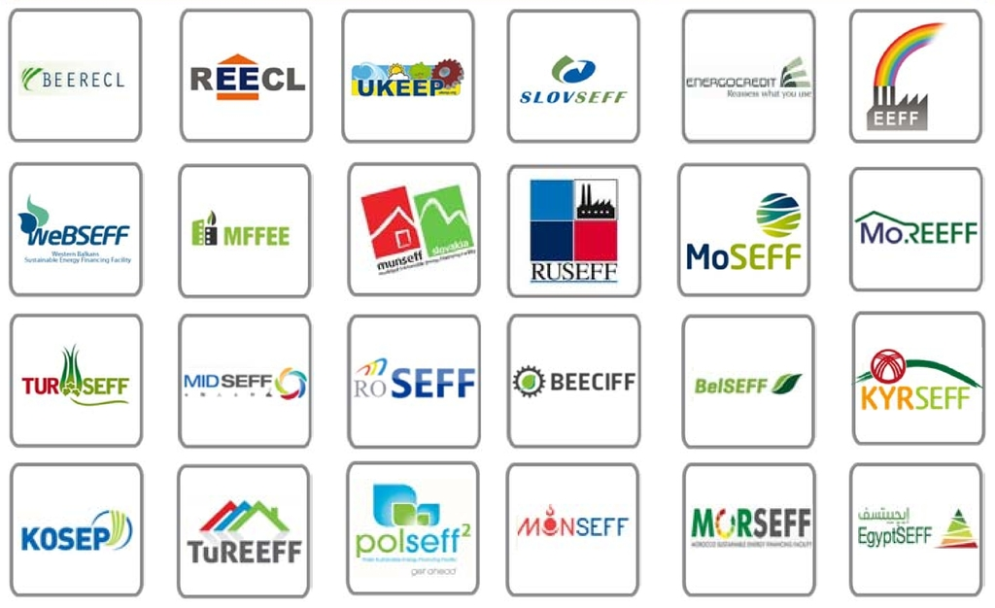
Sustainable Energy Financing Facilities
A SUSTAINABLE ENERGY FINANCING FACILITY (SEFF)
Energy efficiency and renewable energy sources
Clearly focused on creating value for Partner Banks and their clients
Established financing facility with a strong track record
Started in 2006
> €4.0 billion committed
> 120 Partner Banks
> 112,000 clients in 25 countries
> 6 mill. tons of CO₂/a avoided
Croatia Residential Sustainable Energy Financing Facility
2
Notes:
.... is dedicated to financing...
I would like to emphasize...
Thanks to SEFF

Slide 3

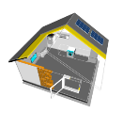

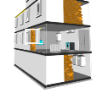

SEFF STRUCTURE - CROATIA
EE improvements
Funding
Sub loans
Partner Banks
€60 million
EBRD Shareholder Special Fund
Free of charge
Implementation support
Project
support
Funding
REENOVA+
Technical Assistance
  TA/Consulting to PB
  TA/Consulting to Sub-borrowers
Croatia Residential Sustainable Energy Financing Facility
3
Notes:
The facility named Reenova+ is focused on residential sector ONLY.
Sub loans under ---- additional banks....
Partner banks and their clients are supported by
The team provides all the necessary assistance to the PB in the implementation of

Slide 4
REENOVA+ LOANS
Financial facility
Loan types and limits
EE investments on dwelling or building level / up to € 150,000
€ 60 million framework
disburse through commercial banks
Vendors
Special Features
pre-approved technologies and materials (LEME list)
on-line Technology selector
Residential Borrowers
manufacturers, suppliers, retailers, installers of EE equipment/ up to € 5 million
free of charge technical assistance
standardized and simplified procedures
Croatia Residential Sustainable Energy Financing Facility
4
Notes:
....depending on fin. benef...
Although it is a residential fac., you can see that we finance vendors as well
The facility offers several...
I will explain it in more detail later.
The main goal is to standardize and ...

Slide 5


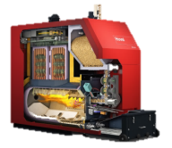
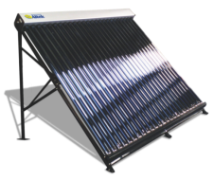



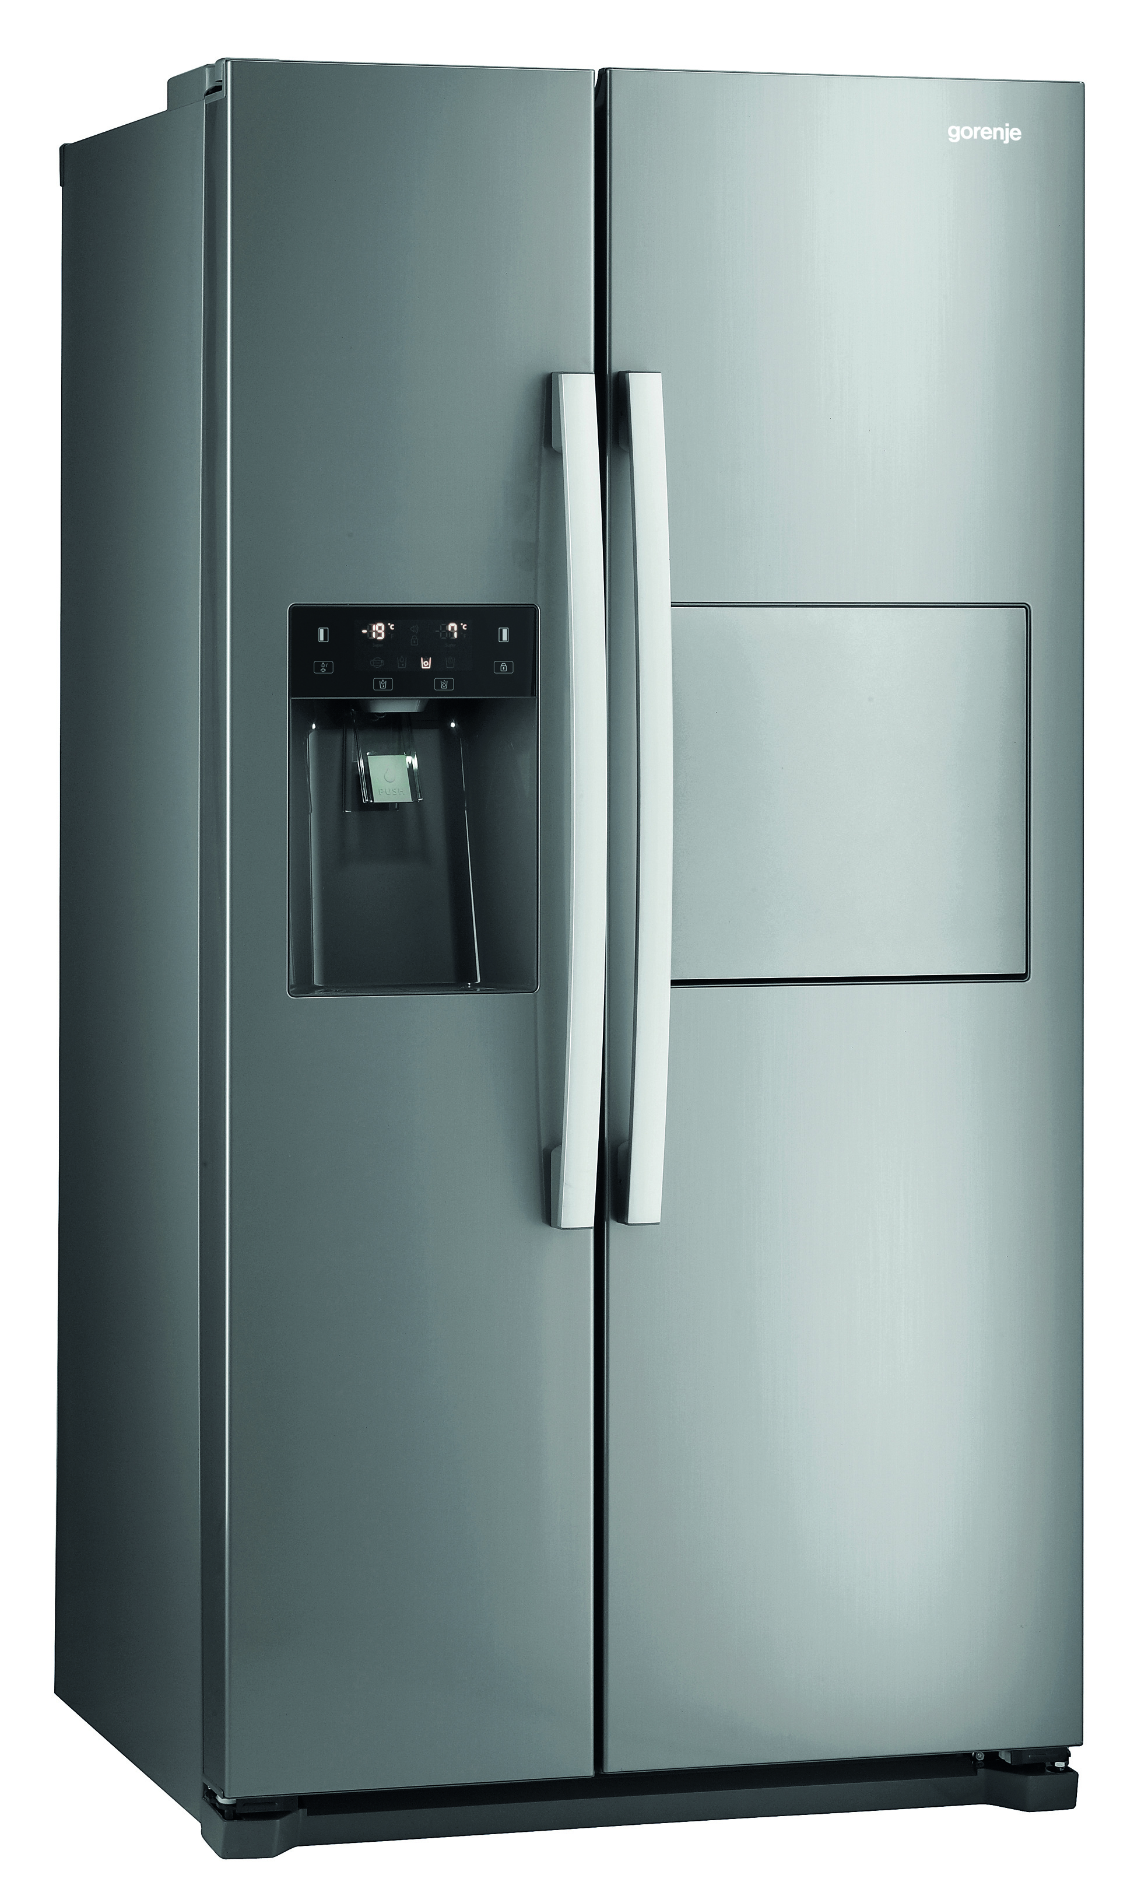
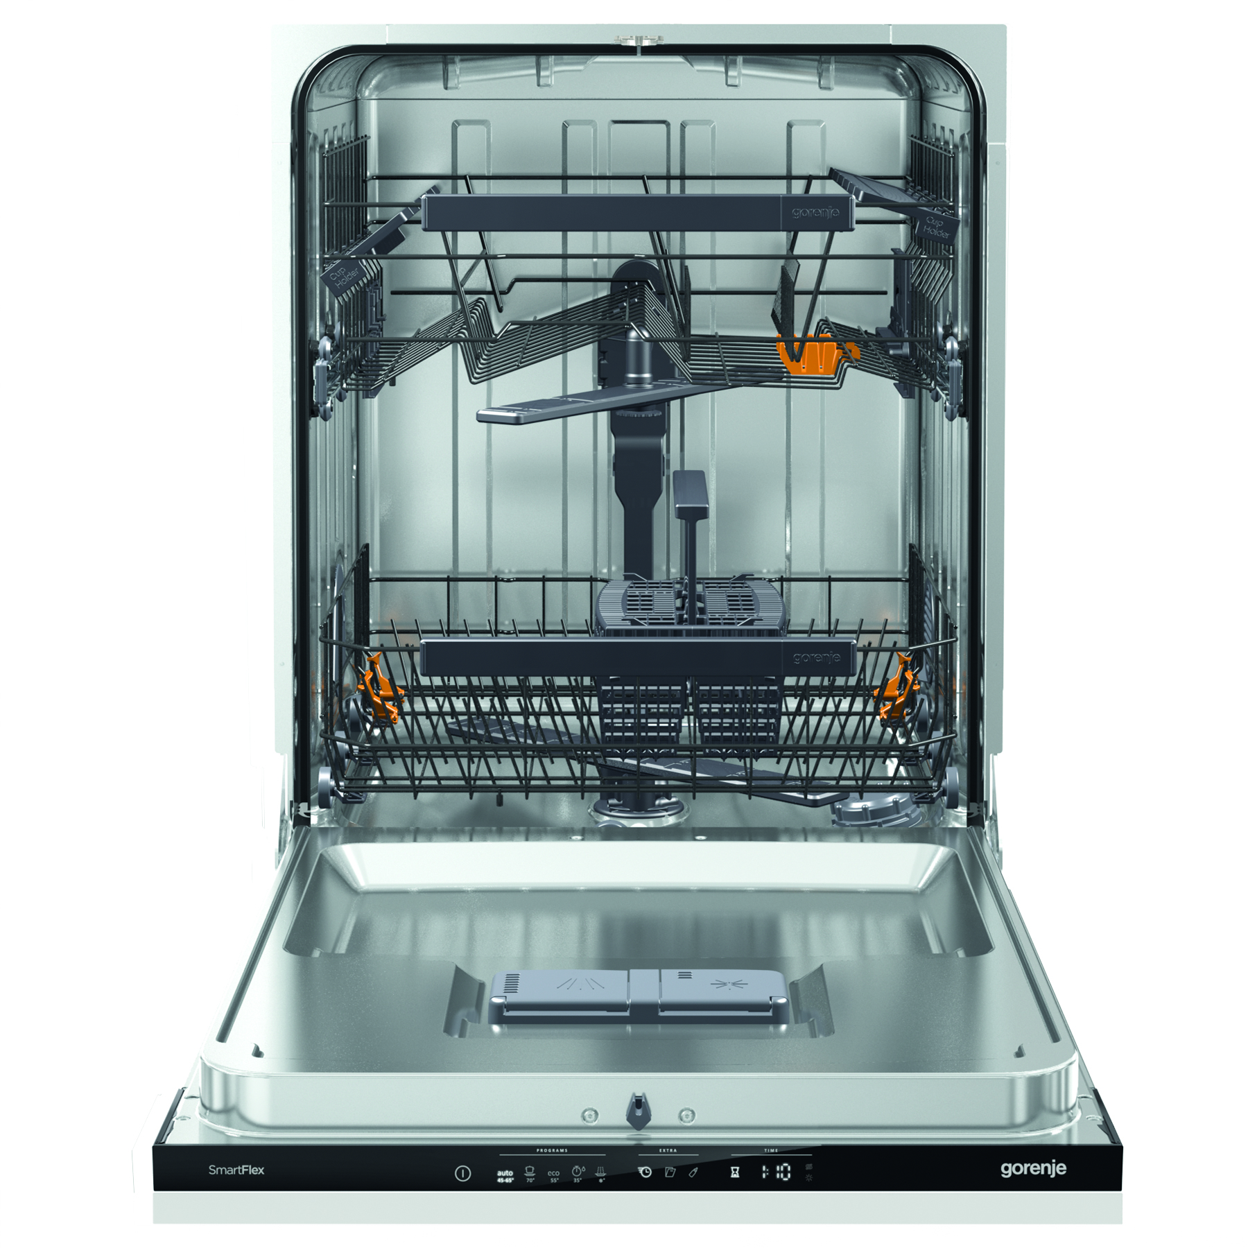
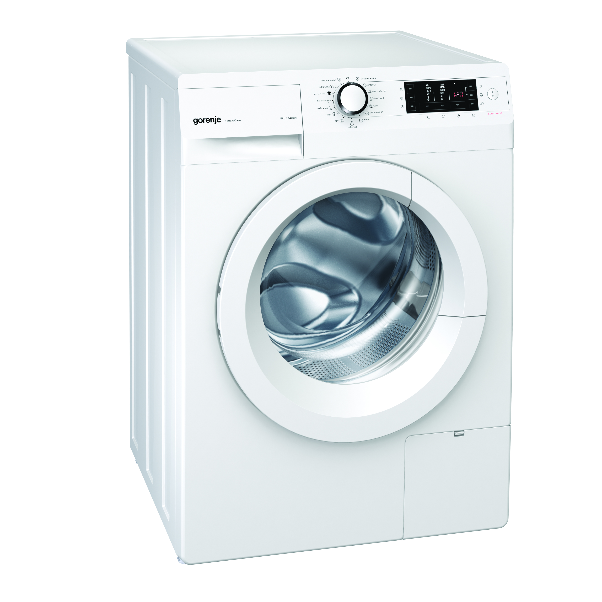
ELIGIBLE TECHNOLOGIES
THERMAL INSULATION (wall, floor, roof)
λ ≤ 0.04 W/mK
WINDOWS AND DOORS
U ≤ 1.4 W/m²K
SOLAR SYSTEMS
  hot water solar
  photovoltaics
HEATING, COOLING, DHW
      Biomass boilers
      Condensing gas boilers
      Heat pumps
      Heating system elements
      Room air conditioners
LED LIGHTING
HOME APPLIANCES
  washing machines
  dish washers
  fridges and freezers
A⁺⁺⁺
Croatia Residential Sustainable Energy Financing Facility
5
Notes:
Eligibility criteria were developed....
All technologies that meet .... can be included to the LEME list
Depending on the implemented measures....

Slide 6
TOOLS & SUPPORT
  Continuous support to Partner banks
  Training of loan officers
  In-branch portfolio screenings
  Operation Manual and standard Templates and Forms
  Product development assistance
Technology Selector
  http://technologies.reenovaplus.hr/en
REENOVA+ Website: www.reenovaplus.hr
  Information
  Energy Savings Calculator
REENOVA+ Facebook
Marketing Materials and support
  Brochures and flyers at facility level, whiteboard animation videos
  Support to Partner Banks in developing materials
  Open days for clients and similar events
  Workshops, conferences, etc
Croatia Residential Sustainable Energy Financing Facility
6
Notes:
We provide ongoing support...
We have designed our marketing materials such as
We offer support to PB in developing
After all, we organize a lot of

Slide 7

TECHNOLOGY SELECTOR
Croatia Residential Sustainable Energy Financing Facility
7
Notes:
We replaced the classic LEME...
This online tool contains a wide range of PRE-APPROVED... which are directly eligible under Reenova and which will save at least
The products are listed by main categories...

Slide 8
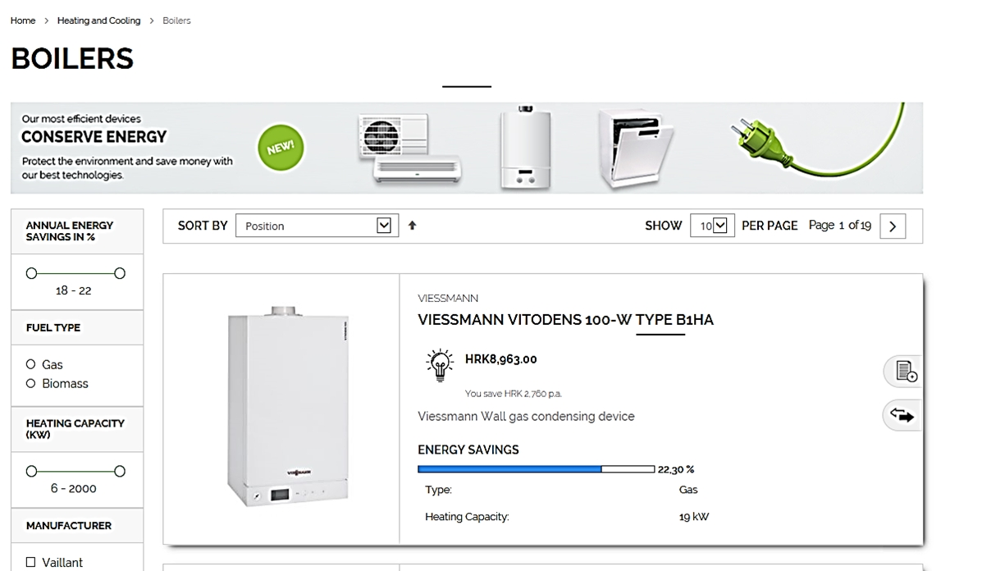
TECHNOLOGY SELECTOR
Maintained and updated by Consultant; including addition of new products
Croatia Residential Sustainable Energy Financing Facility
8
Notes:
Let`s go back to the TS

Slide 9
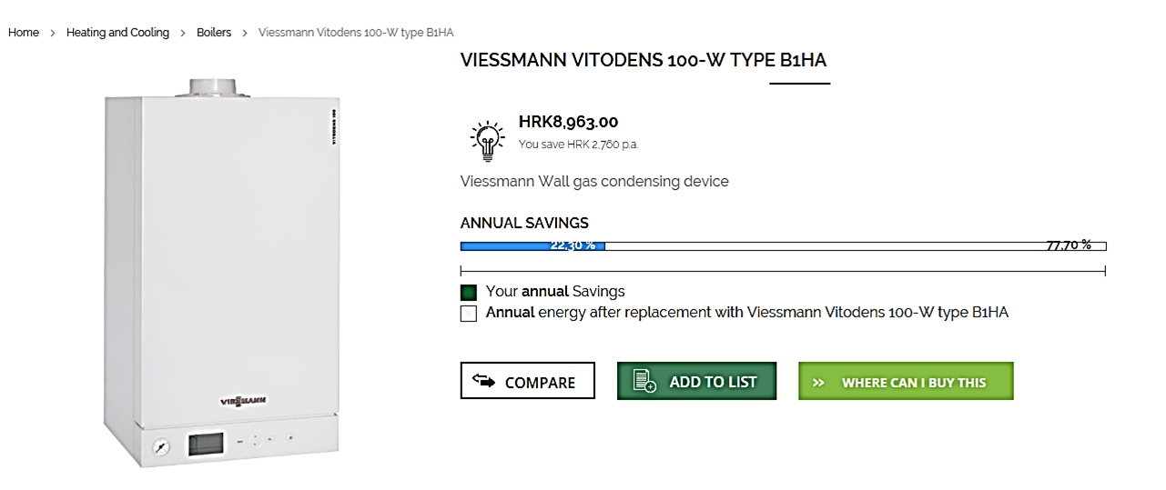
TECHNOLOGY SELECTOR
Compare products or Eligibility Certificate issuing or Where can I buy this
Croatia Residential Sustainable Energy Financing Facility
9
Notes:
The TS also provides an opportunity for vendors to promote.. It is free for them.
The only requirement is that the products meet the criteria.

Slide 10
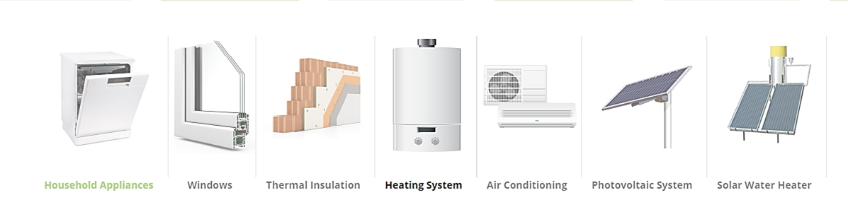
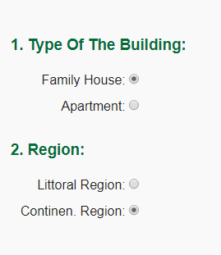
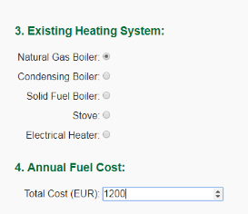
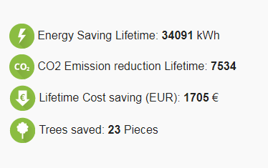
ENERGY SAVINGS CALCULATOR
EE savings ??
Croatia Residential Sustainable Energy Financing Facility
10

Slide 11






HOW TO APPLY?
THREE EASY STEPS ONLY
TECHNOLOGY SELECTOR
SUB-LOAN Application
SUB-LOAN Approval & Disbursement
Croatia Residential Sustainable Energy Financing Facility
11
Notes:
+ These drawings are taken from our whiteboard animation videos.
If a client wants to buy technology that has not been pre-approved...

Slide 12

VALUE ADDED TO PARTNER BANKS AND THEIR CLIENTS
Croatia Residential Sustainable Energy Financing Facility
12

Slide 13
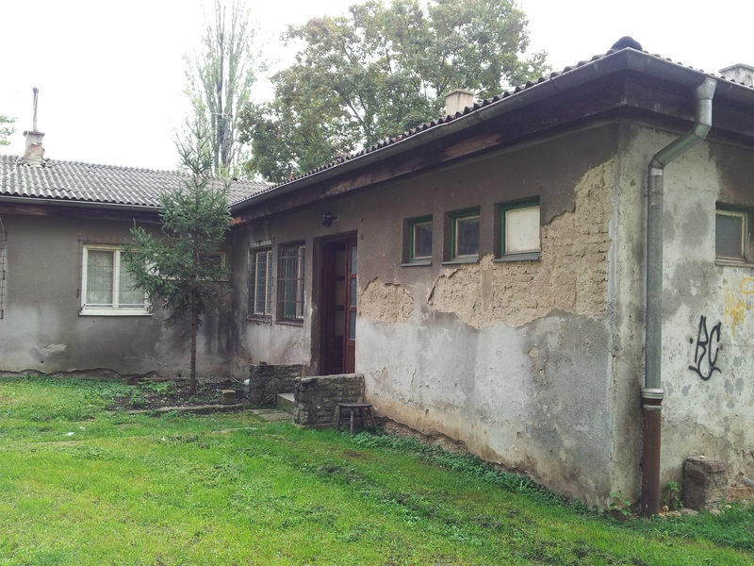

Slide 14
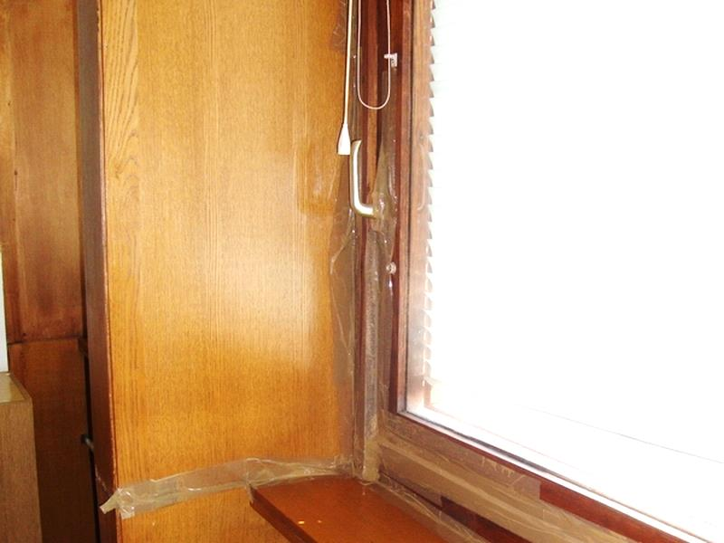

Slide 15
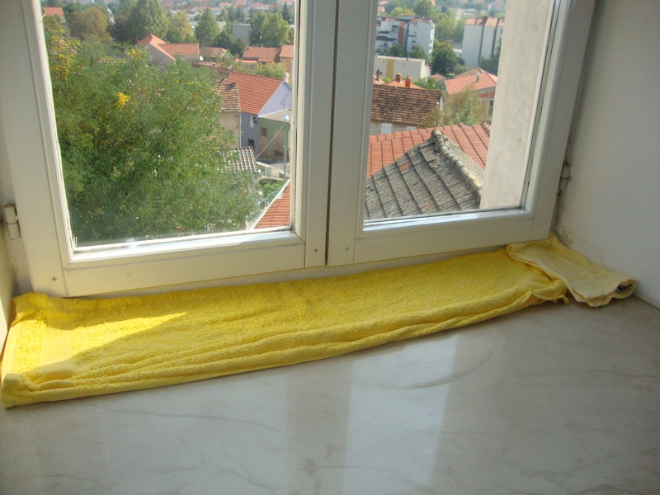

Slide 16
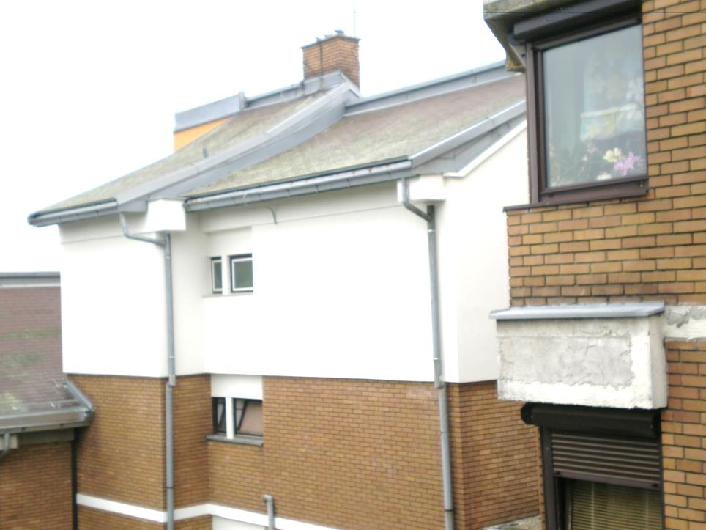
Croatia Residential Sustainable Energy Financing Facility
Notes:
And that is why the REENOVA+ team is actively present in soc. net, that is why we organize and participate in
We have been working continuously to promote not only public awareness about the importance of energy efficiency, but also about the importance of quality.

Slide 17
VALUE ADDED
To PFI Clients
  Free technical advice and support in selecting the correct technologies
  Cheaper and simpler loans
  Energy and cost savings
  More comfortable and healthier home
  Increased compliance with national EE legislation
  Increased value of real estate asset
To Partner Banks
  Develop special product with lower credit risk, which includes free technical advice for the clients
  Use of vendor financing relationships as a disbursement channel
  Enable client to save money through the investment
Croatia Residential Sustainable Energy Financing Facility
17
Notes:
To sum up, I would like to point out that the facility has many...
I would like to conclude by saying that technical assistance and support are playing a key role in the REENOVA+ programme, because...

Slide 18


All decisions are right except the wrong ones!
Goga Tropčić Zekan
Deputy Project Manager and Lead Engineer
+385 1 4686 715 ; www.reenovaplus.hr ; info@reenovaplus.hr
Croatia Residential Sustainable Energy Financing Facility
18

