Slide 1
Energy Services
Energy Supply Contracts for Combined Heating and Cooling in new buildings based on Water-Water Heat Pumps systems
Bratislava, 7th November 2017

Slide 2
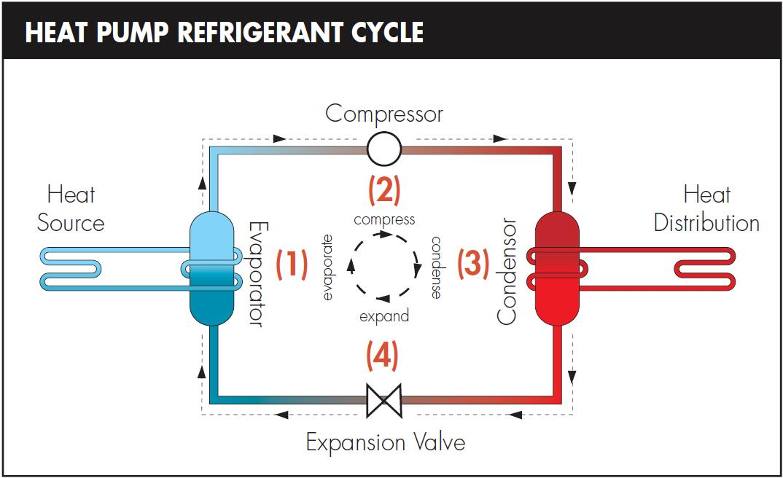
What is a Heat Pump

Slide 3

Water Water Heat Pump

Slide 4
Technical Pre-requisites
Safe hydrogeological conditions
Enough Underground Water Capacity (l/s)
Adequate positioning for wells maintenance

Slide 5
Financial Pre-requisites
Suitable for bigger building complexes
Supply of both Heating and Cooling
Coexistence of Residential and Administrative spaces

Slide 6
Follow the Money
Savings
No need for Chillers on the roof
High Coefficient of Performance
(COP)
One Technology for 2 commodities
High Energy Efficiency Ratio (EER)
COOLING
HEATING

Slide 7
Different Solutions – Different TCOs

Slide 8
Central Heating / Cooling business model
Heat and Cooling Supplier
Client
SE Predaj, s.r.o.
Developer / Facility Manager
Total Investment in the technology covered by SE Predaj, s.r.o.
Facilitation in reaching A1 building certification (budget savings elsewhere)
Complete outsourcing of the heat / cooling supply and related technology service
Prices for heating and cooling cheaper than other technologies
Guarantees of a stable supplier

Slide 9
Limits of supply for Water Water Heat Pump system
Machine Room – Water Water Heat Pump
Delimination of Supply
Building of Water Water Heat Pump based technological solution Building of wells and related infrastructure Supply measured outside the machine room Complete project documentation for building permits Complete supply of service, maintenance, revisions
Limits of Supply
Heat Pumps
Wells

Slide 10

Business Case: Bratislava National Football Stadium

Slide 11
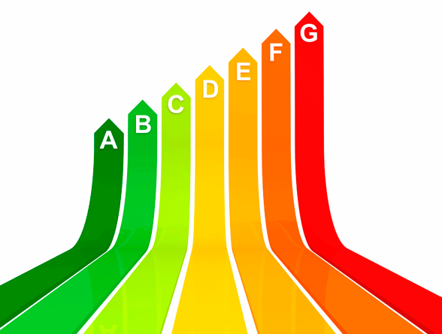
Energy Savings
andrea.pancotti@seas.sk

