Slide 1
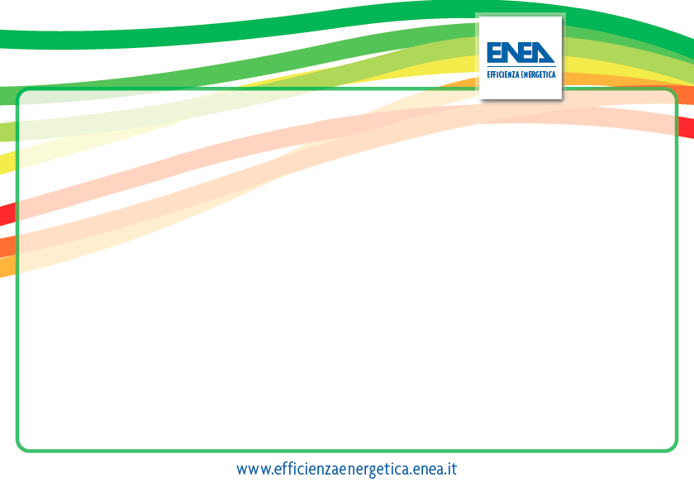
“Financing energy efficiency in private housing, in Italy”
Workshop on Provision of Highly Efficient Heating
and Cooling Solutions for Residential Buildings”
Gabriella Azzolini
ENEA - UTEE
Villa Cagnola (Gazzada Schianno, Varese)
October 18th-19th 2017
www.efficienzaenergetica.enea.it

Slide 2
Directive 2012/27/UE, Article 7:
obligations & alternative measures
Summary of the expected savings, in Mtoe/year 2014-­2020

Slide 3
Tax deduction of 65%
L. 296 - 2006 (National Budget Law 2007)
L.D. 192 - 2007
tax deduction from personal or corporate income taxes, no tax credit;
deduction in 10 years;
range from 30.000 to 100.000 euros;
beneficiaries who belongs to a no tax area could transfer receivables to suppliers.

Slide 4
Tax deduction of 65%
NEWS
L. 232 - 2016 - National Budget Law 2017:
NEWS FOR CONDOMINIUMS
Until 2021;
Increase in the rate of detraction (70% or 75%);
40.000 euro x each apartment;
beneficiaries who belongs to a no tax area could transfer receivables to suppliers or other private entities including banks.

Slide 5
Tax deduction of 65%
Interested buildings
existing;
any real estate register category is eligible;
also buildings classified as «collabenti» units;
heated.

Slide 6
Tax deduction of 65%
Beneficiaries
Tax payers, who pay the intervention and are:
owners/ holders/cohabitants;
natural persons or entities without business income;
enterprises with business income;
public housing institutes.

Slide 7
Tax deduction of 65%
Interventions
Art. 1 – National Budget Law 2007:
C. 344 – global energy requalifications of buildings – 100.000 euros;
C. 345 – building envelope (windows, thermal insulation of structures, solar shading – 60.000 euros;
C.346 – solar thermal systems – 60.000 euros;
C. 347 – heating and dhw production plants – 30.000 euros;
Building automation systems – 30.000e -60.000e, no limits.

Slide 8
Tax deduction of 65%
Advantages
payback of 65%-70%-75%;
several eligible interventions;
large range of detractions;
several eligible subjects;
buildings of any real estate register category;
increased comfort;
property added value;
reduction in energy costs;
simplified documentation.

Slide 9
Tax deduction of 65%
Advantages for the system
recovery of the existing building stock;
support for the construction industry;
acceleration of the spread of advanced technologies;
environmental benefits.

Slide 10
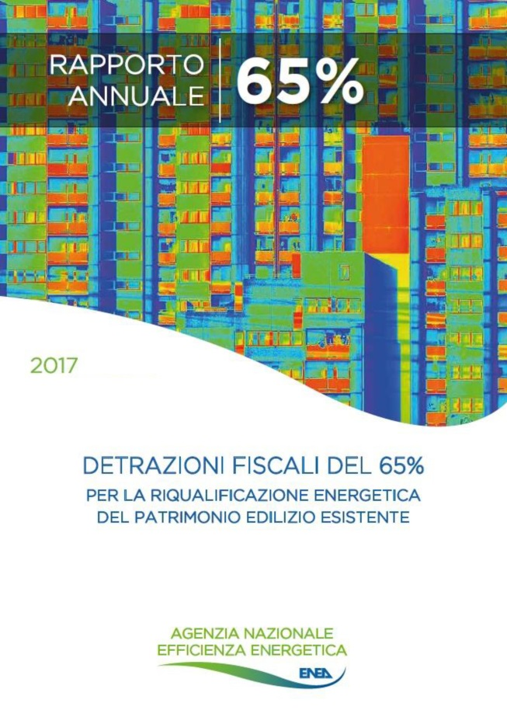
Tax deduction of 65%
Results
From ENEA REPORT 2017
2016:
360.000 applications
1.100 GWh/year energy saving
3,3 Billions euros
2007-2016:
2,9 million of applications
14.000 GWh/year energy saving
31,3 Billions euros invested

Slide 11
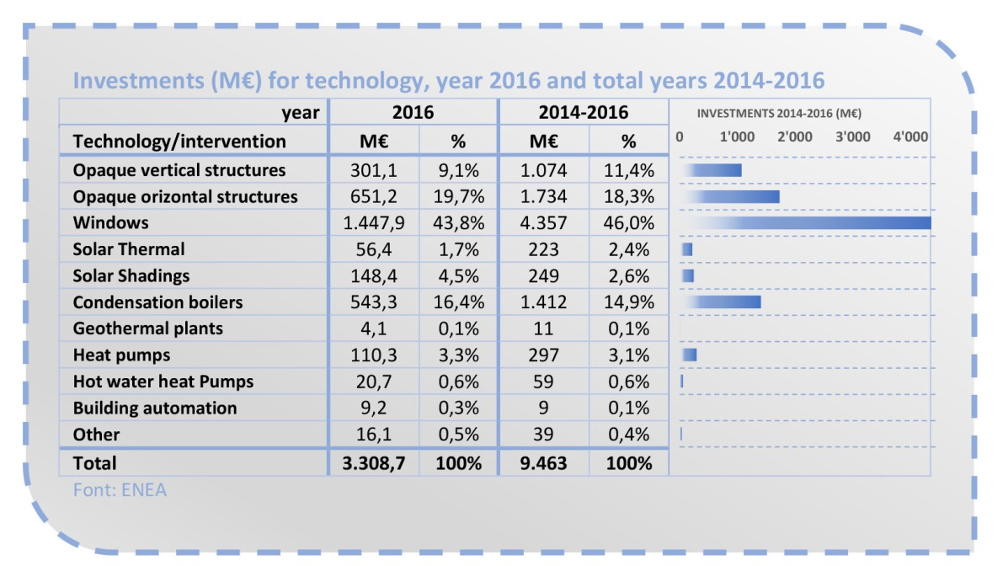
Tax deduction of 65%
Results (2017 ENEA report)

Slide 12
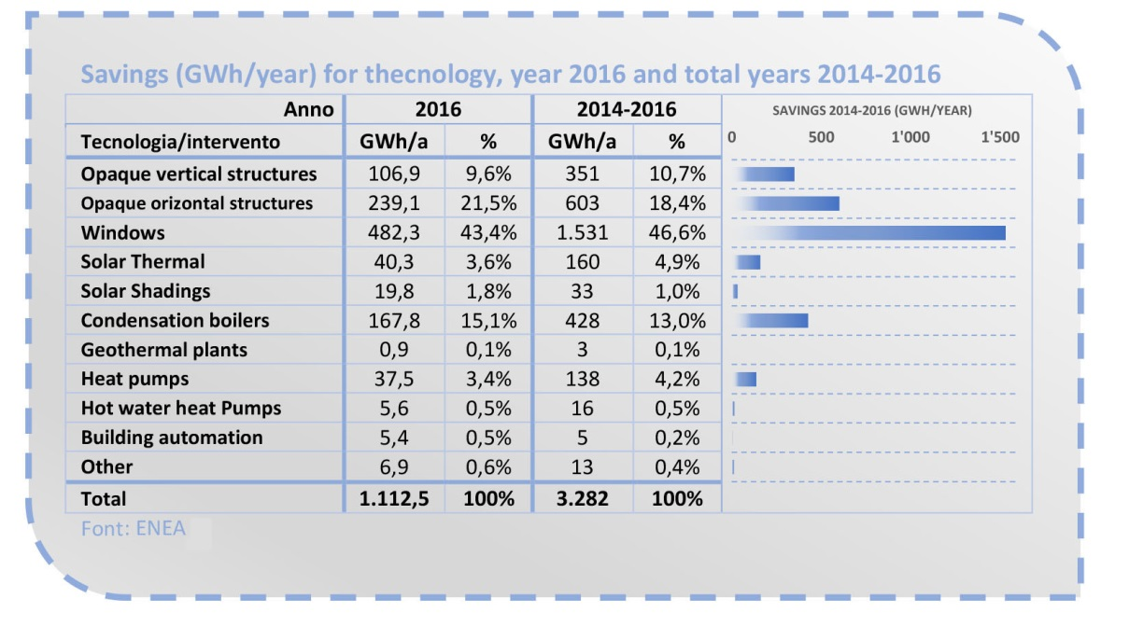
Tax deduction of 65%
Results (2017 ENEA report)

Slide 13
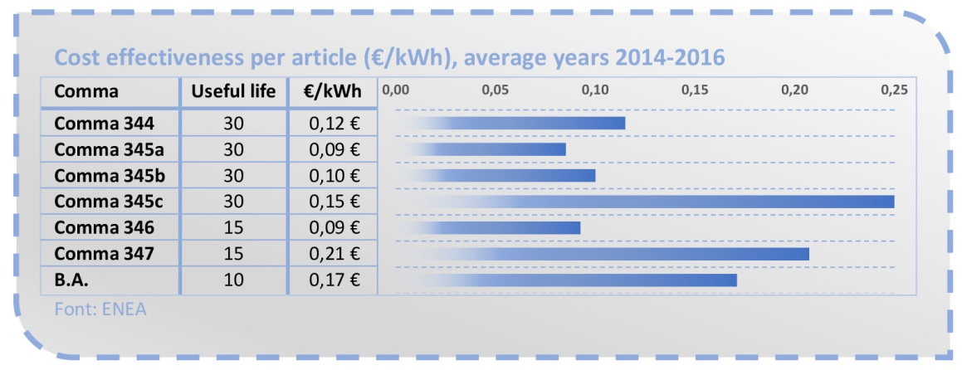
Tax deduction of 65%
Results (2017 ENEA report)

Slide 14
Tax deduction of 65%
Services offered by ENEA
informative website: http://efficienzaenergetica.acs.enea.it
online submission website: http://finanziaria2017.enea.it
e-mail advice;
training and updating of professionals;
communication activities.

Slide 15


Thanks for your attention!
gabriella.azzolini@enea.it
www.efficienzaenergetica.enea.it
Energy Efficiency Promotion Campaign, promoted by MISE and implemented by ENEA

