Slide 1
The CLEAR experience
Providing information and
valuable solutions to consumers
Workshop on Provision of Higly Efficient Heating and Cooling Solutions for Residential Buildings
Villa Cagnola (Gazzada Schianno, Varese) 19 October 2017

Slide 2
Who we are? The first and most popular Italian consumer organization
independent consumer organization set up in Milan in 1973
acknowledged by law ex art. 137 - Codice del Consumo (Dlgs. 206/2005) and member of CNCU
member of BEUC – the European umbrella organization (41 members from 31 Eu countries)
member of Consumers International (240 associations from 120 Countries)
Our activity in figures (2016):
400.000 members
more than 700.000 advices to consumers
more than 23.000.000 visits to www.altroconsumo.it
more than 31.000 followers on Twitter, 388.000 like on Facebook
6 magazines and numerous guides
more than 3.000 tested products
336 professionals on consumer side

Slide 3
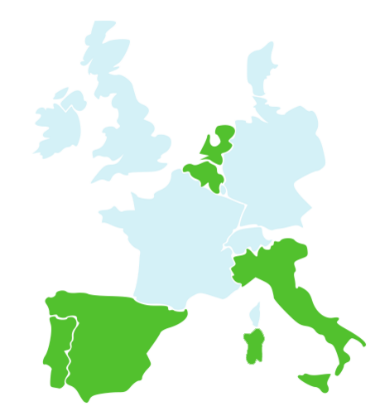
CLEAR Project in a Glance
Partners:
IEE co-funded project: http://www.clear-project.eu/
From 03/2014→ 03/2017
Objectives:
Gain trust of consumers with relevant information (based on test results)
Boost confidence thanks to renewable energies web communities wherein consumers found
Decision making tools
Relevant information
Discussion and interaction with peers, experts and consumers
Face to face meeting with installers and experts (info-sessions)
Increase the investment on RES lowering the prices of technologies via group purchase offers
The CLEAR experience - providing information and valuable solutions to consumers

Slide 4
CLEAR: Consumers Learn Engage Adop Renewable ET
Solar panels
Used to produce electricity
Solar thermal
Used to produce hot water
Pellet Stove
Used for heating
Heat pump for heating & cooling
Used to produce hot water for heating and
cooling
Heat pump
Used to produce
domestic /sanitary
hot water

Slide 5
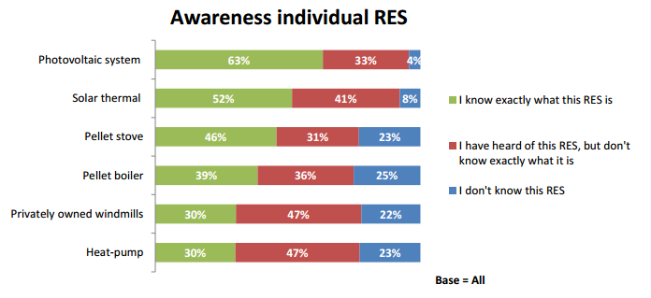
Make it CLEAR to me
Thanks to preliminaries studies carried out by GfK in the 5 countries, the consortium have deeply studied:
the different target groups,
their knowledge and awareness of RES
their attitude toward RES
The CLEAR experience - providing information and valuable solutions to consumers

Slide 6
Information needs – Importance Statements
Cost & Performance (6)
Maintenance cost per year
Installation cost
Additional costs (e.g. insurance, taxes and other fees)
Annual CO2-savings of the RES
Production capacity (how much heat/hot water/electricity per year)
If the RES has a monitoring system (to monitor production & consumption)
Return on Investment (4)
Payback period
Total running costs
How much money I would save
Guarantees
Payment & subsidies (3)
Financial aids (e.g. certificates, subsidies, fiscal benefit,…)
Existence of subsidy schemes
Payment possibilities
Specific product related items (6)
Performance insurances
Quality difference - different models of same type of RES
To what extent I can personalize the offer
Tool that provides personalized solution for my house
Safety of RES (smoke, electricity, cabling,...)
Information regarding the installation
Durability (2)
Lifetime
Warranty length and reliability
The CLEAR experience - providing information and valuable solutions to consumers

Slide 7
Information needs – Most important
The most important information category is return on investment. Respondents want an estimation of the returns, they want confirmation that investing in RES is beneficial.
The CLEAR experience - providing information and valuable solutions to consumers

Slide 8
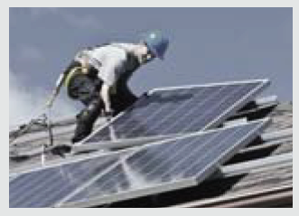
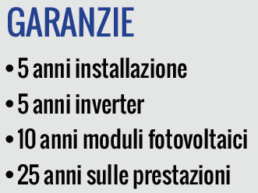
Group offers – reasons to participate
Convenience / Additional services (9)
Cons. org. makes selection
Monitor energy consumption
Home energy labeling and certification
Energy audit
Cons.org. checks fine print
Extend maintenance plan for other appliances
Benefit the environment
Reliable after sales service (incase of bankruptcy)
Option to personalize the GO
Payment / Financial benefits (4)
Ability to pay in terms
Get advantageous loan
Lower prices
Makes RES affordable
Reassurance (5)
Worry-free period of 20 year
Long term maintenance plan
Professional contact center for questions
Insure RES performance
Backed by cons.org. in case of problems
The CLEAR experience - providing information and valuable solutions to consumers

Slide 9
Group offer – reasons to participate
Top 10 items
All three topics, convenience/additional services, payment/financial benefits and reassurance are important. Each category has highly important items and less important items.
The CLEAR experience - providing information and valuable solutions to consumers

Slide 10
Purchase jouney of Renewable Energy Solutions
Attitude regarding environment and climate is highly important
Strengthen the positive attitude regarding RES by reassuring that RES is a wise and suitable choice
Financial aspects are an important player in every step of the decision making process
Consumers believe in the necessity and correct fit of RES for their situation
Consumers need reassurance as well as product specific information
A group offer fits my needs best
Financial
Assurances
Environmental

Slide 11
CLEAR projet
What ?
A web platform with a live community exchanging information, questions and experiences about:
► Heat-pump for heating and cooling
► VP solar panels
► Pellet stoves
► Thermal solar equipment for sanitary hot water
► Heat pump for domestic hot water
How?
Thanks to our experience in comparative testing, we tested qualitative performance, technical and safety aspects of the products on the market to find the best one and negotiate with selected qualified networks of installers in order to ensure plant efficiency and consistent performance over time. Free Purchasing Groups, organized on the basis of the published results of our tests.
The CLEAR experience - providing information and valuable solutions to consumers

Slide 12
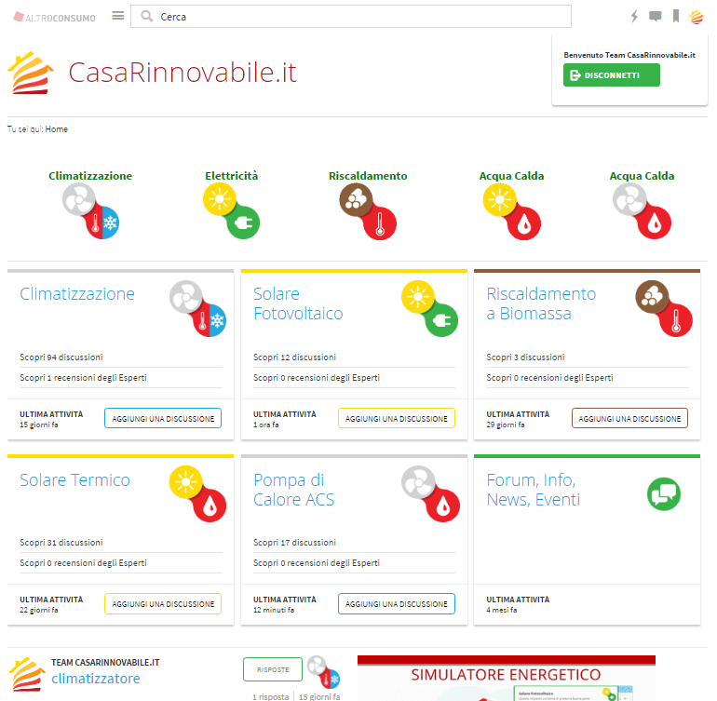
Web Site
www.casarinnovabile.it
The CLEAR experience - providing information and valuable solutions to consumers

Slide 13
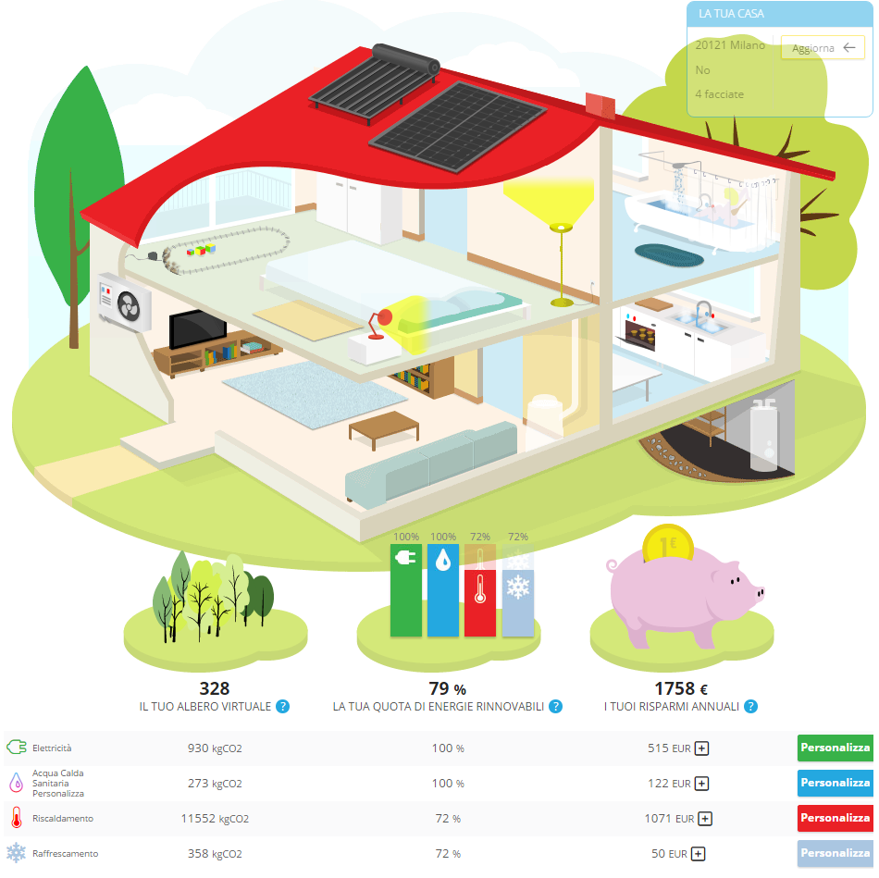
Interactivity Energy Simulator →
The ideal home ↓
The CLEAR experience - providing information and valuable solutions to consumers

Slide 14
Social Community
The CLEAR experience - providing information and valuable solutions to consumers

Slide 15
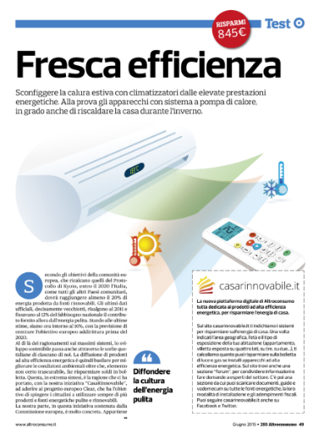
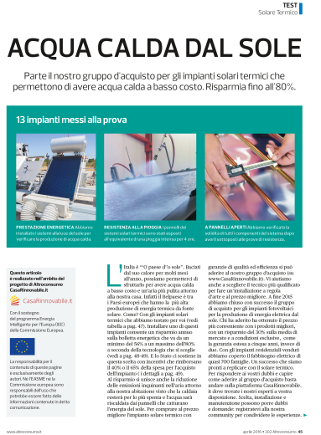
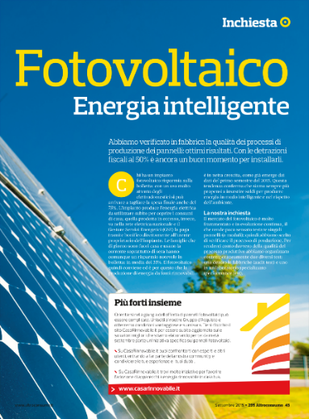
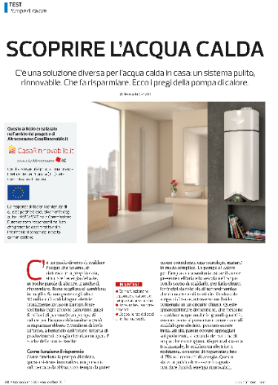
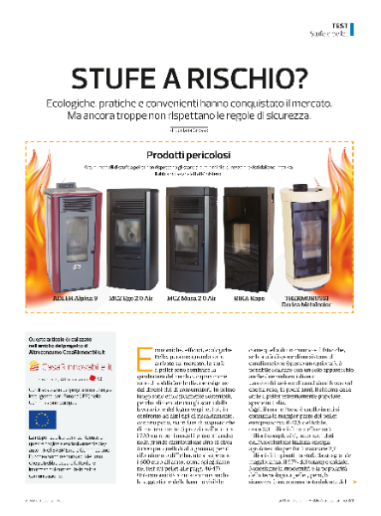
The CLEAR experience - providing information and valuable solutions to consumers

Slide 16
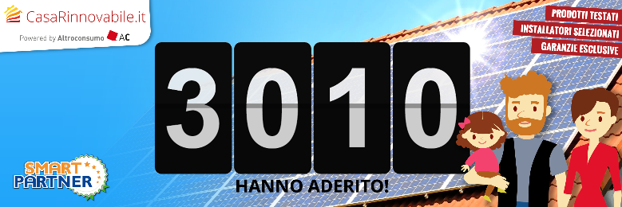
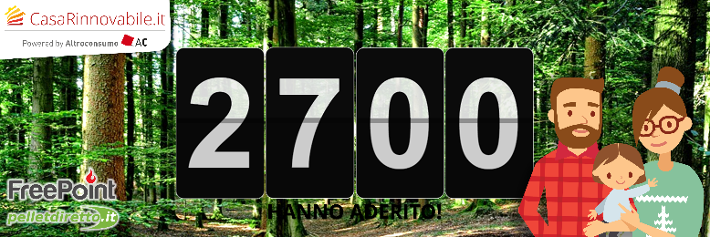
Purchase Groups
Solar & Termal Panels 2016
Solar Panels
2015
Pellet Stoves 2015
Pellet Stoves
2016
Heat Pump Heating & Cooling
Heat Pump
Domestic Hot Water
The CLEAR experience - providing information and valuable solutions to consumers

Slide 17
The CLEAR experience - providing information and valuable solutions to consumers

Slide 18
Main results
6 Group offers at national level
21.200 enrolled people in the 6 group offers
2.500 plants installed
40% average discount on market prices
11.800.000€ direct turnover generated
10% residential solar plants installed in Italy during 2015 -2016
7 international comparative testing
The CLEAR experience - providing information and valuable solutions to consumers

Slide 19
Main results
Numer of municipalities hosting one of clear plants
Product tested
Dangerous
products
The CLEAR experience - providing information and valuable solutions to consumers

Slide 20
Main results
Emission saved
Field equivalent of new green (woods)
Toe saved
Money saved on domestic energy expenditure
The CLEAR experience - providing information and valuable solutions to consumers

Slide 21
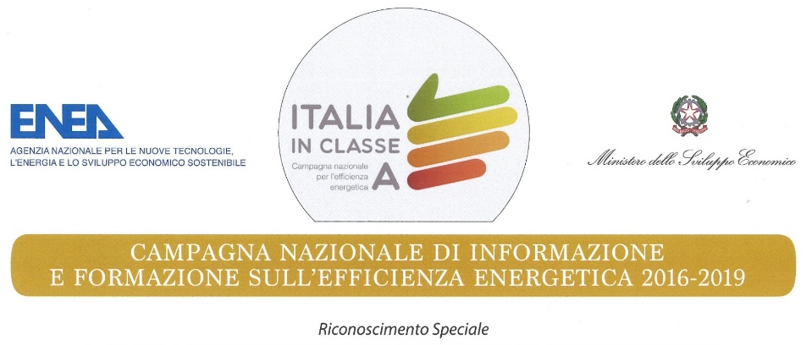
The CLEAR experience - providing information and valuable solutions to consumers

Slide 22
Lessons learnt – the CLEAR experience
18 Group purchases launched in 5 countries; Almost 80.000 enrolled in 18 campaigns. % of installation range between 1% till 25%
Regulatory instability is one of the main deterrent
More successful campaign over the more “known” technologies: Photovoltaic and Heat pump for heating and cooling
More energy and resources needed than expected:
communication budget
finding the best guarantee and after sales warranties
handling personal dossiers
After sales controls and check up of installations
Confidence and trust in consumers organizations is high. Our rigorous approach (and tests) reassure the consumers
Second round of campaigns are more successful, persons get aware about these types of actions
Consumers do not expect only advantageous prices from a group purchases made by consumers organization
Face-to-face sessions and web communities/discussion forum reassures consumers
The CLEAR experience - providing information and valuable solutions to consumers

Slide 23
Thank you!
CLEAR
Enabling Consumers to Learn about, Engage with and Adopt Renewable energy technologies
Marialuisa Villa Relazioni Istituzionali Dipartimento Relazioni Esterne _____________________________ Altroconsumo Via Valassina 22 20159, Milano pr@altroconsumo.it

Slide 24
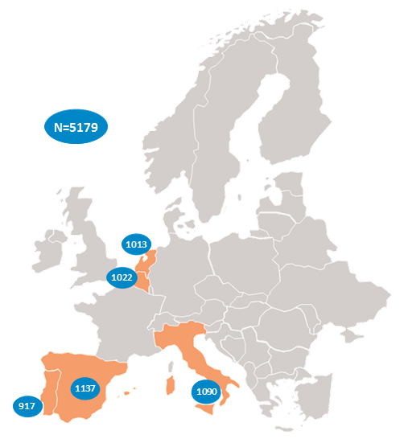
Method and fieldwork period An online survey with an average duration of around 23 minutes per respondent was organized by GfK Belgium in December 2014 – January 2015.
Target group The survey was conducted within five EU countries: the Netherlands, Belgium, Italy, Portugal and Spain. A random sampling approach, with minimum quota on certain subgroups, was applied to collect the data. Aiming at minimum 700 – maximum 1000 respondents per country, a total of 5179 respondents was surveyed. The population in the study was the general public with a minimum age of 18
Reporting Due to the nature of the results, which are highly country specific, the results of the survey were reported per country so that they were used as guidelines to help define group offers in each country.

